Slide 1
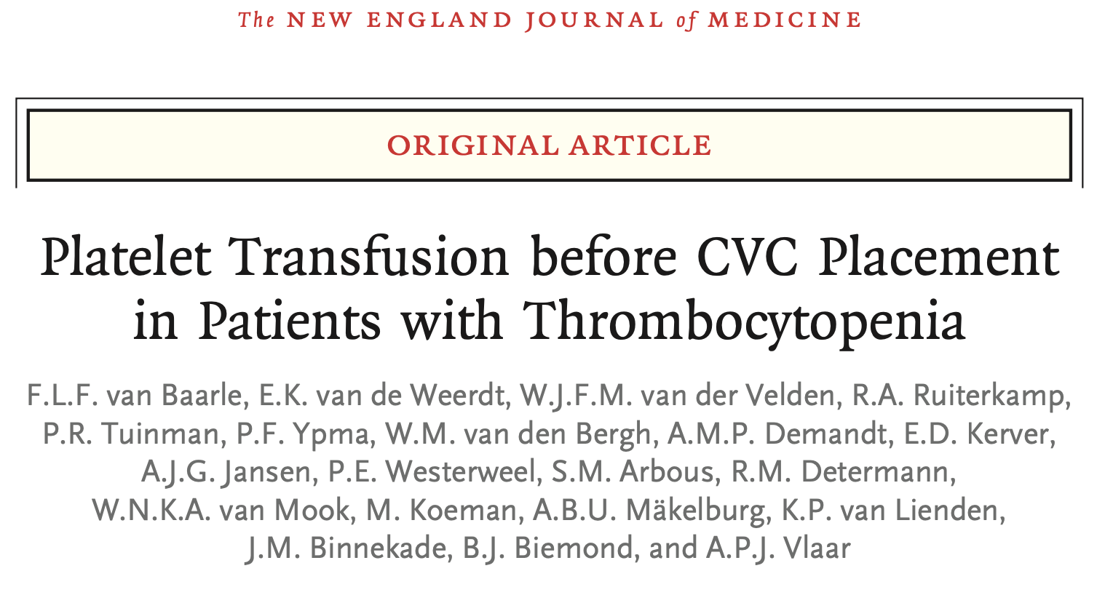
Notes:
May 2023 in NEJM

Slide 2
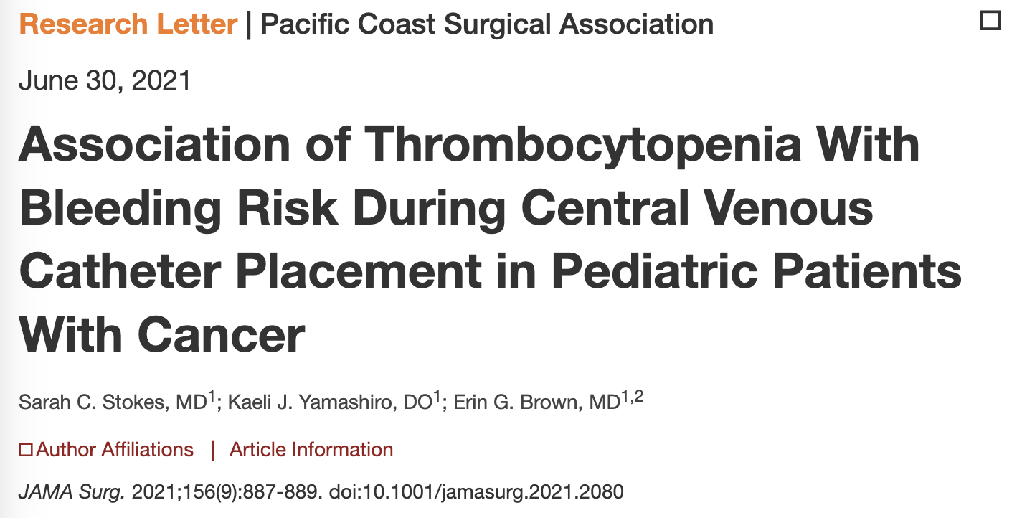
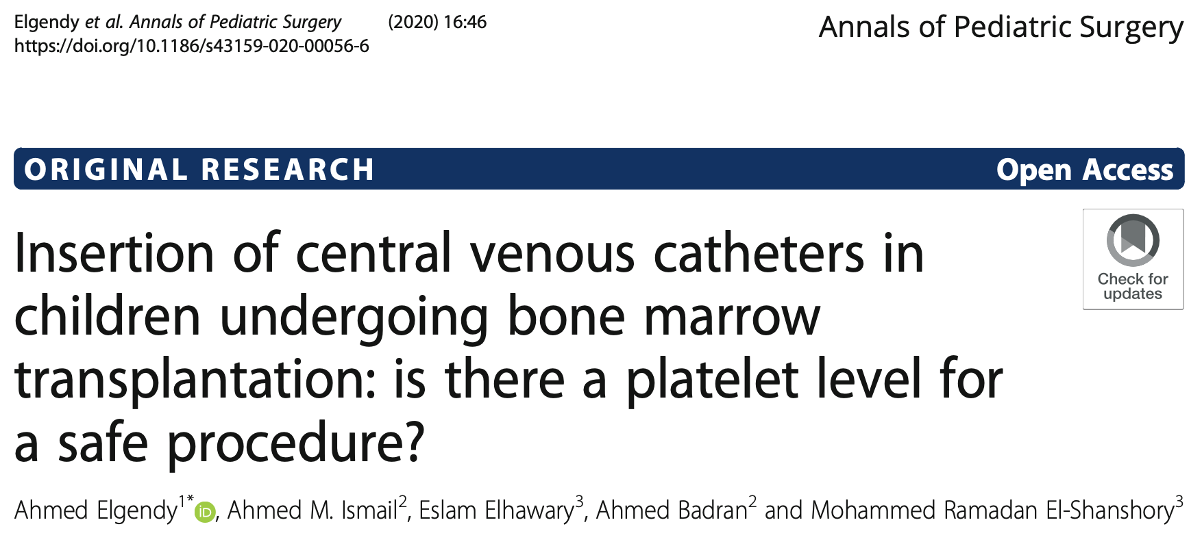
Background
Reported rate of major bleeding complications after CVC placement very low
However, no prospective studies available (→ risk for underestimation)
Consequently, guidelines for prophylactic platelet transfusion vary widely concerning threshold (20,000 to 50,000 platelets per mm³ in adults)
Data for children even more sparse; mostly oncology patients
Notes:
Study JAMA Surg: Increased bleeding risk in patients with platelets below 50 before surgery (but only minor bleeding; major bleeding stays very rare)
Study in Annals of Pediatric Surgery: Patients with platelets below 50 received transfusion; then, no major bleeding in the whole population

Slide 3
Protocols
Dutch national guideline for adults and children (see link below):
Trigger for prophylactic platelet transfusion before CVC placement: platelets < 50,000 per mm³
However, the authors also discuss that from limited literature, a threshold of < 20,000 per mm³ may be suitable for ultra-sound guided CVC placement
WKZ SOP placement CVC:
Thrombocytopenia relative contra-indication
Preparation: “Corrigeer eventuele stollingstoornissen / trombocytopenie”
Princess Máxima Center guideline on transfusions:
Platelet transfusion if platelets below 50,000 per mm³ during the first 24 hours after CVC placement (and before)
Source: https://richtlijnendatabase.nl/richtlijn/bloedtransfusiebeleid/trombocytentransfusies/trombocytenwaarde_voor_profylactische_trombocytentransfusie.html

Slide 4
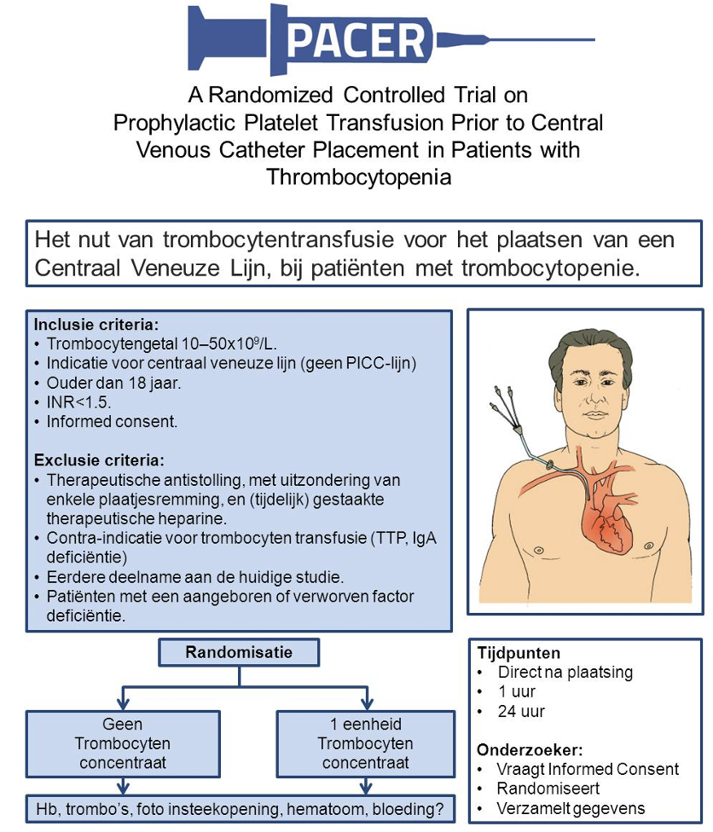
Research question
Given the low incidence of major bleeding in ultra-sound guided CVC placement: Is it justifiable to omit prophylactic platelet transfusions in patients with platelets below 50,000 per mm³ before the procedure?

Slide 5
Study design
Multicenter, randomized, controlled, non-inferiority trial (PACER)
Single-blind (patient and treating physician; operator blinded if possible)
Funded by ZonMw
10 Dutch hospitals (7 academic, 3 general)
Intervention: Prophylactic platelet transfusion prior to CVC placement in patients with thrombocytopenia (10,000 to 50,000 per mm³) versus no transfusion
Population: Adult (!) patients undergoing ultrasound-guided CVC placement at hematology department or on ICU
CVC:
Tunneled or nontunneled, any diameter, placed in internal jugular vein, subclavian vein, or femoral vein
Procedure by experienced operator (> 50 procedures)
Exclusion criteria: Therapeutically administered anticoagulants, prolonged INR, history of congenital or acquired coagulation deficiency
Randomization: Stratified according to the trial center and catheter type (large-bore dialysis catheter or regular catheter).
Notes:
Platelet counts: Measured within 24 hours before CVC placement
Retrospectively expected bleeding risk with platelet transfusion: 1%; powered if rate in non-transfusion group is 3.5%

Slide 6
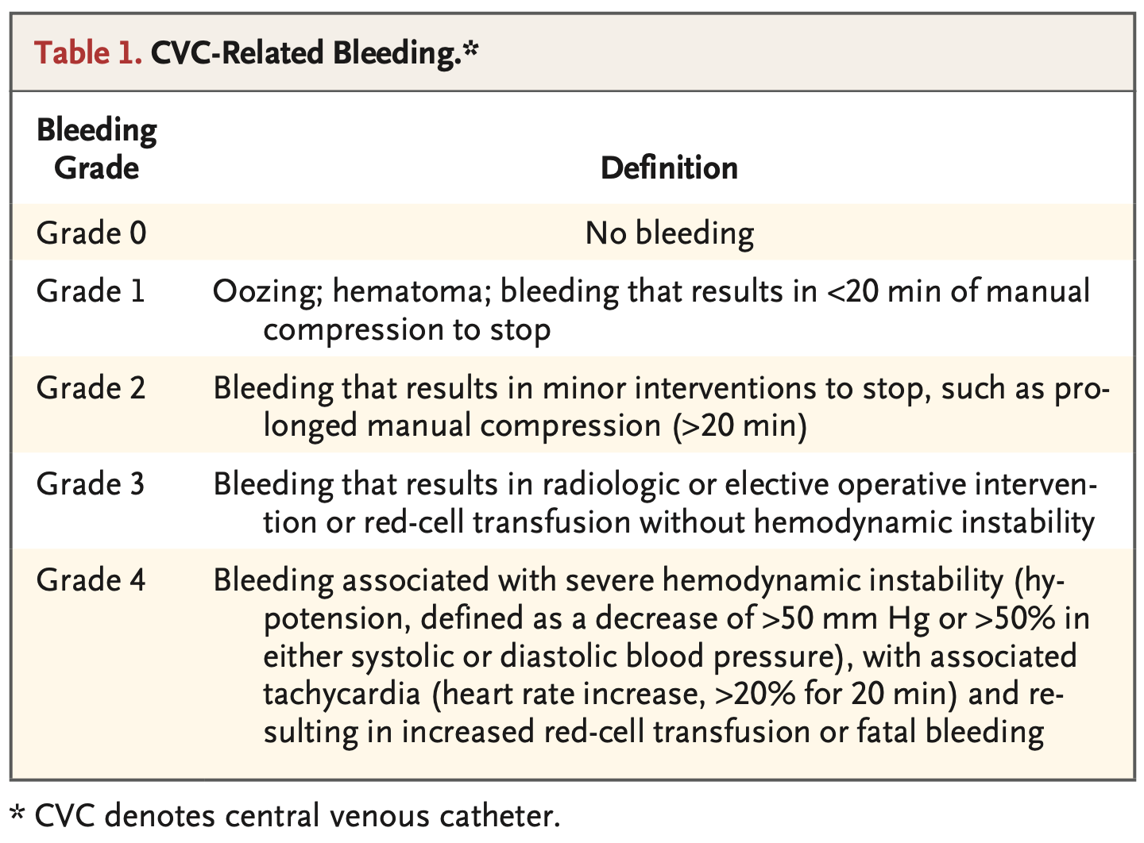
Outcomes
Primary outcome: Occurrence of catheter-related bleeding of grade 2 to 4 within 24 hours after CVC placement
Secondary outcomes:
Major bleeding (grade 3 and 4)
Grade 1 bleeding
Platelet and red-cell transfusions within 24 hours after CVC placement
Hb and platelet counts at 1 hour and 24 hours after CVC placement
Allergic transfusion reactions within 24 hours after CVC placement
Onset of acute lung injury within 48 hours after CVC placement
Length of ICU and hospital stay
In-hospital mortality
Financial costs
Table S3a-c for complete additional baseline characteristics

Slide 7
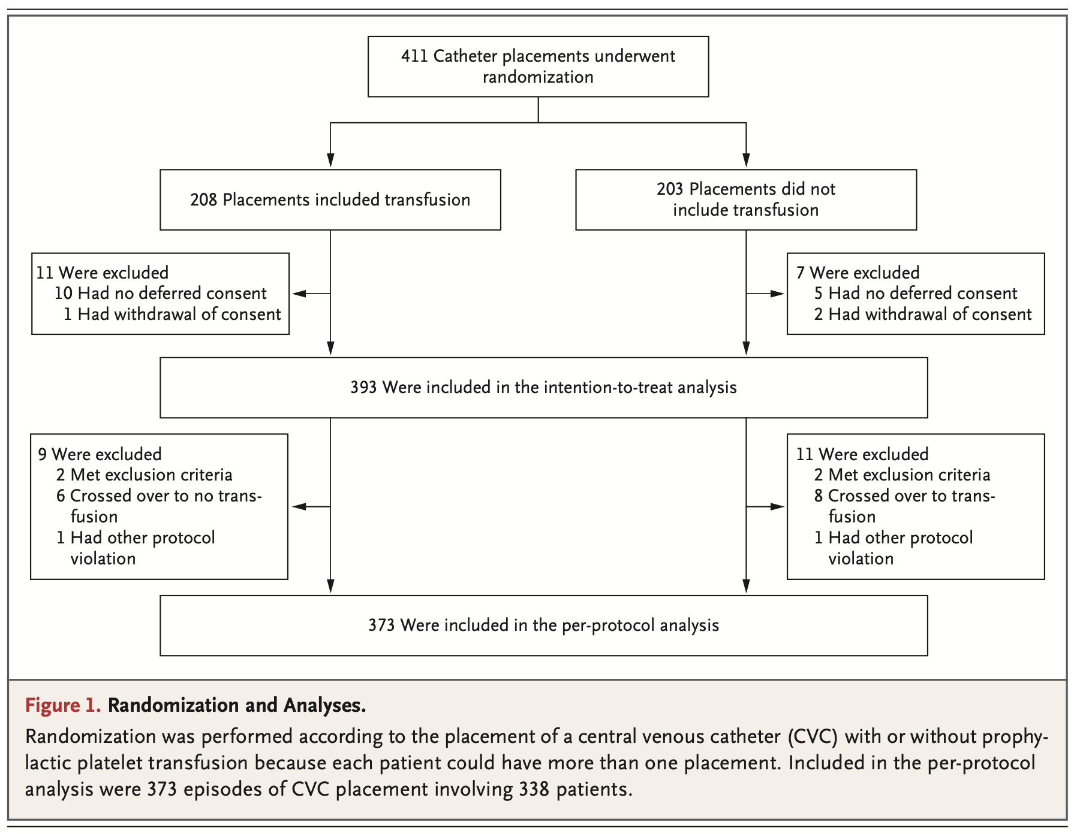
Study enrolment

Slide 8
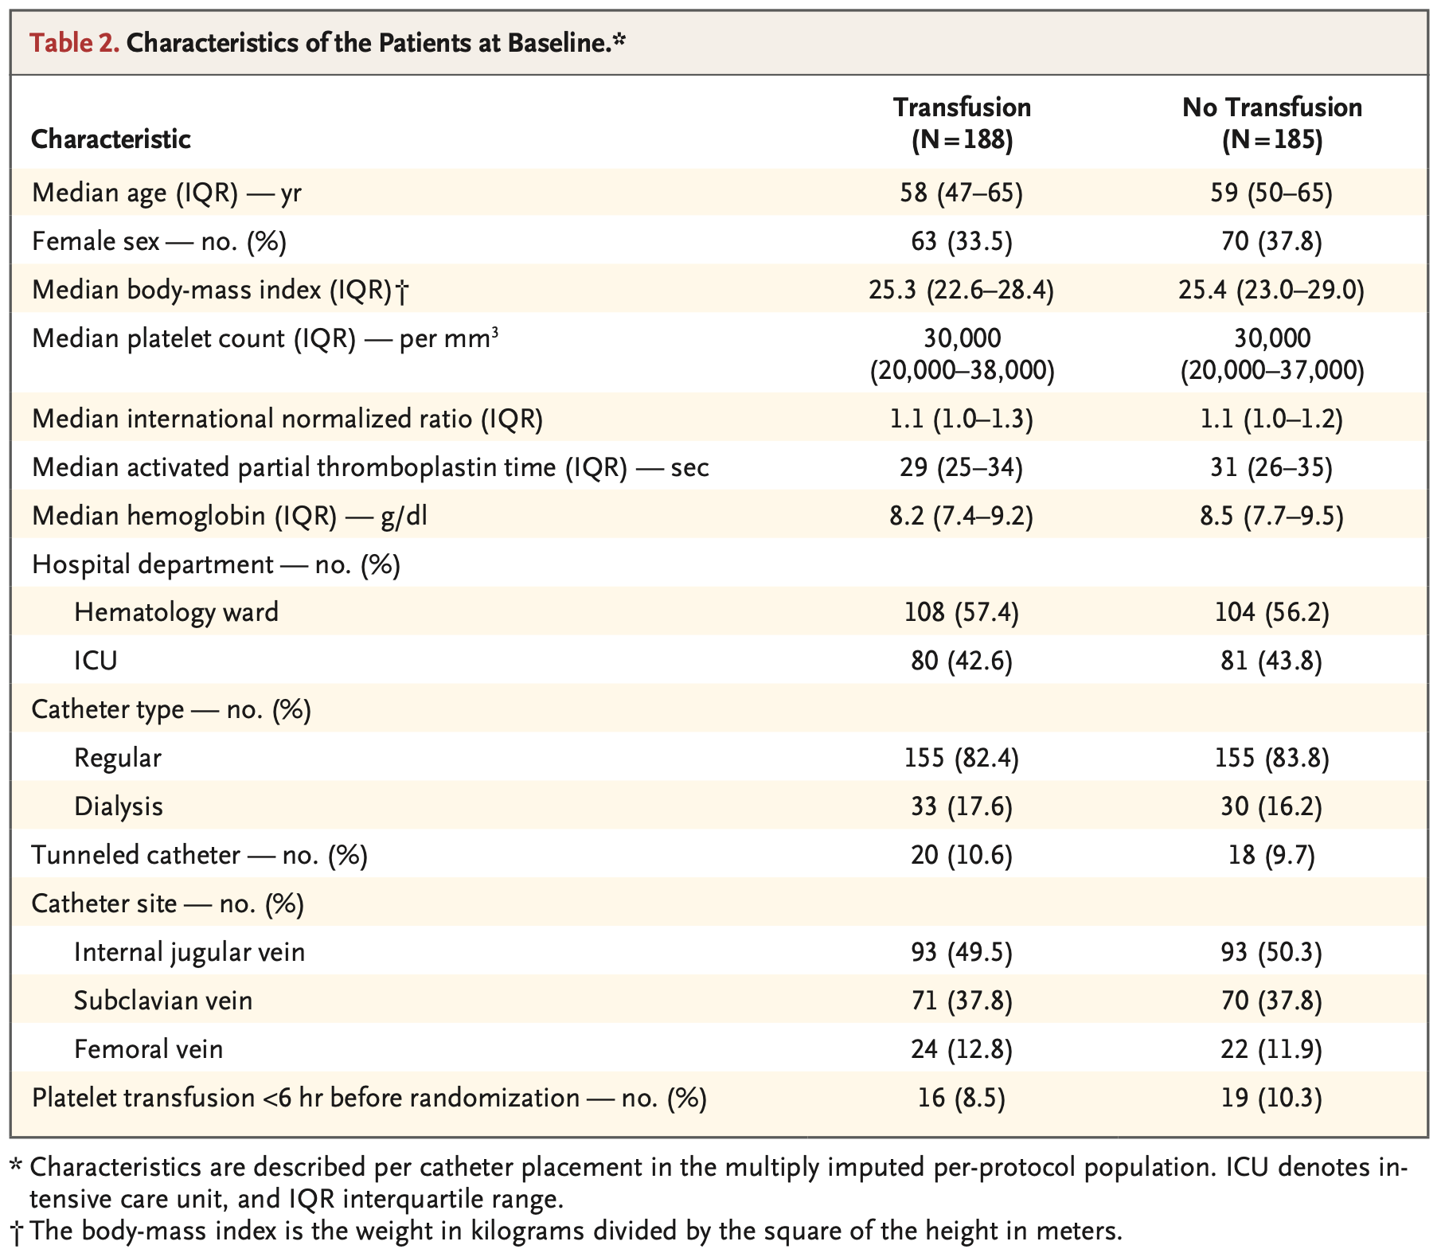
Patient population
Notes:
Well balanced

Slide 9
Primary Outcome
Non-inferiority threshold not reached → increased bleeding risk without prophylactic platelet transfusion
Bleeding risk substantially higher than in earlier (retrospective) studies (but no grade 4 bleeding)
Figure taken from Research Summary
Notes:
Missing data for primary outcome: 7.2%

Slide 10
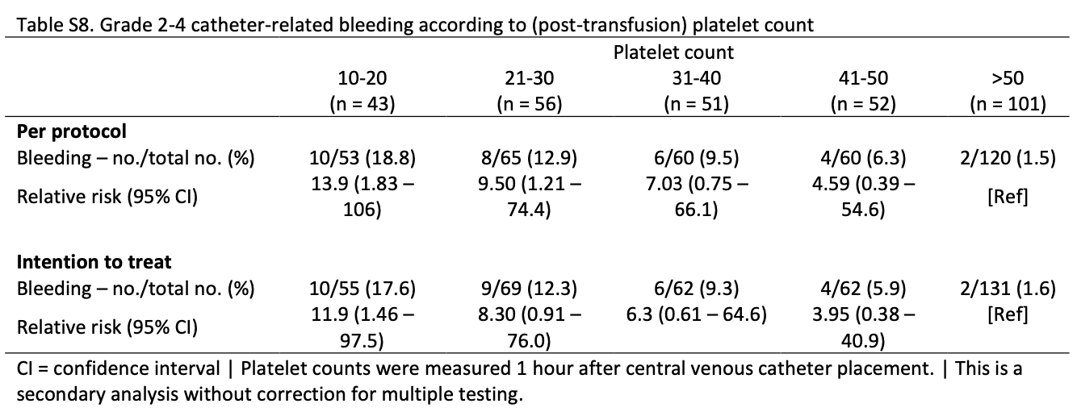
Primary Outcome
Non-inferiority threshold not reached → increased bleeding risk without prophylactic platelet transfusion
Bleeding risk substantially higher than in earlier (retrospective) studies (but no grade 4 bleeding)
Secondary analysis: Risk of grade 2 to 4 CVC-related bleeding increased with lower platelet counts
Figure taken from Research Summary

Slide 11
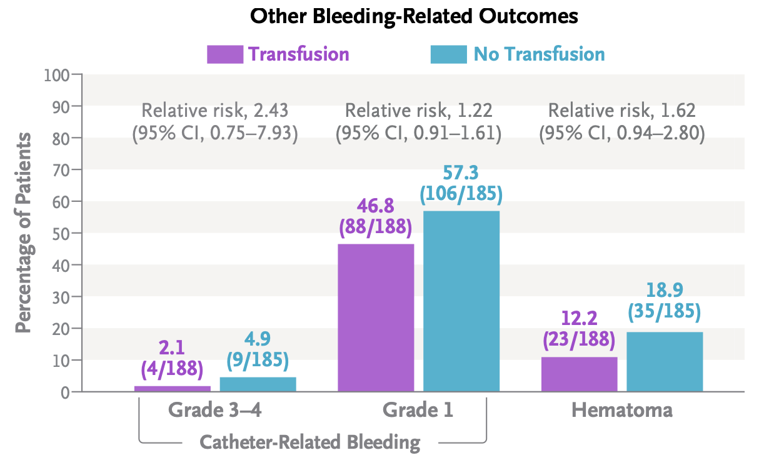
Secondary Outcomes
Figure taken from Research Summary
. 2015

Slide 12
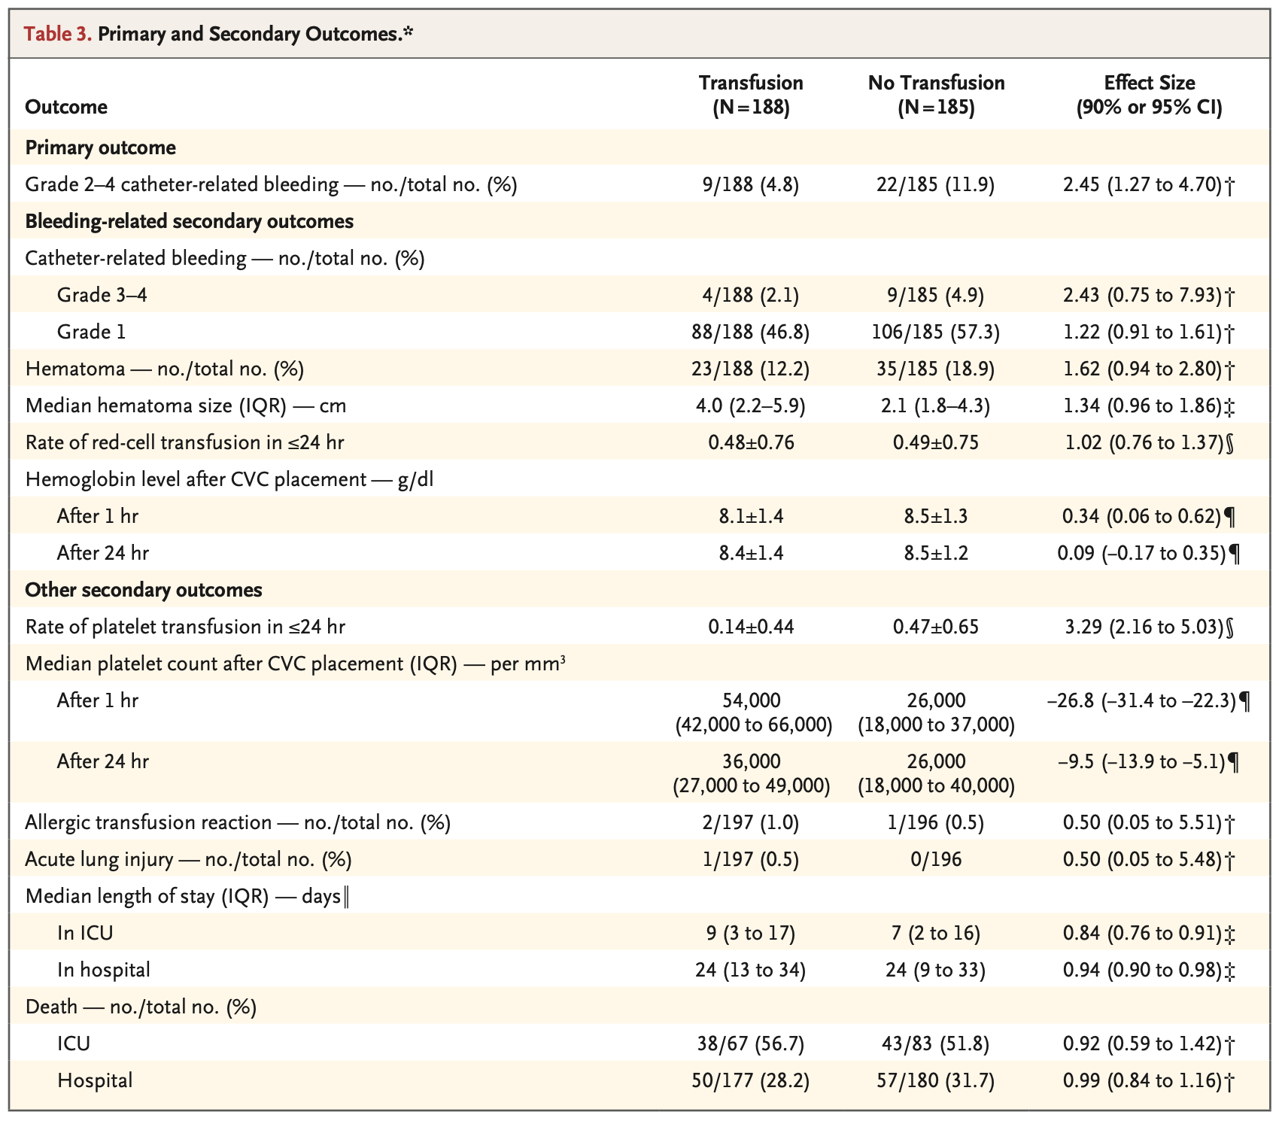
Secondary Outcomes
No difference in red-cell transfusions overall
No-transfusion group received RBC transfusions specifically for CVC-related bleeding (16 vs. 6)
More platelet transfusions in no-transfusion group after CVC placement
Few allergic transfusion reactions (3) and only once acute lung injury case
ICU stay in no-transfusion group slightly shorter, mortality similar

Slide 13
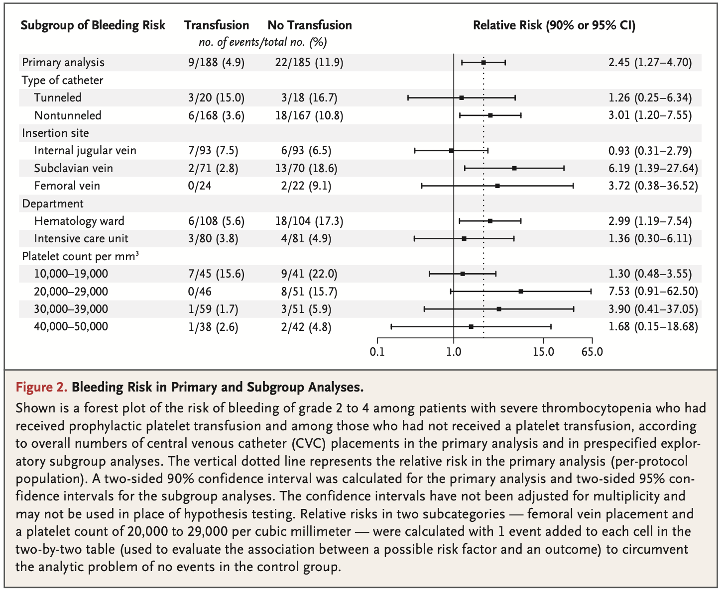
Secondary Outcomes
Subgroup analysis: Higher bleeding risk in no-transfusion group …
… in patients receiving nontunneled CVC (but substantially higher overall risk for patients receiving a tunneled CVC)
… subclavian (and femoral) vein CVC
… at the hematology ward and not so much for patients at the ICU
… in patients with platelets < 20,000 per mm³ 1 hour after CVC placement (with still a substantial risk for bleeding in transfusion group)
Cost analysis: Transfusion group with higher costs (mainly driven by up-front costs of prophylactic platelet transfusion)
Notes:
Difference hematology ward and ICU expected: Patients at ICU more often have consumptive thrombocytopenia whereas patients with hematological issues more often have hypoproliferative thrombocytopenia (?)

Slide 14
Limitations
Authors:
Although multicenter, only Netherlands → probably not applicable for other countries
Only single-blinded (although goal was to keep operator blinded)
Primary outcome driven by grade 2 and 3 bleeding (no grade 4 bleeding) → clinical relevance of grade 2 bleeding?
Patients in transfusion group received one unit of platelets regardless of platelet counts and no verification of platelet increment after transfusion (“opbrengst”) → maybe some patients with low starting platelet counts would have needed more than one unit?
My thoughts:
What about patients with < 10,000 platelets per mm³?
Applicability for pediatric population:
Higher bleeding risk in children ¹
Higher risk for allergic reaction to platelet transfusions in children ²
¹ Josephson et al. Blood. 2012; ² Oakley et al. Transfusion. 2015

Slide 15
Conclusions by the authors
Personalized approach:
Consider prophylactic platelet transfusion in patients with platelets < 30,000 per mm3 especially at hematology ward as they will likely require a platelet transfusion in the 24 hours after CVC placement anyway
Patients at ICU: No prophylactic transfusion given lower bleeding risk in the study and better setting for intensive monitoring
Consider raising platelet-count threshold for tunneled catheters given substantial bleeding risk
Future study: Measure platelet increment (“opbrengst”) after transfusion given the still substantial bleeding risk also in the transfusion group if platelets remained < 20,000 per mm³ one hour after CVC placement
Notes:
Difference hematology ward and ICU expected: Patients at ICU more often have consumptive thrombocytopenia whereas patients with hematological issues more often have hypoproliferative thrombocytopenia (?)

Slide 16
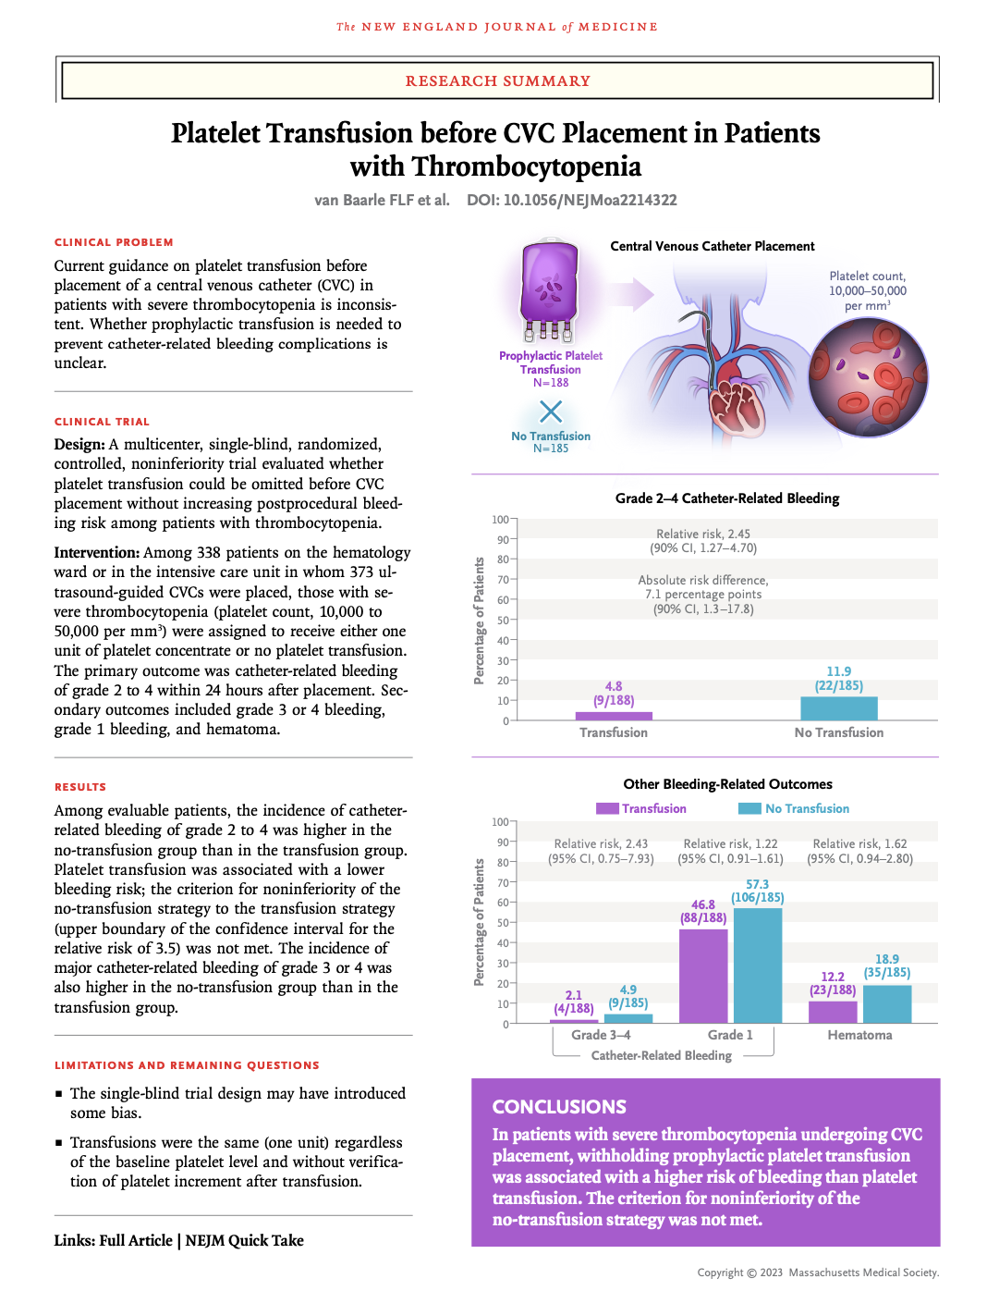
Condensed information

Slide 17
Implications for the WKZ PICU
Are the results relevant for the WKZ PICU: Yes
If yes:
What do I want to implement for the WKZ PICU? Platelet threshold of 50,000 per mm³ for prophylactic platelet transfusion
Should we plan a colloquium with experts to give this some form? Not necessarily for adding the above-mentioned sentence to the SOP However: Prospective study in children similar to the PACER trial to (a) get a better estimate on true major bleeding complications after CVC placement and to (b) assess whether prophylactic platelet transfusions are truly necessary

