Slide 1
Journal club PICU
Pediatr Crit Care Med. 2024 Jun 1;25(6):538-546.
Nicardipine or Nitroprusside for Postoperative Blood Pressure Control in Infants After Surgery for Congenital Heart Disease: Single-Center Retrospective Noninferiority and Cost Analysis, 2016-2020
Rudolph J Wong ¹, Allison L Mruk ², Lisa M Grimaldi ³ ⁴, Reena Patel ³, Lucia Mirea ⁵ ⁶, Kevin P Engelhardt ³ ⁴
Affiliations: Children’s Hospitals Phoenix and Dallas
Diana A. Papazova
1 juli 2024

Slide 3
Wat ga je kiezen?
Midagoverdracht is klaar.
De cardioapatient van vanochtend heeft hypertensie.
Operatieve correctie VSD
Operatieve correctie ToF
Operatieve correctie hypoplastische Ao boog
Ik heb meer info nodig

Slide 4
Postoperative hypertension occurs frequently after congenital cardiac surgery
Nitroprusside
‘we’ve always used nitroprusside’
NB cyanide toxicity
NB methemoglobinemia
Nicardipine
‘it’s a calcium channel blocker, a no-go’
NB possible myocardial depression
NB possible rhythm problems

Slide 5
Postoperative hypertension occurs frequently after congenital cardiac surgery
Nitroprusside
Gemengd veneus en arterieel effect
Verlaagt preload+afterload
Reflextachycardie
Nicardipine
Perifere arteriele vasodilatator
Preload bijna geen effect
Reflextachycardie

Slide 6
And the question is…
P: children after congenital cardiac surgery
I: nicardipine
C: nitroprusside
O: achievement of blood pressure goal at 1-hour post-initiation of an antihypertensive agent
Secondary outcomes
blood pressure goal at 2 hours after medication initiation, Vasoactive-Inotropic Score (VIS),
blood transfusion, crystalloid volume, calcium needs

Slide 7
Methoden
Retrospective non-inferiority study
Before-vs-after cohort study (change of practice)
1st cohort: 2016-2018 nitroprusside n=71
2nd cohort: 2018- 2020 nicardipine n=52
Inclusion criteria
<1year of age, postop care at PCICU
Exclusion criteria
Non-cardiovascular surgery, ECLS or LVAD/RVAD

Slide 8
Demographics and baseline characteristics

Slide 9
Resultaten
No association between antihypertensive study period cardiopulmonary bypass use, cross-clamp time, use of deep hypothermic circulatory arrest.
The nitroprusside study period was associated with longer duration of cardiopulmonary bypass (2 years earlier, surgeon has gotten faster?)

Slide 10
No difference was found in primary outcome At both 1 and 2 hours post-medication initiation, nicardipine was noninferior to nitroprusside No association between both drugs and secondary outcomes Nicardipine – cost-effective

Slide 11
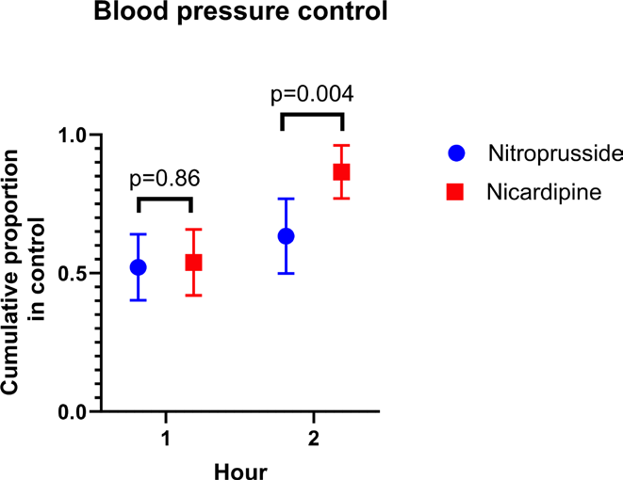
Two potential benefits of nicardipine The proportion of patients who did achieve control at 2 hours, was higher in the nicardipine group than in the nitroprusside group Second line agent was less needed in the nicardipine group

Slide 12
Thoughts
Patients/types of surgery similar to ours
Blood pressure goal not always stated, similar to us
Was this study a waste of time/money/effort as it didn’t lead to change of practice but was the result of it?
No data on sedation/ ventilation (y/n),
type of inotropic/vasopression medication
NB milrinon = afterload ⬇

Slide 13
Wat ga je doen?
Midagoverdracht is klaar.
De cardioapatient van vanochtend heeft hypertensie.
Operatieve correctie VSD
Operatieve correctie ToF
Operatieve correctie hypoplastische Ao boog
Ik heb meer info nodig

Slide 14
Implicaties voor de PICU WKZ
1. Is het resultaat van de studie relevant voor PICU WKZ?
JA
2. Indien Ja:
a. Wat zou je willen implementeren voor de PICU WKZ?
Nicardipine toevoegen in postop cardio protocol
What is the reason for the hypertension ->
pathophysiology hypothesis ->
how to treat it?
b. Is het nodig om een colloquium in te plannen met experts om dit vorm te geven?

