Slide 1

Artificial intelligence in critical illness and its impact on patient care: a comprehensive review
Journal club 9 sept 2024
Erik Koomen

Slide 2

THE DOCTOR WILL
SEE YOU NOW
HOW AI IS GOING TO CURE OUR SICK HEALTH CARE SYSTEM

Slide 3
Healthcare is ready for A.I. and machine learning
…healthcare is uniquely primed for machine learning due to the exponential increase in the volume of patient data over the past two decades. Today, around 30% of the world's data is generated by the healthcare industry.
- big data
standardization -
…the standardization of medical concepts dramatically eases communication between software…
…the global Artificial Intelligence (AI) in healthcare market is projected to grow from $13.82 billion in 2022 to $164.10 billion by 2029…
- investments
complexity -
…more complex neural networks and the ability to learn from high dimensional data allow models to learn and extract as much knowledge as possible from the various kinds of medical data…

Slide 4
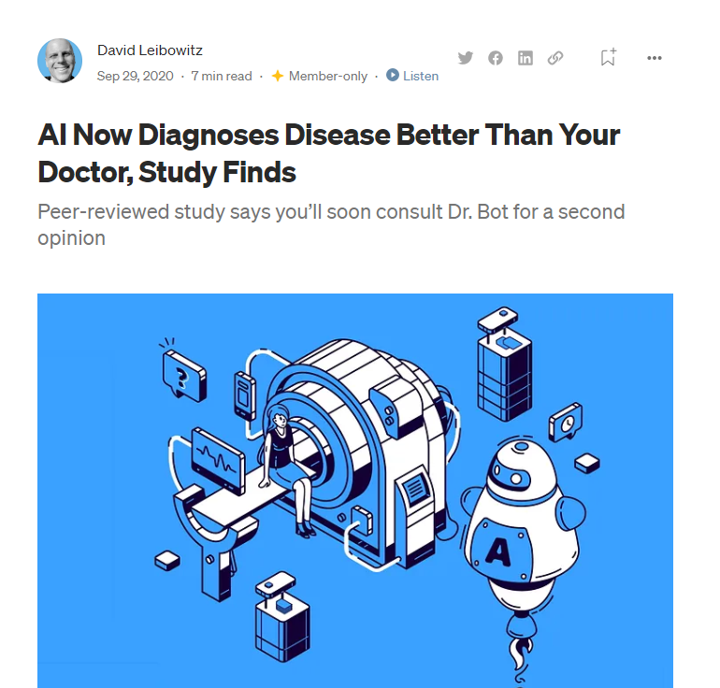

Slide 5
2017
2020

Slide 6

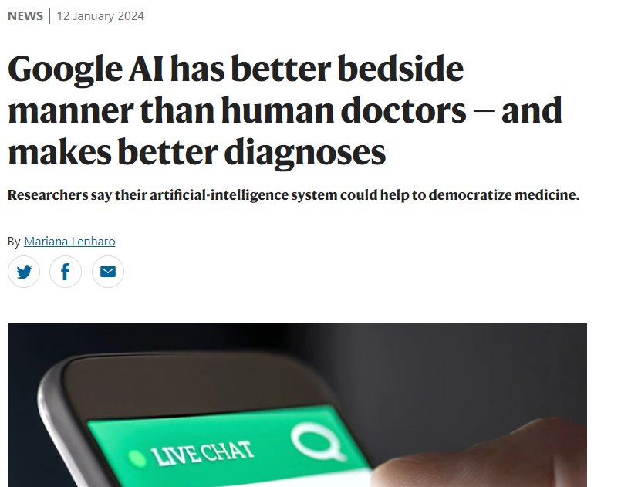
2024

Slide 7
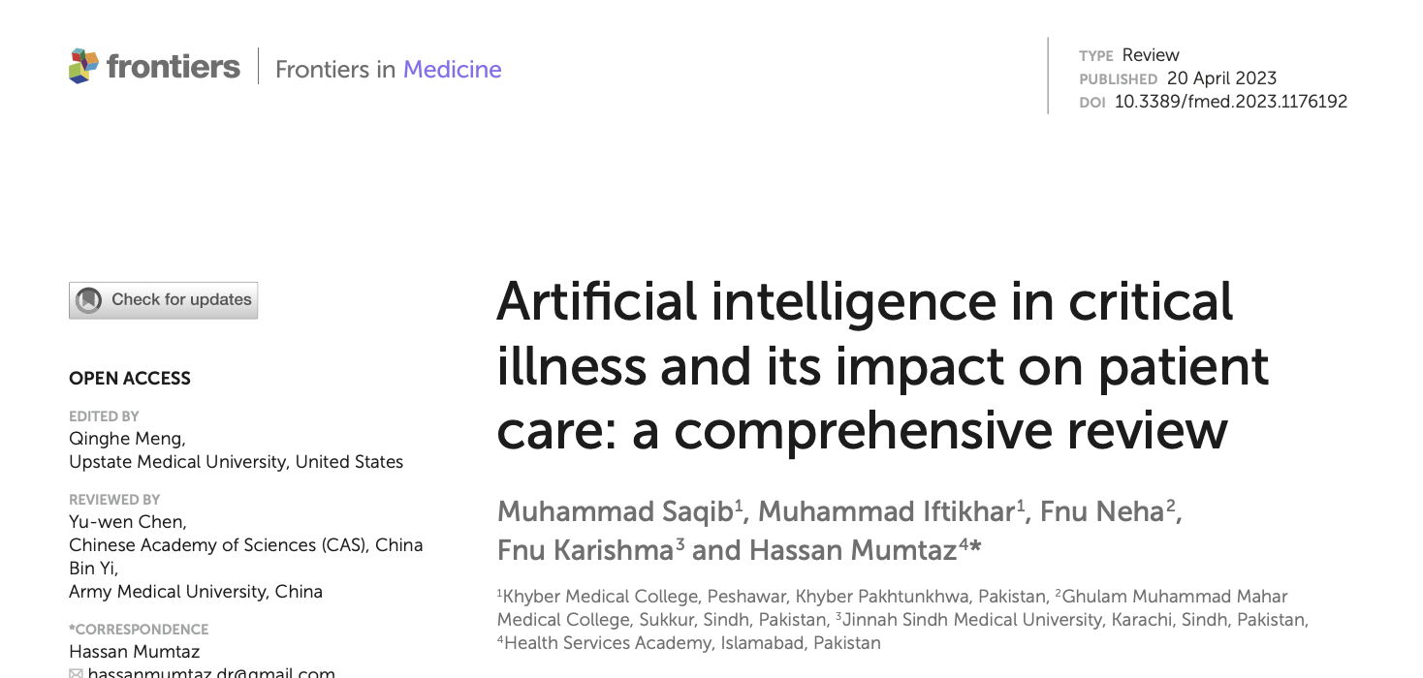
Why is it taking so long?
…if Healthcare is ready for A.I.

Slide 8

Comprehensive Review

Slide 9
Comprehensive Review
A valid comprehensive review is a systematic, scientifically designed review of a defined literature base that employs the rigor of original research in an effort to limit outcome bias. A properly conducted comprehensive review has the most probability of all forms of reviews to become an important source of evidence for prehospital and disaster health and medical decision making
A common mistake in comprehensive reviews is the equal weighting of evidence presented in all the literature included in the review. This error can lead to bias and vagueness of results.

Slide 10
Definition of review
The use of software, algorithms for machine learning,
or artificial intelligence (AI) to simulate mental abilities in the interpretation, evaluation, and comprehension of healthcare data is referred to as AI in healthcare.

Slide 11
Aim / Question of review
Review aims to improve understanding of the applications of AI in critical illness and its impact on patient care, and it makes recommendations for the future.

Slide 12
Methods
A comprehensive search was carried out in PubMed, Google
Scholar, PLOS One, and Scopus for all relevant literature using the following terms: “critical care,” “intensive care medicine,” “ICU medicine,” “artificial intelligence,” “AI,” “machine learning,” and “critical illness” from January 2018 through February 2023 in the English language.

Slide 13
Applications of AI in critical care
1. Recognition of disease
2. Prediction of disease progression using random forest models
3. Recognition of unique patterns in complex data
4. Aid to complex decision-making in critical care
5. Intelligent decision making intervention in critical illness

Slide 14
Outcomes
A review of 172 AI solutions created from chart data revealed that the clinical readiness level of AI was low, with 93% of the analyzed solutions falling below stage 4 for real-world application and only 2% undergoing prospective validation

Slide 15
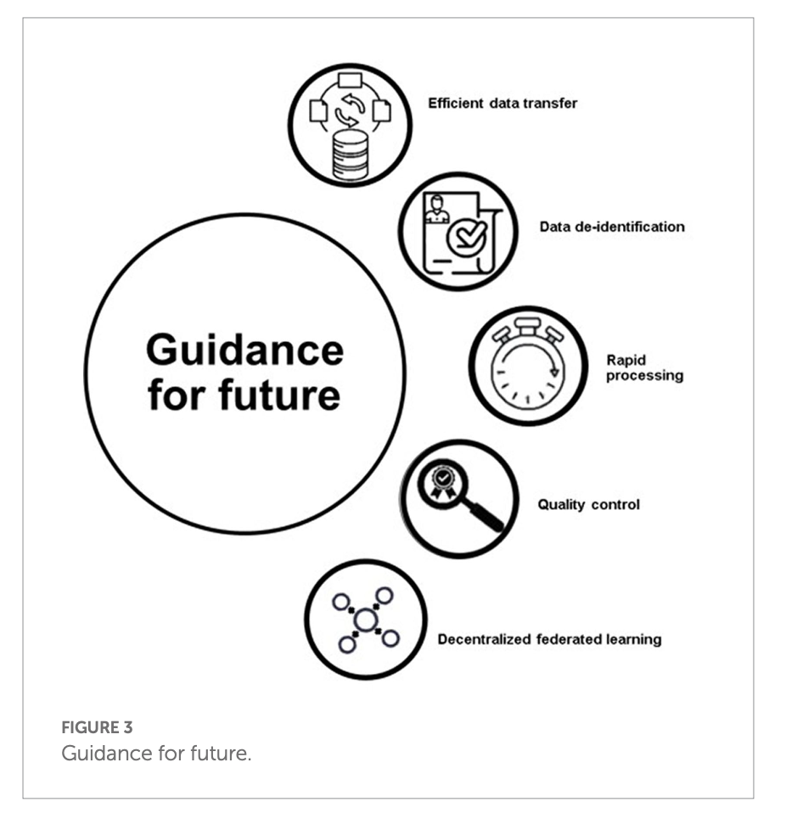
Future

Slide 16
Conclusion
The utilization of artificial intelligence (AI) in critical care presents numerous opportunities for enhancing outcomes in critically ill patients by enabling the perception of disease, predicting changes in pathological processes, recognizing unique patterns in disease presentations, and assisting in the process of clinical decision-making in a symbiotic fashion
with care-givers.

Slide 17
My conclusion
Poor Comprehensive Review:
Summery klopt dat er beperkt wat bekend
Bias => vooroordeel => toekomst is erg rooskleurig
Waarom?

Slide 18
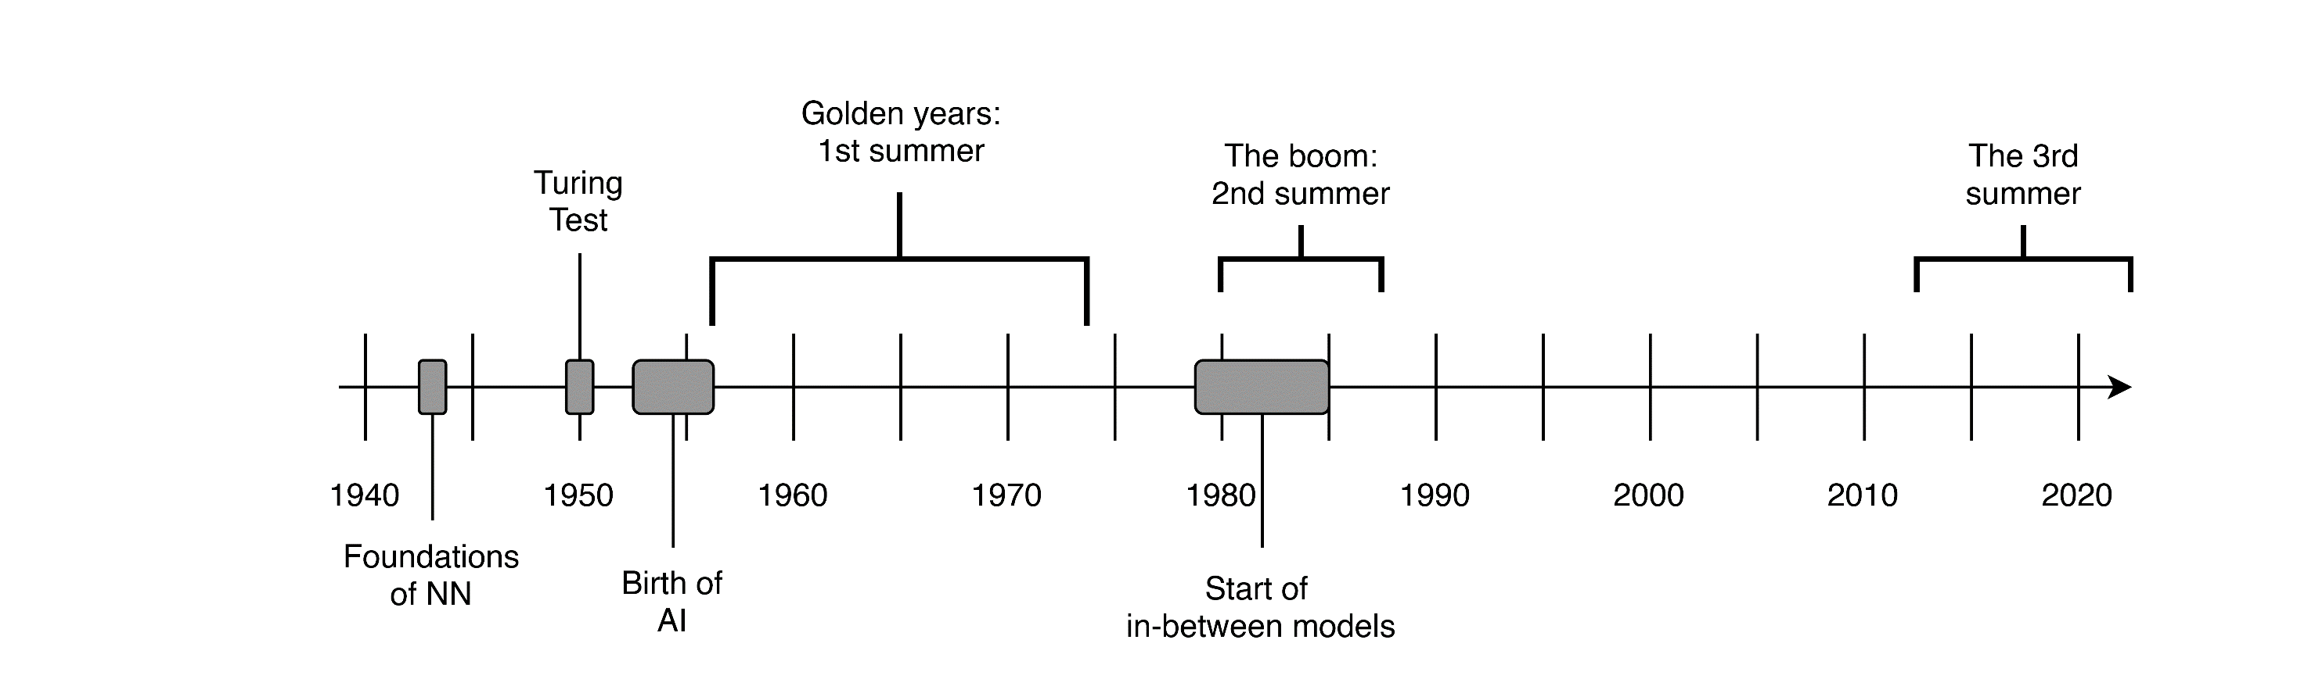
Timeline of A.I. in Healthcare
Promise:
Computer solves
everything
Promise:
Computer solves
everything
Promise:
Computer solves
everything
Promise:
Computer solves
Everything
????

Slide 19
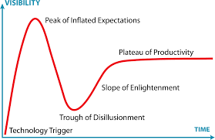
Gartner hype cycle

Slide 20
Timeline of A.I. in Healthcare
Promise:
Computer solves
everything
Promise:
Computer solves
everything
Promise:
Computer solves
everything
Promise:
Computer solves
Everything
????
No scalable infrastructure

Slide 21


Slide 22

Using data from an Electronic
Medical Record is like squeezing water from an only moist sponge

Slide 23
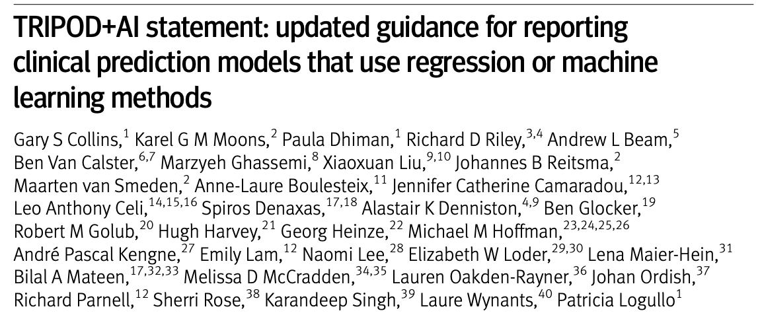
TRIPOD (Transparent Reporting of a multivariable prediction model for Individual Prognosis Or Diagnosis)

Slide 24
Conclusie
Matig artikel
AI geloof groot maar de basis is niet op orde en samenwerking tussen AI en Human Intelligentie is nodig!

Slide 25

Artificial Intelligence
AND
Human Intelligence

