Slide 1
Journal club PICU
Anesth Analg 2023 Nov 1;137(5):1056-1065.
Administration of Milrinone Following Tetralogy of Fallot Repair Increases Postoperative Volume Administration Without Improving Cardiac Output
Kwannapas Saengsin ¹ ² ³, Francesca Sperotto ¹ ², Minmin Lu ¹ ², Julia Garcia Mancebo ¹ ², Elizabeth Sacco ¹, Manasee Godsay ¹, James A DiNardo ⁴ ⁵, John N Kheir ¹ ²
Affiliaitons: Boston Children's Hospital, Boston, Massachusetts + Chaing Mai University Hospital, Chaing Mai, Thailand.
Diana A. Papazova
27 januari 2025

Slide 2
Wat ga je doen?
Middagoverdracht is klaar.
De patient na TOF correctie vanochtend heeft hypotensie
- goede biventriculaire functie op TEE, dikke RV
- milrinone 0,5 gamma
Ik heb meer info nodig

Slide 3
Milrinone = the inotrope for congenital cardiac surgery
Inotrope, lusitrope, vasodilator
Vasodilation, along with an inotropic effect, is thought to be responsible for clinical improvements in congestive pathologies
PRophylactic Intravenous use of Milrinone After Cardiac OpeRation in Pediatrics
PRIMACORP study
RCT: showed that administration of milrinone (75 μg/kg loading dose followed by a 0.75 μg/kg/min) reduced the incidence of LCOS in pediatric patients after cardiac surgery, including repair of TOF

Slide 4
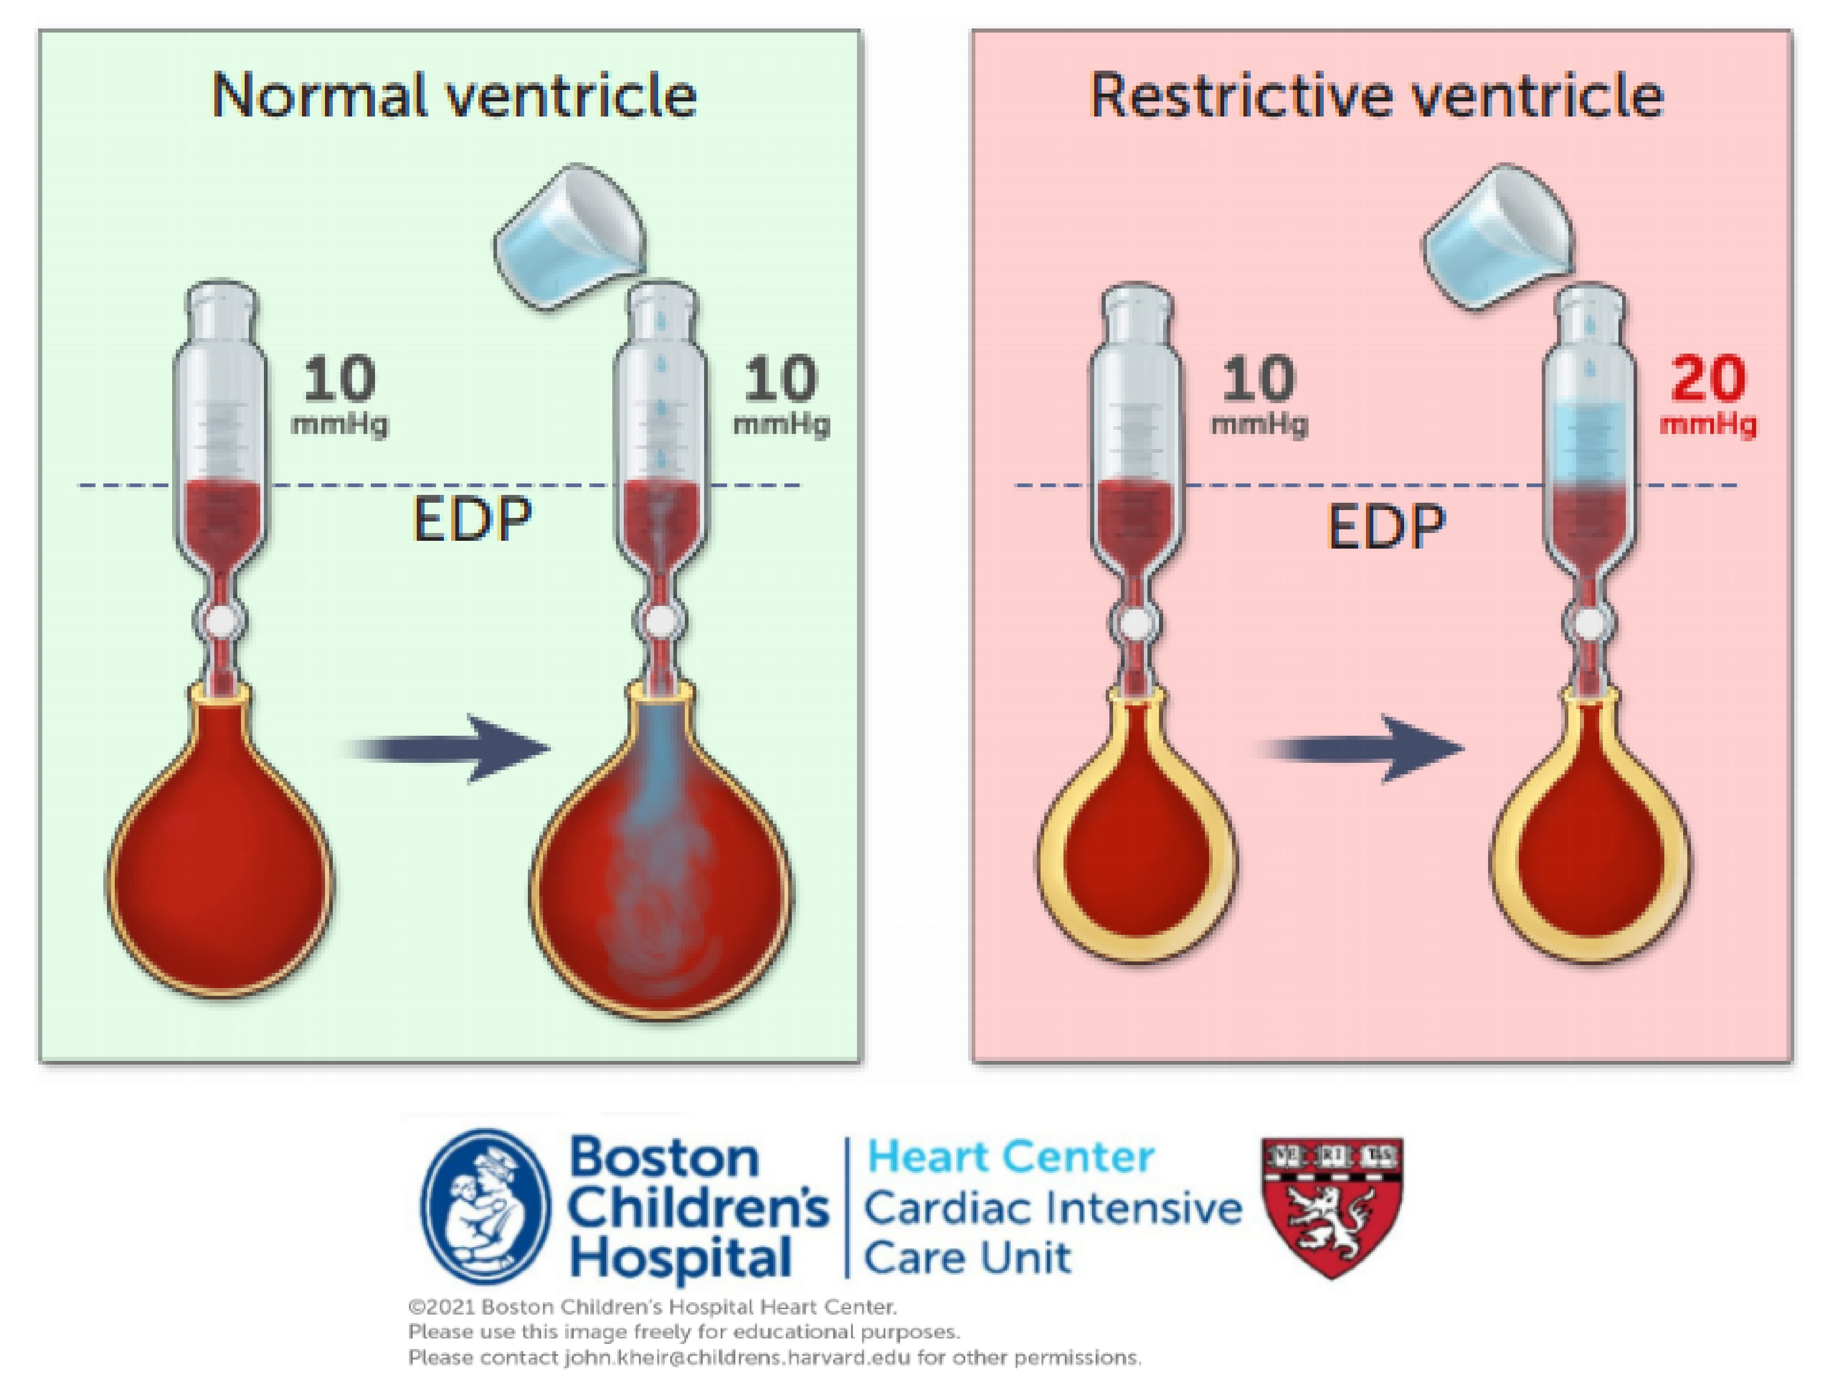
Restrictive physiology in TOF

Slide 5
And the question is…
P: children after TOF repair
I: milrinone
C: no milrinone
O: administration of volume (yes/no) during the first 72 postoperative hours following TOF repair
Secondary outcomes
vital signs (heart rate and blood pressure)
indices of cardiac output and oxygen delivery (eg, arteriovenous oxyhemoglobin saturation [AVO2] difference) and serum lactic acid)
Association between the total perioperative dose of milrinone and the total volume administered during the first 72 postoperative hours

Slide 6
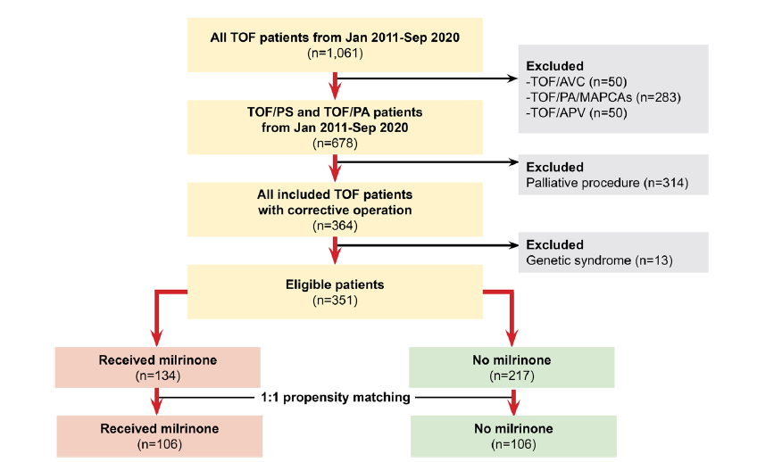
Methods
Retrospective study 2011-2020 at Boston Children’s Hospital
all patients undergoing surgical repair
of TOF with
Inclusion criteria
<TOF with pulmonary stenosis or pulmonary atresia
Exclusion criteria
MAPCA’s, TOF and atrioventricular canal
TOF with absent pulmonary valve.
palliative procedure (eg, modified Blalock-Taussig shunt, central shunt),
patients with a known genetic syndrome, and
patients who required extracorporeal membrane oxygenation (ECMO) support within 72 hours of repair.
Patients on ECMO also excluded

Slide 7
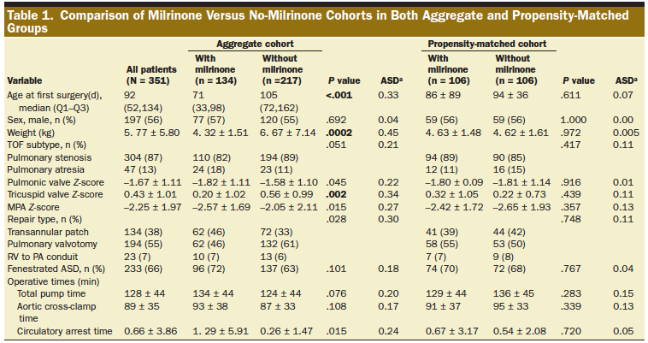
Patients that received milrinone were younger, lighter and with smaller right side (before matching)

Slide 8
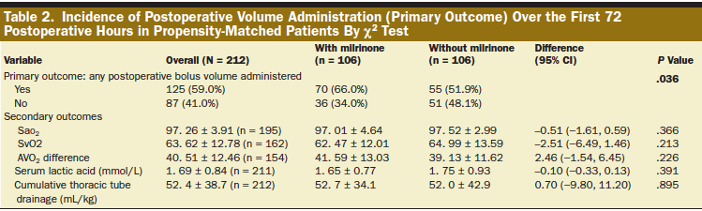
Patients on milrinone received more volume

Slide 9
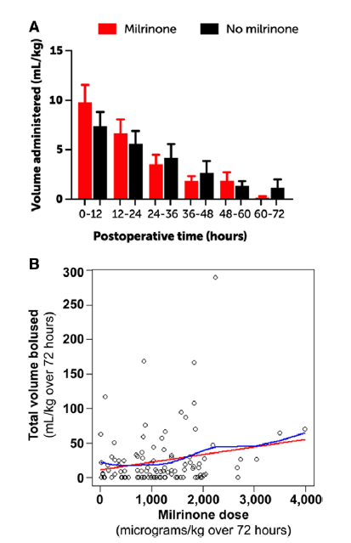
Results

Slide 10
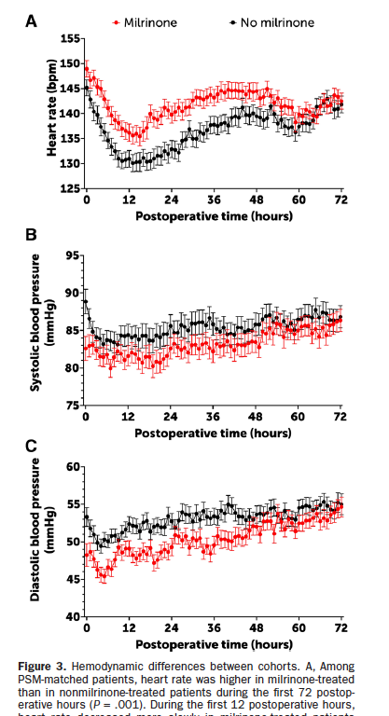
Results

Slide 11
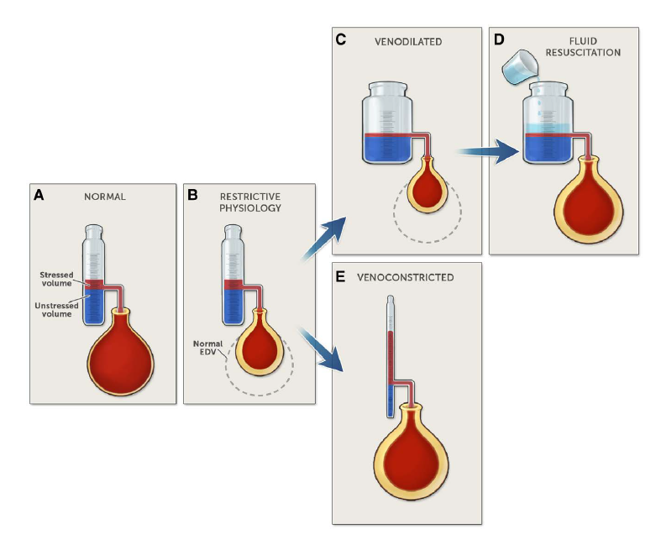

Slide 12
In a nutshell
Question: Does milrinone improve hemodynamics following TOF repair?
Findings: Propensity-matched patients who received milrinone within the first 72 hours following TOF repair
were given volume more frequently
had slower recovery of tachycardia
Had lower blood pressure,
Had no improvement in indices of cardiac output
volume administration increased linearly with a dose of milrinone.
Meaning: Milrinone administration following TOF repair may convert stressed volume to unstressed volume, increasing the likelihood of volume replacement, increasing heart rate, and decreasing blood pressure without improving cardiac output;
the clinical impact of milrinone in this setting should be studied prospectively.

Slide 13
Thoughts
Retrospective, no clinical significance
Patients/postop period not similar to ours
Milrinone dose and usage not protocolized, similar to us
Great example of sharing data and institutional practices

Slide 14
Wat ga je doen?
Middagoverdracht is klaar.
De patient na TOF correctie vanochtend heeft hypotensie
- goede biventriculaire functie op TEE, dikke RV
- milrinone 0,5 gamma
Ik heb meer info nodig

Slide 15
Implicaties voor de PICU WKZ
      1. Is het resultaat van de studie relevant voor PICU WKZ?
  JA
  2. Indien Ja:
  a. Wat zou je willen implementeren voor de PICU WKZ?
  What is the reason for the hypotension ->
  pathophysiology hypothesis ->
  how to treat it?
  b. Is het nodig om een colloquium in te plannen met experts om dit vorm te geven?

