Slide 1
eClinicalMedicine 2025;81: 103077

Slide 2
Traumatic brain injury
61% significant morbidity after moderate-severe TBI
Management strategies: minimising secondary brain injury
ICP < 20 mmHg
CPP 40-50 mmHg
Pediatric thresholds?

Slide 3
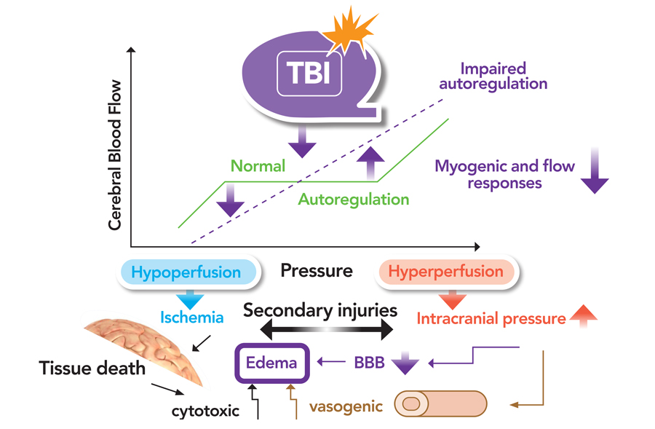

Slide 4
Cerebral vasomotor pressure reactivity
a proxy measure of cerebrovascular component of cerebral autoregulation
Assessment: the transmission of slow wave fluctuations of ABP to slow changes in ICP, where ICP is treated as a surrogate of cerebral blood volume, thereby cerebral blood flow (CBF)
Pressure reactivity index (PRx):
Negative values: representing robust cerebral autoregulation (ABP not reflected in ICP)
Positive values: representing deranged cerebral autoregulation (ABP fluctuations transmitted into ICP)

Slide 6
Study aim
To identify critical thresholds of PRx in relation to outcome in a multicentre pTBI cohort,
To create a research database of high-resolution physiological monitoring data with demographics, clinical details, as well as neuropsychological outcome up to 12 months in this cohort.

Slide 7
STARSHIP
Prospective, multicenter (10 PICUs), observational study in the UK
from 01.07.2018 till 31.04.2024

Slide 8
Inclusion criteria
Age ≤16 years
TBI
Glasgow Coma Score (GCS) ≤8 and/or TBI related pathology confirmed
on neuroimaging
requiring invasive ICP and ABP monitoring for clinical indications

Slide 9
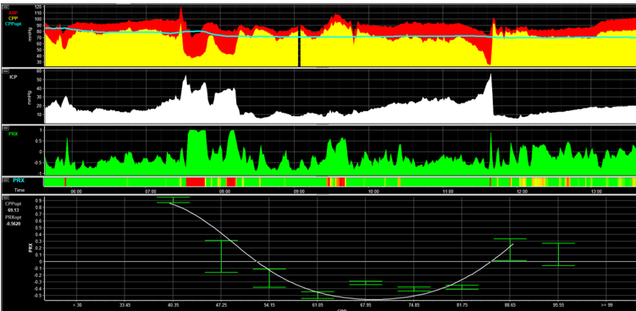
ABP
CPP
CPPopt
ICP
PRx
CPPopt calculation
CPP - PRx

Slide 10
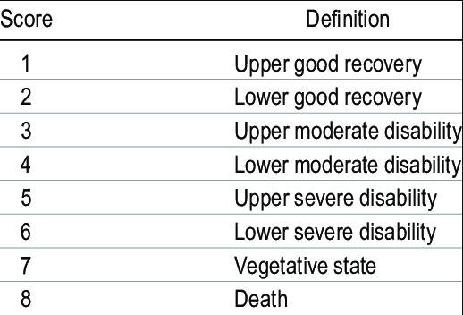
Glasgow Outcome Scale Extended Pediatric version (GOSEP)
GOSEP
CONSCIOUSNESS
INDEPENDENCE IN THE HOME
INDEPENDENCE OUTSIDE THE HOME
SCHOOL/WORK
SOCIAL & LEISURE ACTIVITIES
FAMILY & FRIENDSHIPS
RETURN TO NORMAL LIFE

Slide 11
Glasgow Outcome Scale Extended Pediatric version (GOSEP)
Study outcome
favourable (GOSEP 1–4)
unfavourable (GOSEP 5–8).

Slide 12
Multivariate analyses
Sliding dichotomy
The definition of favourable and unfavourable outcome is adjusted depending on the initial disease severity.
For a patient with very poor prognosis based on the clinical parameters, survival would be regarded as a favourable outcome. In a patient with excellent prognosis on admission, only a GOSEP of 1 or 2 would be considered a favourable outcome, any other outcome would be considered unfavourable.
Low likelihood: GOSEP 1-2 considered as favourable
Intermediate likelihood: GOSEP 1-4 considered as favourable
High likelihood: GOSEP 1-6 considered as favourable
Propensity score matching
1:1 matching
Mixed effect model
To adjust for variations across centers while assessing the overall treatment effects

Slide 13
Propensity score matching
Age
Motor GCS
Pupillary reactivity
Injury severity score
Rotterdam score of traumatic brain injury
Pre-hospital hypoxia
Hypotension
Cardiac arrest

Slide 14
Multivariate analyses
Sliding dichotomy
The definition of favourable and unfavourable outcome is adjusted depending on the initial disease severity.
For a patient with very poor prognosis based on the clinical parameters, survival would be regarded as a favourable outcome. In a patient with excellent prognosis on admission, only a GOSEP of 1 or 2 would be considered a favourable outcome, any other outcome would be
considered unfavourable.
Low likelihood: GOSEP 1-2 considered as favourable
Intermediate likelihood: GOSEP 1-4 considered as favourable
High likelihood: GOSEP 1-6 considered as favourable
Propensity score matching
1:1 matching
Mixed effect model
To adjust for variations across centers while assessing the overall treatment effects

Slide 15
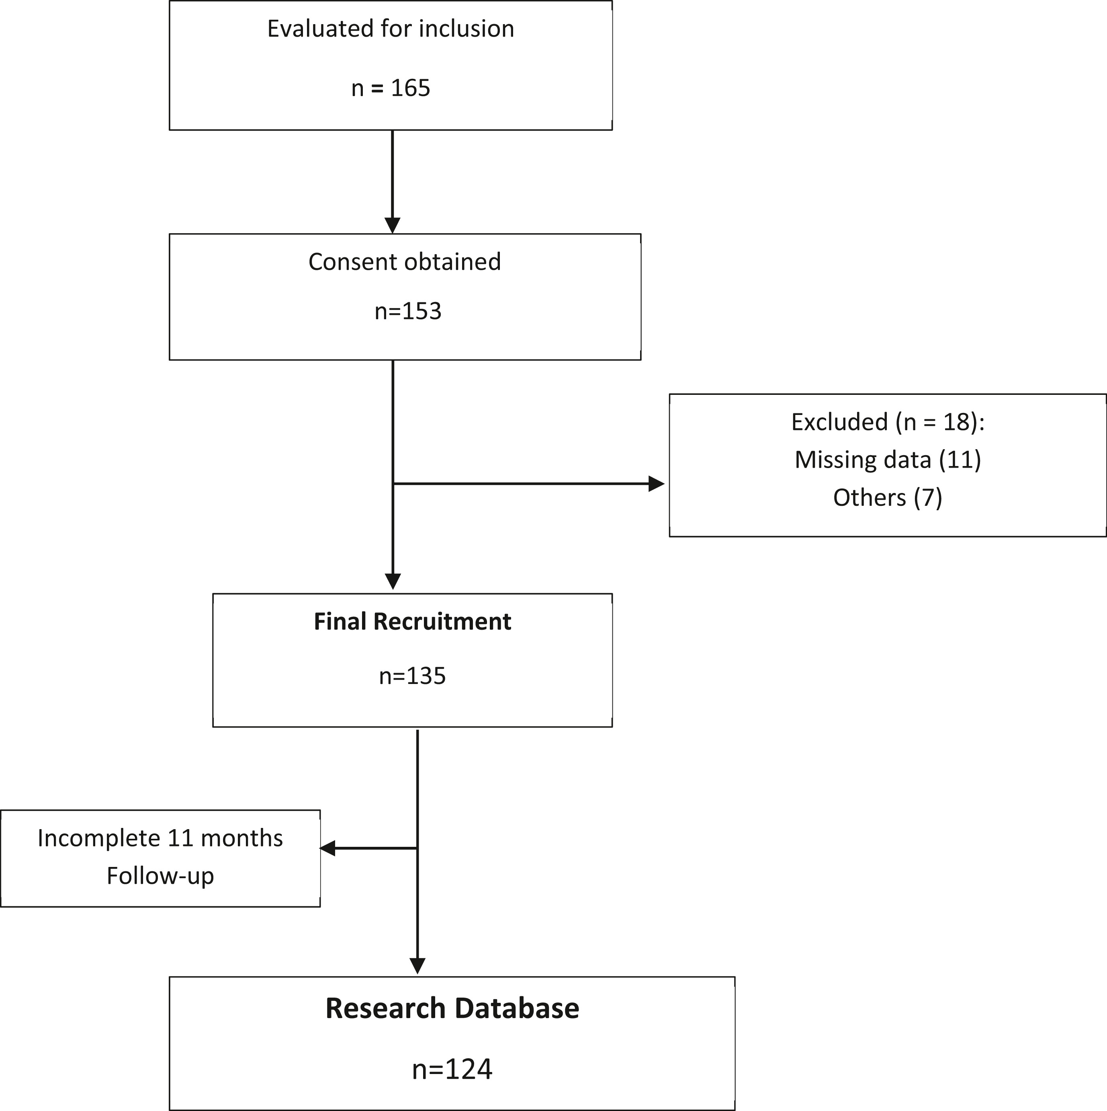

Slide 16
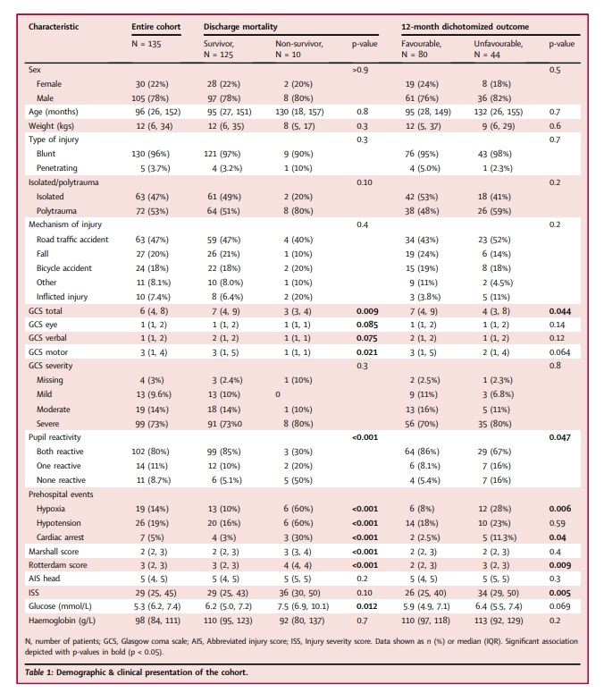

Slide 17
Median amount of available data within the first 24 h was 13 h (IQR 8–18)
The median percentage of good monitoring time (i.e. after artefact
removal) was
91% (IQR 84–96%) for ABP
88% (IQR 75–93%) for ICP
PRx and CPPopt could be calculated for 73% (IQR 62–91%) and 82%
(IQR 81–92%) of the length of monitoring period/ patient

Slide 18
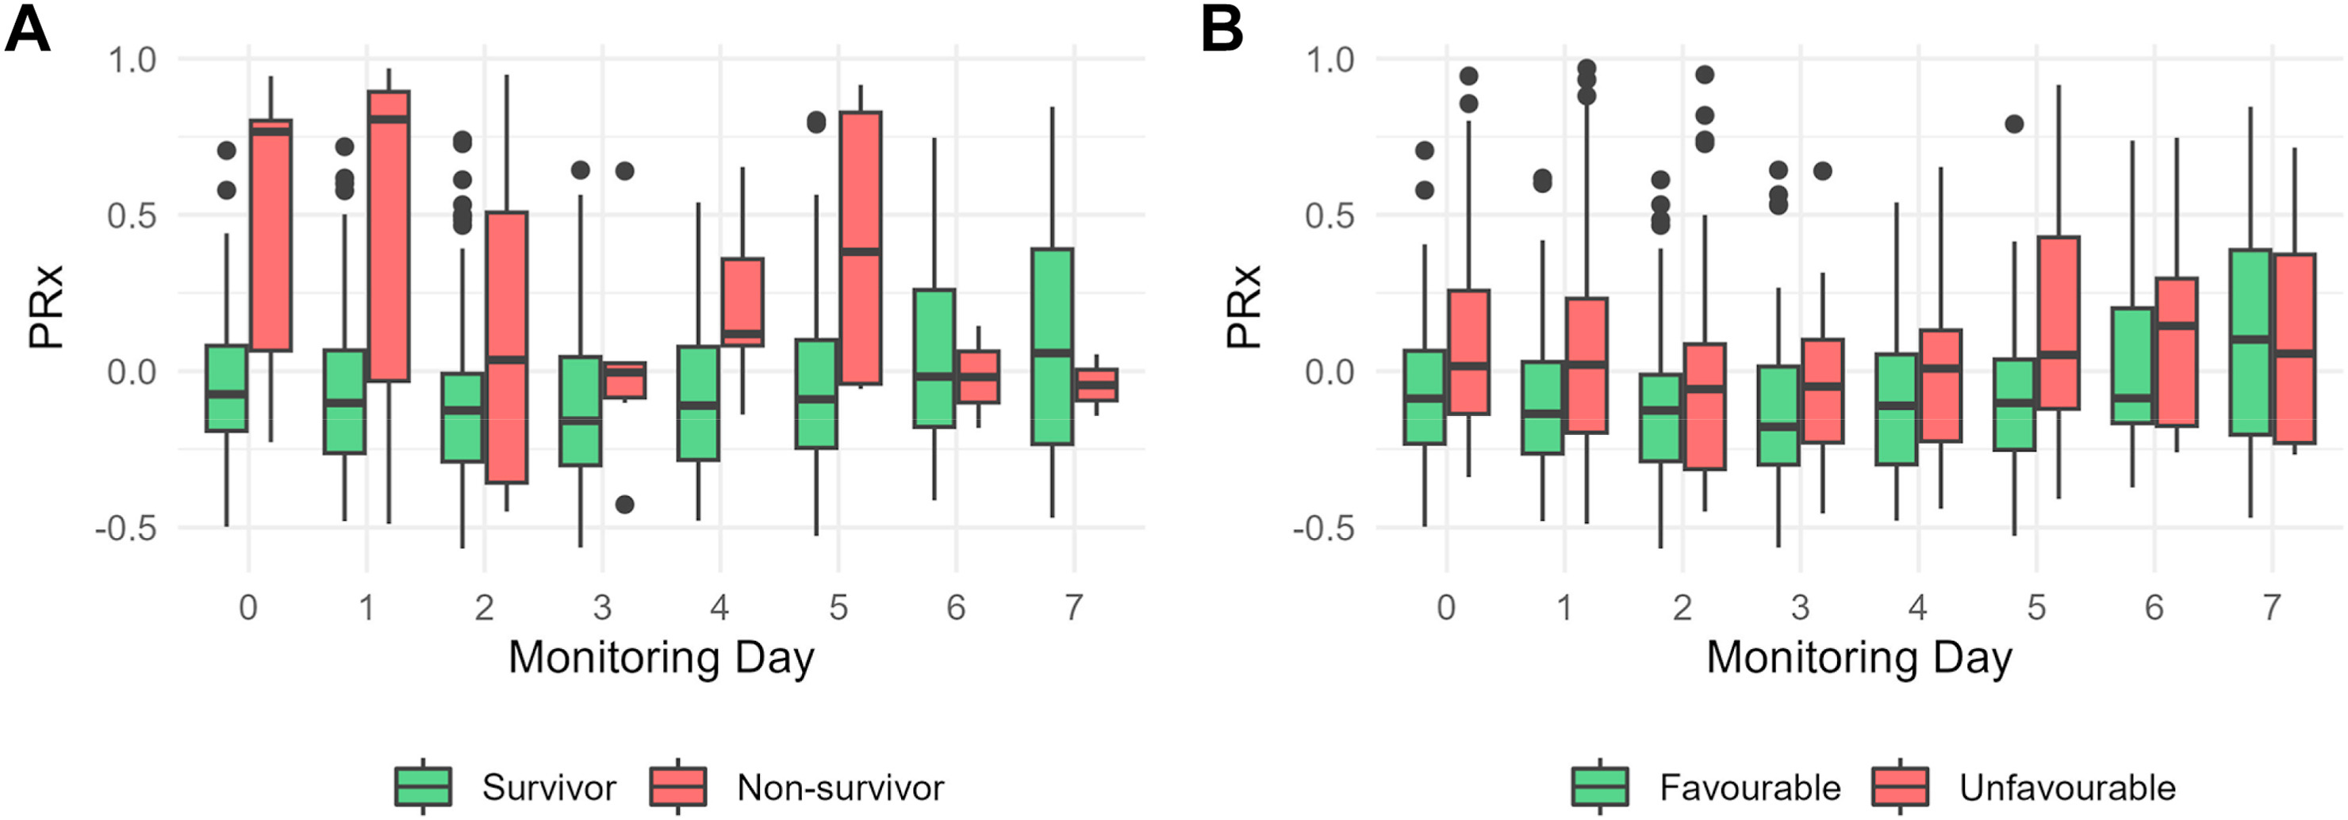

Slide 20
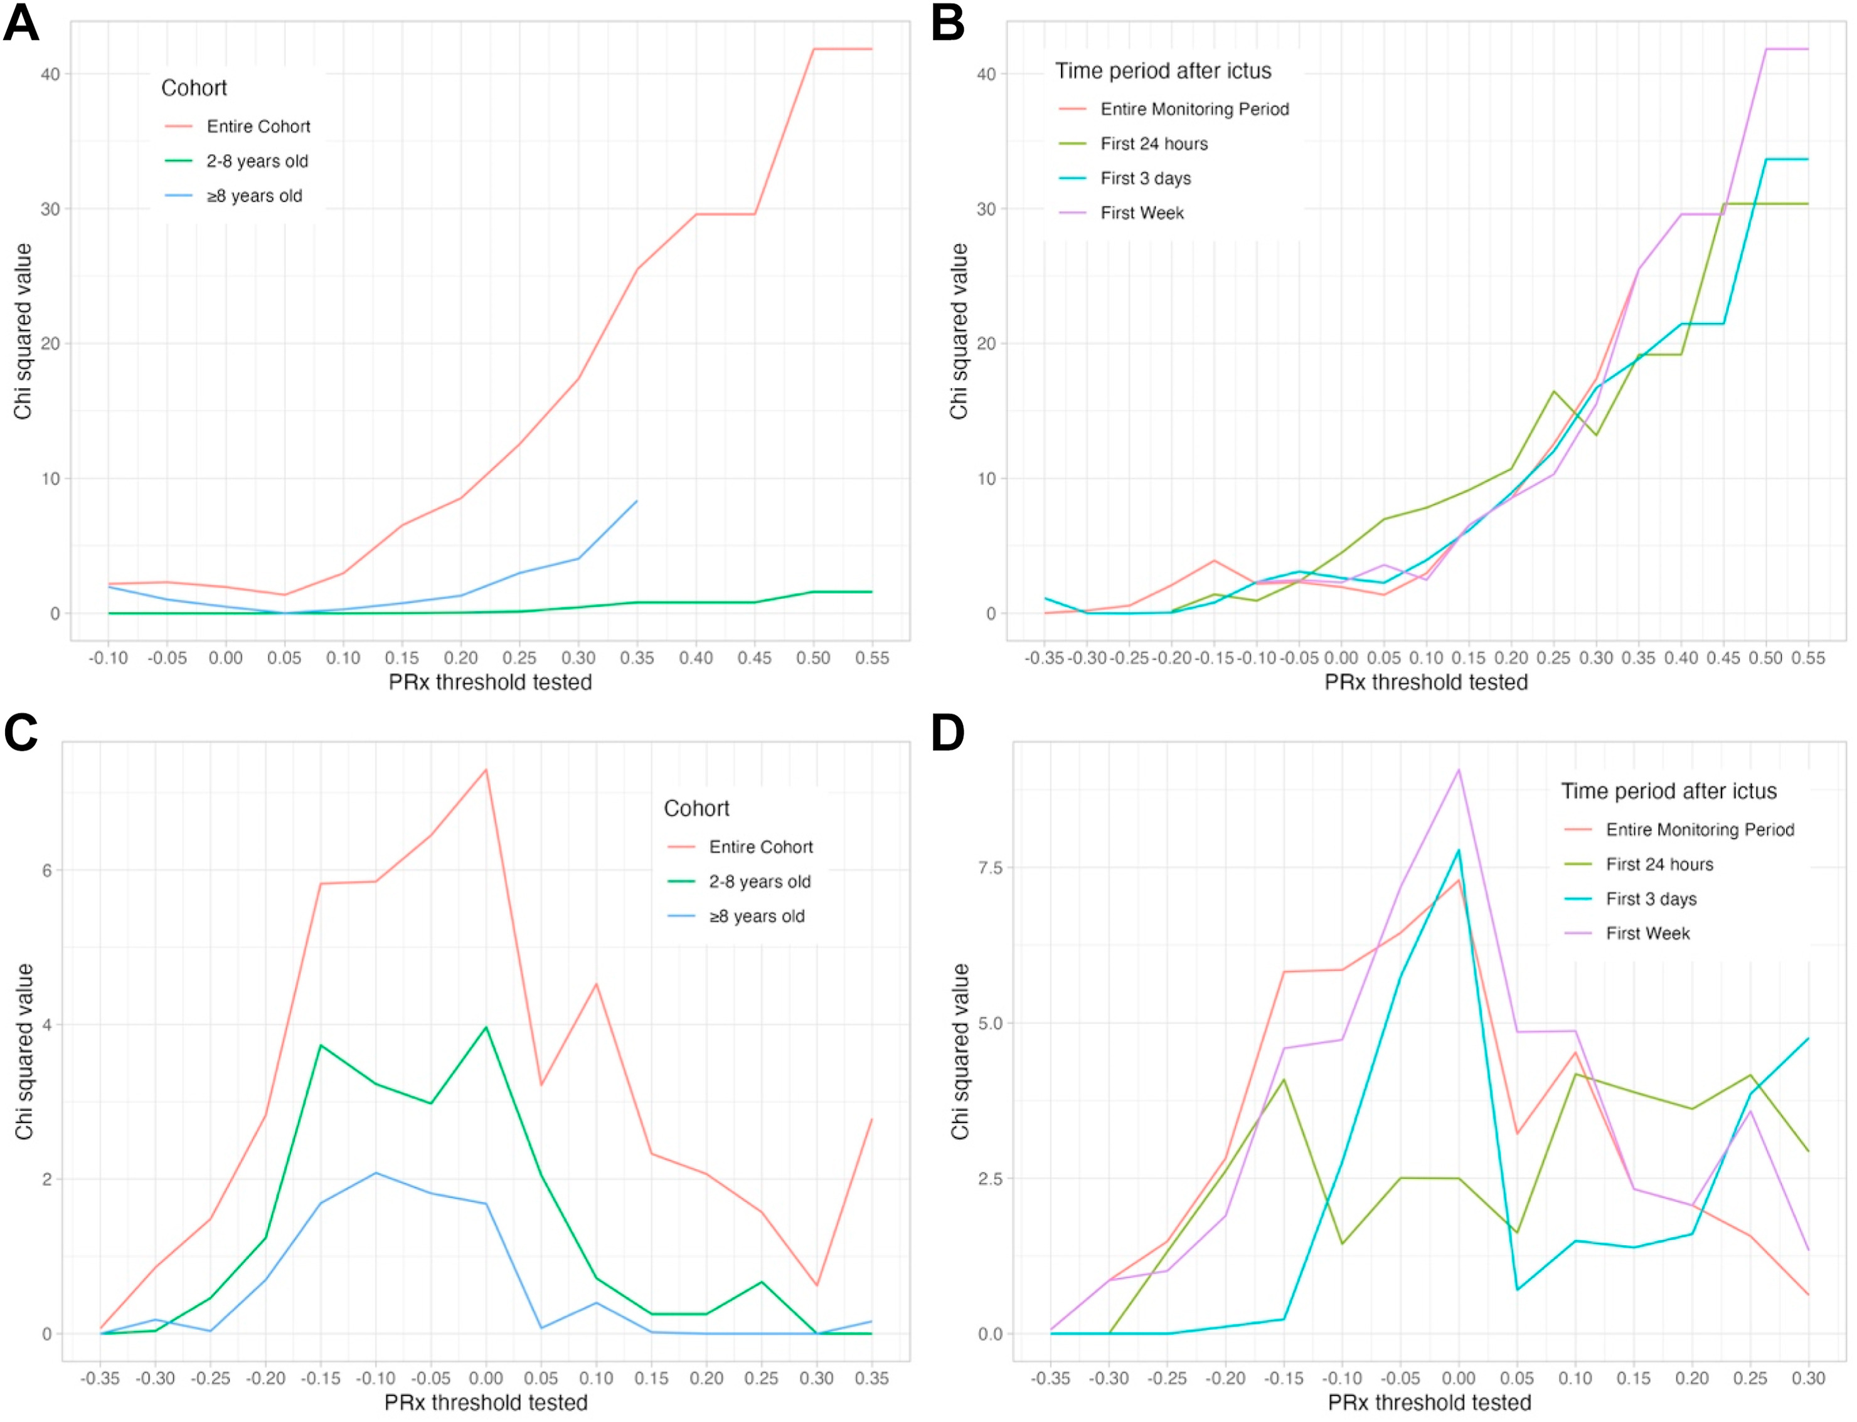
Mortality
Critical PRx-threshold: 0.5
Favourable
outcome
Critical PRx-threshold: 0.0

Slide 21
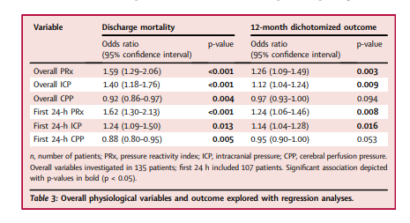

Slide 22
PRx significantly associated with outcome, even after adjustment for
Initial disease severity
Propensity score matching
Center specific effect

Slide 23
Strengths
Prospective multicenter design
Predefined sample size and protocol
Limitations
Sample size based on pilot study with a higher mortality. Only 10 patients died in the current study.
Possible impact of COVID-19 pandemic
Most of the analyses were performed with one value of PRx per patient representing the overall state of CA considering either the first 24 h or full monitoring period

Slide 24
Implicaties voor de PICU WKZ
Is het resultaat van de studie relevant voor PICU WKZ?
Ja, echter voor nu nog te vroeg om bij ons te implementeren. Bewijs moet nog geleverd worden of interventies gebasseerd op PRx ook een betere outcome opleveren.

