Slide 1
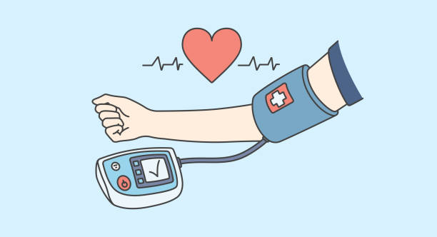
Fifth Centile Versus 50th Centile Mean Blood Pressure Targets in Pediatric Septic Shock: A Randomized Controlled Trial
Journal Club 4 augustus
Hannah Kansen

Slide 2
Introductie
What should be the target mean blood pressure in children presenting in septic shock needing vasoactive medications?
Hypotensie voorkomen vanwege risico op
verminderde weefselperfusie
multi orgaanfalen
Mean RR wordt gebruikt voor titratie van vasopressie.
Theoretische voordelen van lagere MAP
minder (lang) medicatie nodig
minder CVL gerelateerde risico’s (infectie, trombose)
Notes:
Theoretically targeting MBP greater than 5th centile should be acceptable if the end-organ perfusion parameters, such as acidosis, urine output, mentation, and capillary refill time are improving. Also, the use of higher doses of vasopressors in an attempt to achieve higher blood pressure (BP) may have unwarranted consequences, such as tissue ischemia, myocardial dysfunction, arrhythmias, etc. Central venous catheters used for administering vasoactive agents carry a risk of infection, thrombosis, and other complications.

Slide 3
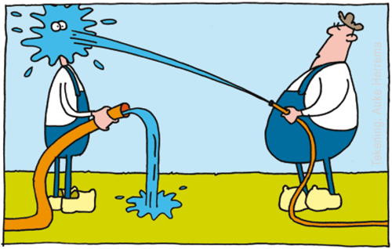
Wat doen jullie?

Slide 4
Methode
Single-center open-label randomized noninferiority studie
Derdelijns PICU in India van 2021 tot 2024
Domein
1 maand tot 16 jaar
Septische shock met indicatie tot vasopressie
Exclusie
Determinant
p5 vs. p50 voor leeftijd met range 5 mmHg
Uitkomst
Primair: mortaliteit 28 dagen
Secundair: o.a. lengte opname, duur behandeling en adverse events
Notes:
tertiary care PICU of an academic hospital in India from April 15, 2021, to March 31, 2024.
Inclusion Criteria. All patients presenting to the PICU in the age group of 1 month to 16 years with septic shock refractory to fluid boluses and needing vasopressors were eligible for enrollment.
Exclusion Criteria. We excluded children who received vasopressors for more than 24 hours before admission to our PICU. Children were also not eligible if the consultant felt that the cause of shock was overt neurogenic, cardiogenic, or hemorrhagic in origin.
After enrollment of patients, vasopressor treatment was adjusted to maintain the target BP. Low normal MBP greater than or equal to 5th centile for age was defined as MBP (mm Hg) of 40 + 1.5 × age (yr), while high normal MBP greater than or equal to than the 50th centile for age was defined as MBP (mm Hg) of 55 + 1.5 × age (yr). The target MBP range in the low normal group was 5th centile to 5th centile + 5 mm Hg and in high normal group was 50th centile to 50th
Primary Outcome. The primary outcome was death from any cause by 28 days of inclusion.
Secondary Outcomes.
1) Length of stay in the PICU.
2) Length of stay in the hospital.
3) Duration of vasoactive drugs and maximum Vasoactive-Inotropic Score (VIS).
4) Occurrence of vasopressor-induced adverse events namely extravasation, limb/digit necrosis, arrhythmias, bowel ischemia, feed intolerance, and venous thromboembolic events.
5) Need for continuous renal replacement therapy, invasive ventilation, and prevalence of acute respiratory distress syndrome (ARDS).

Slide 5
Stappenplan vasopressie
Adrenaline
  Start 0.05 μg/kg/min
  Ophogen tot max. 0.3 μg/kg/min
Noradrenaline
  Start 0.05 μg/kg/min
  Ophogen tot max. 0.3 μg/kg/min
  Vasopressine
  Start 0.0002 IU/kg/min
  Ophogen tot max. 0.0012 IU/kg/min
  Hydrocortison bij adrenaline en noradrenaline op hoogste stand.
  Milrinone bij lage veneuze saturatie of verlengde CR.
Notes:
patients with hypotension were started on epinephrine in a starting dose of 0.05 μg/kg/min, and the dose was escalated every 15 minutes, if the target BP was not reached. If a patient presented in a pulseless state then the starting dose of epinephrine was 0.1 μg/kg/min. Each time the dose was escalated, the BP was recorded by the treating nurse. All patients were initially started on vasopressors through external jugular venous cannulation or a wide-bore peripheral cannula. Within an hour of starting vasopressor central venous line (CVL) was inserted and vasopressors were administered through the CVL. If the target BP was not achieved after reaching an epinephrine dose of 0.3 μg/kg/min, norepinephrine was added. The starting dose of norepinephrine was 0.05 μg/kg/min and titration was similar to epinephrine. Vasopressin was added if the norepinephrine requirement was more than 0.3 μg/kg/min.
Vasopressin was initiated at a dose of 0.0002 international units/kg/min and then titrated every 15 minutes to a maximum of 0.0012 U/kg/min. Hydrocortisone was added when the norepinephrine and epinephrine were at a dose of greater than or equal to 0.3 μg/kg/min.
Milrinone was started in patients who achieved normal BP after initial vasopressors but still had low mixed venous saturation or abnormal perfusion (CFT > 2 s). The starting dose being 0.33 μg/kg/min to a maximum dose of 0.99 μg/kg/min. Clinicians could modify the protocol depending on clinical findings and bedside functional echocardiography. Adequacy of intravascular volume status was performed on ongoing basis using indices, such as inferior vena cava distensibility and collapsibility index.

Slide 6
Stappenplan vasopressie
Step up
RR > 5 mmHg boven p5/p50
Combinatie van twee of meer tekenen van slechte perfusie, namelijk RR 3 mmHg boven p5/p50, lactaat > 4 mmol/L of CR > 4 sec
Step down
4 uur RR op of boven p5/p50
Afbouw (nor)adrenaline met 0.01-0.02 μg/kg/min
Notes:
There were two criteria for rescue treatment, either a mean BP value greater than 5 mm Hg below threshold or a combination of two or more signs reflecting poor perfusion, namely a mean BP value 3 mm Hg below threshold, lactate greater than 4 mmol/L or a capillary refill time greater than 4 seconds
0.01–0.02 μg/kg/min every hour

Slide 7
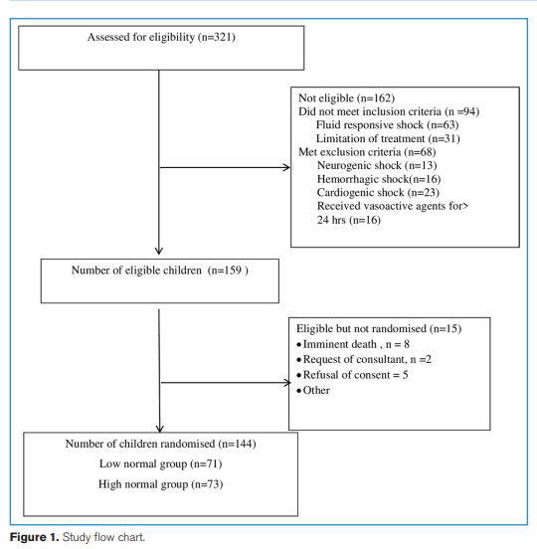
Studie flowchart

Slide 8
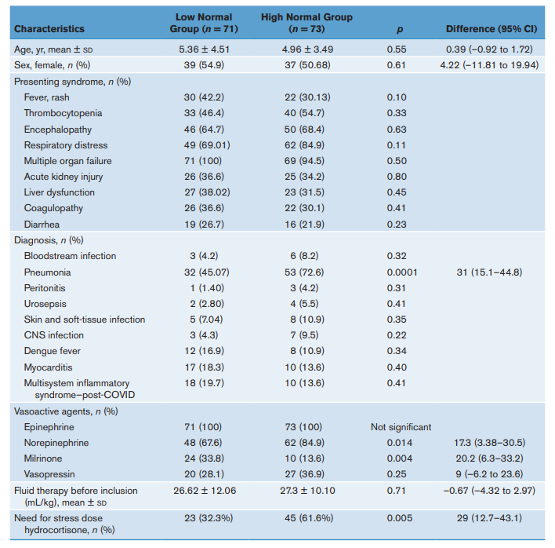
Baseline

Slide 9
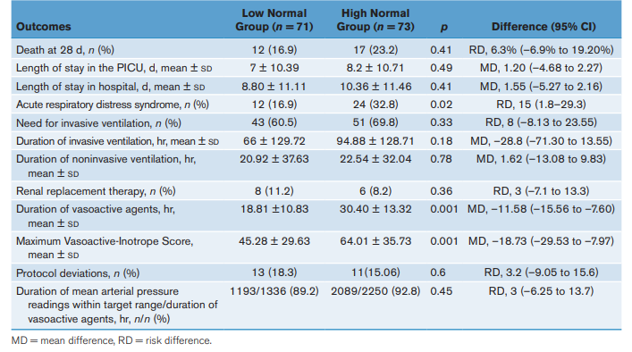
Uitkomst

Slide 10
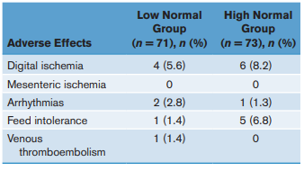
Adverse events

Slide 11
Discussie
Relevante onderzoeksvraag
Pragmatische aanpak, reflectie van klinische praktijk
Domein: andere studie populatie?
Determinant: protocol afwijkingen (vaker bij p5), veel andere factoren die beslissing beïnvloeden
Uitkomst: 1-1 testen, geen model, geen correctie voor bias van andere factoren die van invloed zijn
Wat nu? Trial UK 18 PICU’s onderweg

