Slide 1
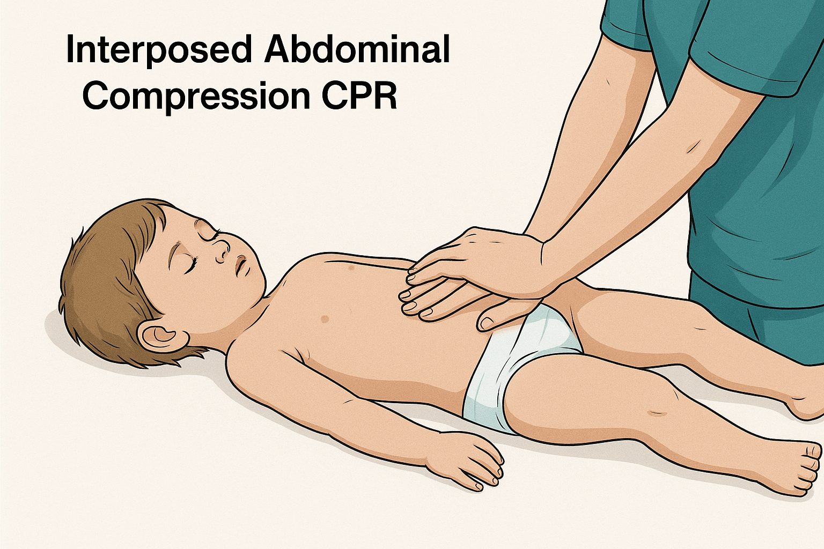
Interposed Abdominal CPR

Slide 2
Emma
Notes:
Emma’s four year old.
Her parents describe her as open, sweet, exciting, cheerfull and a fighter
She goes to school, plays with her friends, she’s loves to play dress up and here favorite food are pancakes.
She’s iving in a small town, in a nice house. Just a normal girl except for one thing…
I was there when she was born, and I was there when we resuscitated here for 30 minutes and she died.
I will come to the resuscitation part later, but first let’s go back to the birht of Emma.

Slide 3
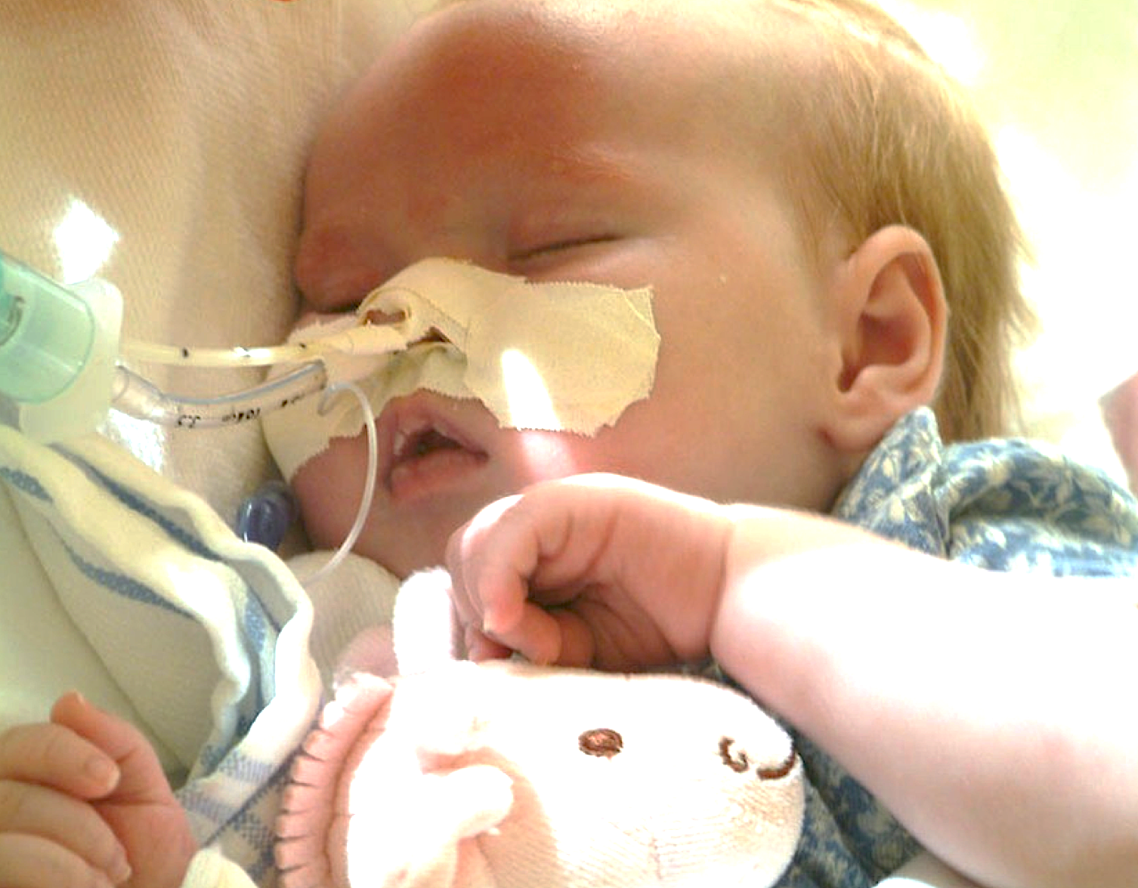
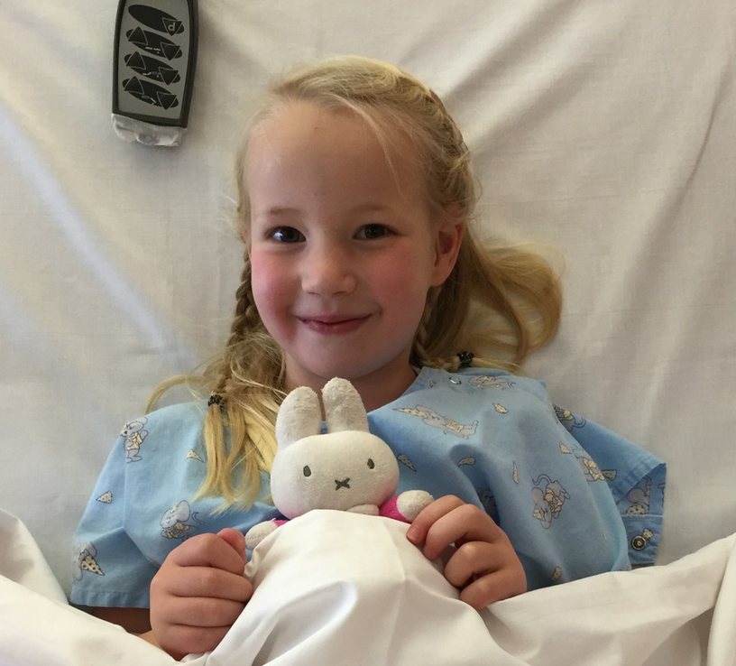
Emma
Notes:
Here she is. Emma was born with a congenital heart defect called: Hypplastich Left Heart Syndrome.
It’s a rare congenital defect, 5 in 10.000 births. → underestimated?? Terminating pregnancy?? Spontanious abortion?? Etc.
((In the netherlands every pregnant female is offered a structured ultrasound examination at 20 week gestation age. If a Hypoplastic left heart is diagnosed, you are counseld by a pediatric cardiologist and have a legal option terminating the pregnancy… ))
Emma’s parents decided otherwise, every life is precious and has enormous value to them.

Slide 4
HLHS
Notes:
So Hypoplastic left heart syndrome, you are practicly born with one functional ventricle. Here you see the much too small LV, an underdeveloped acending aorta, and a wide open ducturs arteriosus.
There’s an Atrial septum defect, because blood should be able to flow from the LA tot the RA in order to get oxygenated blood in the aorto (thruw the ductus).
The fysiology and treatment is really fascinating an challenging, even for pediatric cardiac surgeons and perdiatric cardiologist.

Slide 5
Norwood
Glenn
Fontan
Notes:
A three staged repair is done, first the Norwood:
Shunt, as like a neo ductus that is not going to close without prostin, and a unubstructed atrial septum defect
The main pulmonary artery and the aorta are connected and the main pulmonary artery is cut off from the two branching pulmonary arteries that direct blood to each side of the lungs. Instead, a connection called a shunt is placed between the pulmonary arteries and the aorta to supply blood to the lungs.
Glenn: the shunt is taken down (clipped) then the IVC is connected to the pulmonary artery, hereby all blood that originates from the IVC will thirst flow through the lung and then (well oxygenated)
This operation usually is performed about six months after the Norwood to divert half of the blood to the lungs when circulation through the lungs no longer needs as much pressure from the ventricle. The shunt to the pulmonary arteries is disconnected and the right pulmonary artery is connected directly to the superior vena cava, the vein that brings deoxygenated blood from the upper part of the body to the heart. This sends half of the deoxygenated blood directly to the lungs without going through the ventricle.
Fontan:
Here is the fontan circulation, you see the SVC en IVC connected too the pulmonary system, and there is ONE outflowtract out of the developed ventricle.
There is a passive flow trought the lungs
Flow and pressure is everyting, trans pulmonary pressure should be low, otherwise blood is nog able too flow back to the atrium.

Slide 6
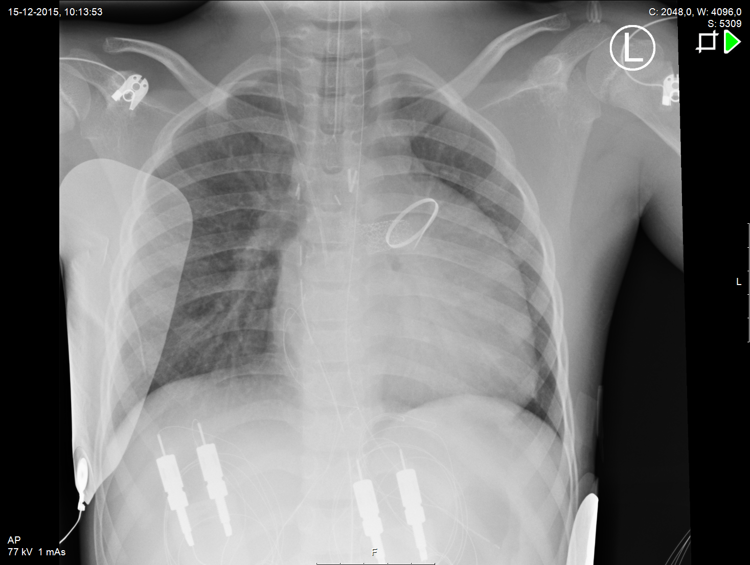

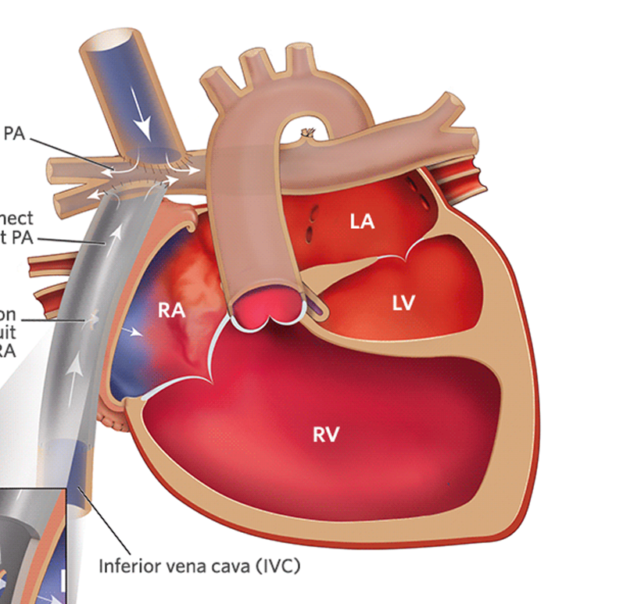


Notes:
Here you see bloofflow in a fontan patiënt. This is a actual ches X-ray from Emma.
Oxygenated blood is pumped out of the developed ventricle in the (neo) aorta. All blood from the VCI en VCS flows back, passive trought the lungs to the mono atrium. And then the cycle repeats its sellf.
For the fontan to work you need a LOW trans pulmonary pressure. When the intrathoracale pressure is too high blood will have trouble flowing back too the heart. AV valve disfunction…..
There a two main driving factors:
Breathing creeets a negative pressure wich helps blood flow back in to the heart.
The relaxation part (after contraction) creats a sucting like function, witch succs blood to the heart.
CIRCULATION:
decreased ventricular preload and increased afterload
Three resistence beds: vascular, cavopulmonary connection, pulmonary vascular bed
VENTILATION
1/3 of pulmonary blood flow is respartory dependent
Geen pulsus paradoxis
PEEP High, CO LOW
PULMONARY CIRCULATION
PVR = single most important factor influencing CO (pre-load!!) blood has to flow thruw the lungs…

Slide 7
https://www.youtube.com/watch?v=cd3Gxu7Maqk

Slide 8
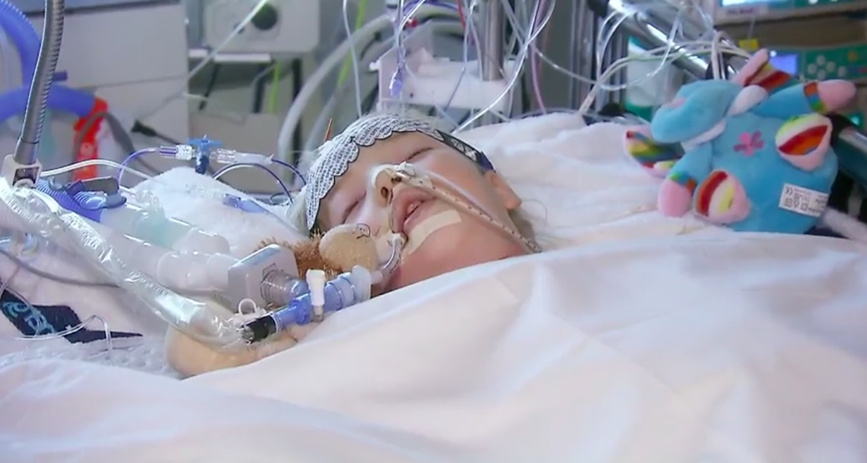
Evidence
Notes:
One year ago, someone at SMACCDUB (who is going to talk too you very shortly) asked us in a wonderfull presentation to reflect on::: WHAT DO YOU FEAR?? When he asked me that, I was thinking about emma.:
Here’s Emma in my ICU. She’s four years old, and has a working FONTAN circulation.
She has been resuscitated because she had ventricular fibrilation. Now my shift starts and she develops an Pulsless Electrive Activity, and we start resuscitation.
Let’s go to the available evidence:
There is little evidence about resusciation a fontan patiënt. Everything is expert opinion in my opinion. But one thing comes back over and over again, and the recent years there has been some publications about this in patients with no cardiac patients. Is adding abdominal compressions to CPR, or using abdominal only compressions during CPR.

Slide 9
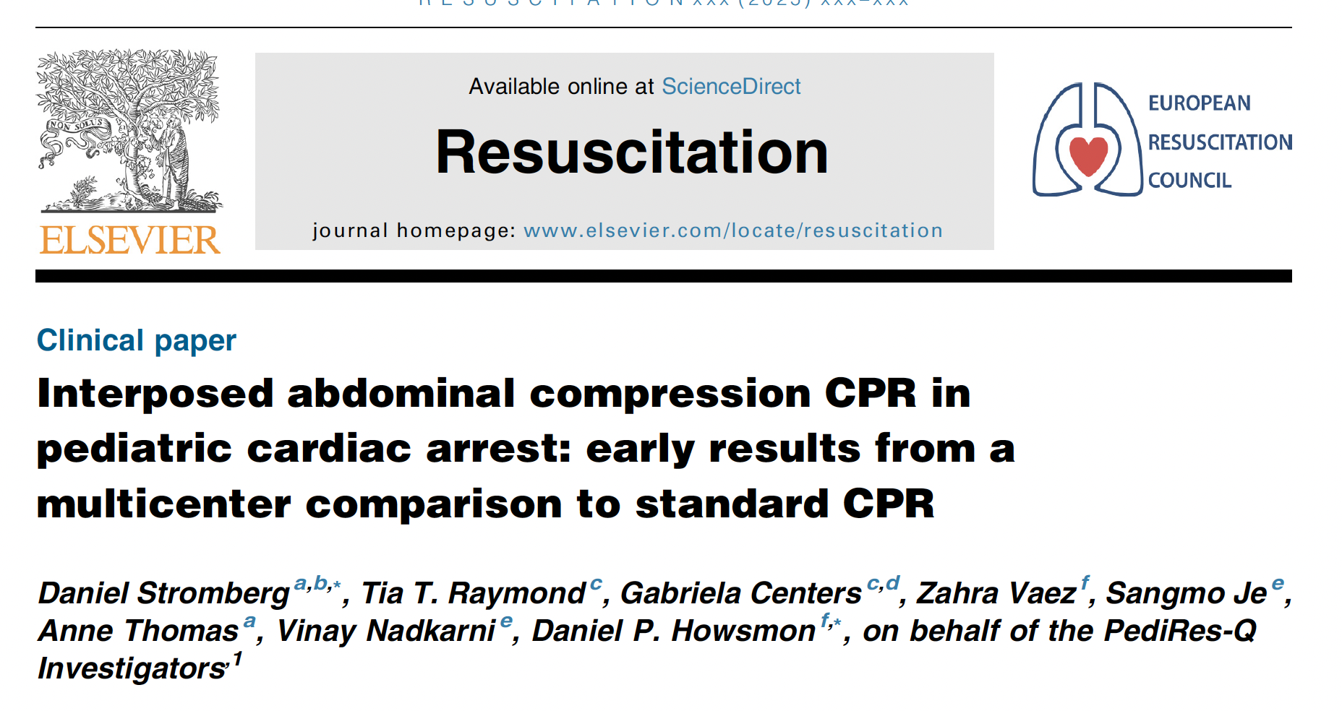

Slide 10
Methode
Design: Multicenter prospectieve kwaliteitsstudie (PediRes-Q, 2020–2024).
Populatie: 17 kinderen (<1 jaar, 14/17 single ventricle, vaak postoperatief).
Interventie:
  Eerst 1–2 min standaard CPR (S-CPR).
  Daarna 1–2 min IAC-CPR (zelfde patiënt → eigen controle).
  IAC-CPR = borstcompressie + abdominale compressie tijdens recoil-fase.
Uitkomstmaten:
  Primair: diastolische bloeddruk (DBP).
  Secundair: systolische bloeddruk (SBP), ROSC, ECMO, overleving, neurologische uitkomst.

Slide 11
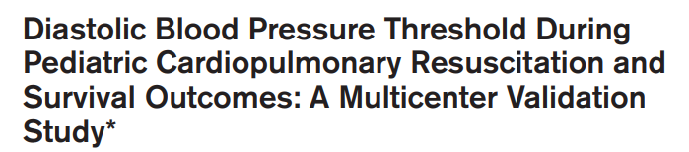
Diastole?? (Journal Club Walker 2025)

Slide 12
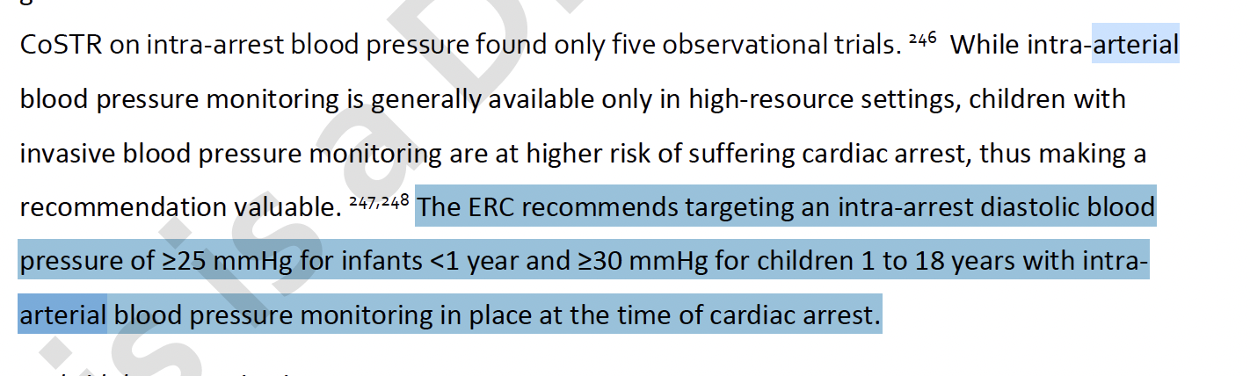
Diastole?? (ERC 2025 guideline)

Slide 13
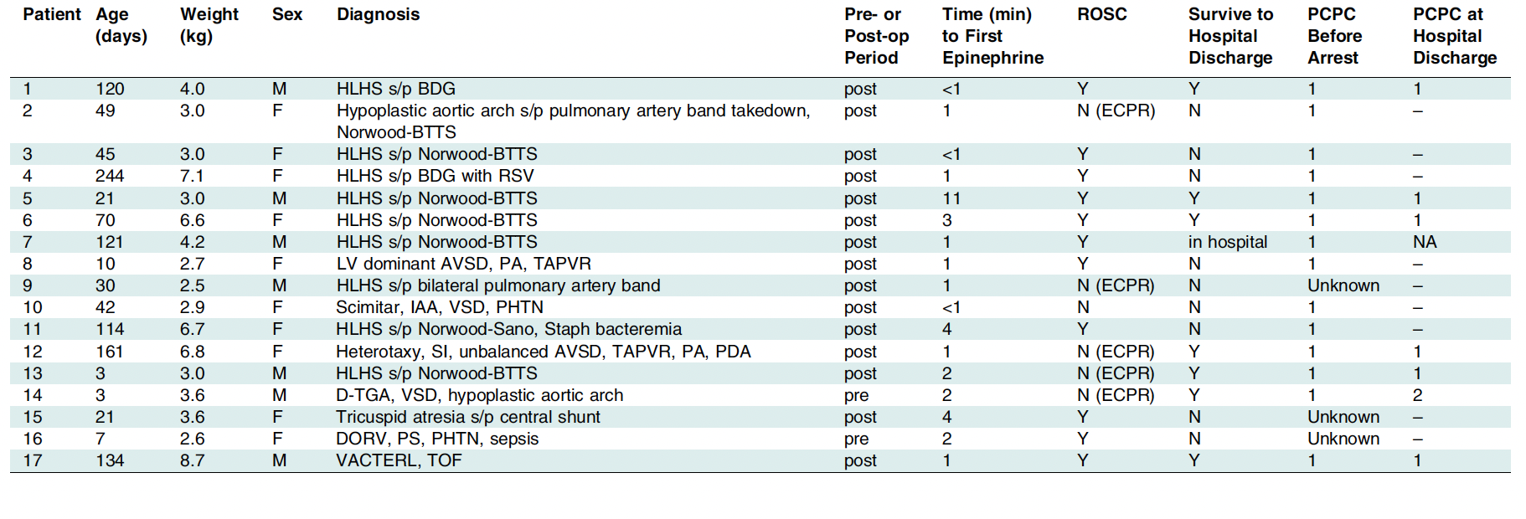

Slide 14
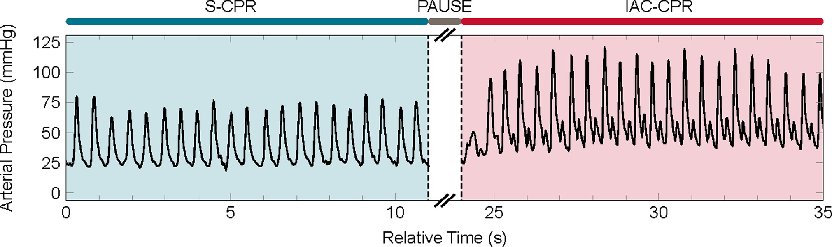

Slide 15
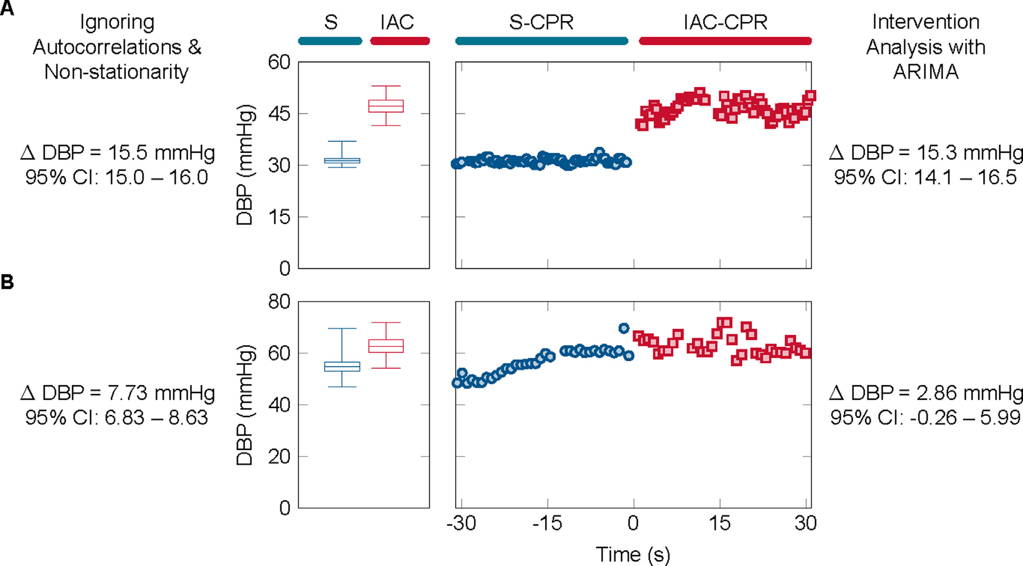

Slide 16
Results
IAC-CPR can increase DBP signifi-cantly (11.6 mmHg, 95% CI [2.2 – 21.1], p = 0.018)
16 out of 17 teams continu IAC-CPR after study period…

Slide 17
Implementeren in ons rea protocol?

Slide 18

Notes:
Obduction showed a very large ventricular infacrtion.
When she was born, 4 years seemed impossible long. Now it’s unbelievable short…

