Slide 1
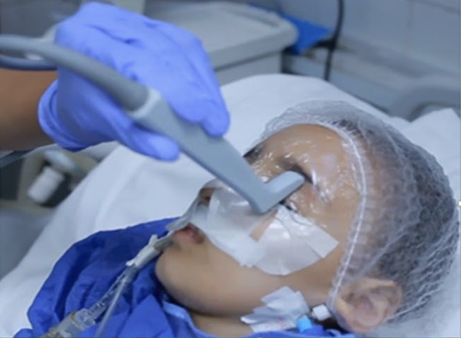
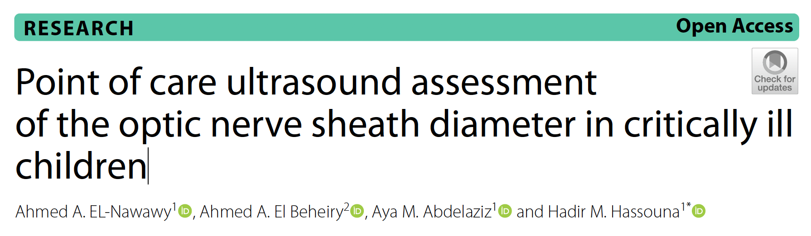
Journalclub Oktober 2025

Slide 2
Background
↑ ICP associated with poor clinical outcome & death
Underlying problem directs appropriate actions
Lowering ICP crucial
Invasive ICP measuring ‘gold standard’, but…

Slide 3
Background
Challenges/risks invasive ICP-monitoring:
Neurosurgeon
Bleeding/infection
CT/MRI ‘hassle’ → non-invasive, reproducible & simple bedside technique very welcome

Slide 4
Background
Optic nerve sheath diameter (ONSD) ultrasonography:
identifies ↑ ICP prior to development papilledema (after several hours)
Optic nerve sheet derived from 3 layers of meninges
Pressure change intra-orbital subarachnoid = intracranial subarachnoid space

Slide 5
Background
Optic nerve sheath diameter (ONSD) ultrasonography:
↑ ICP → expansion and thickening optic nerve sheath
Cutoff points adults established
Children?

Slide 6
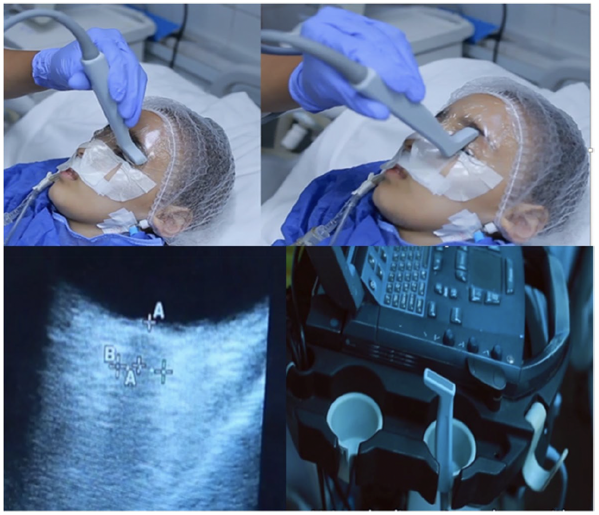
Methods
Notes:
The patients were placed supine, with a centralized head, and the upper body was elevated at a 30° angle. A small coating of gel was applied to both eyelids of closed eyes covered with an adhesive transparent strip. Care was taken to avoid air entrapment between the film and
external eyelids, as this would degrade the image quality. Using B mode, the linear transducer was placed on the eyelid and gently pressed on the eyeball. By moving the probe over the closed upper lid, two measurements were taken for each optic nerve in the vertical and transverse planes.

Slide 7
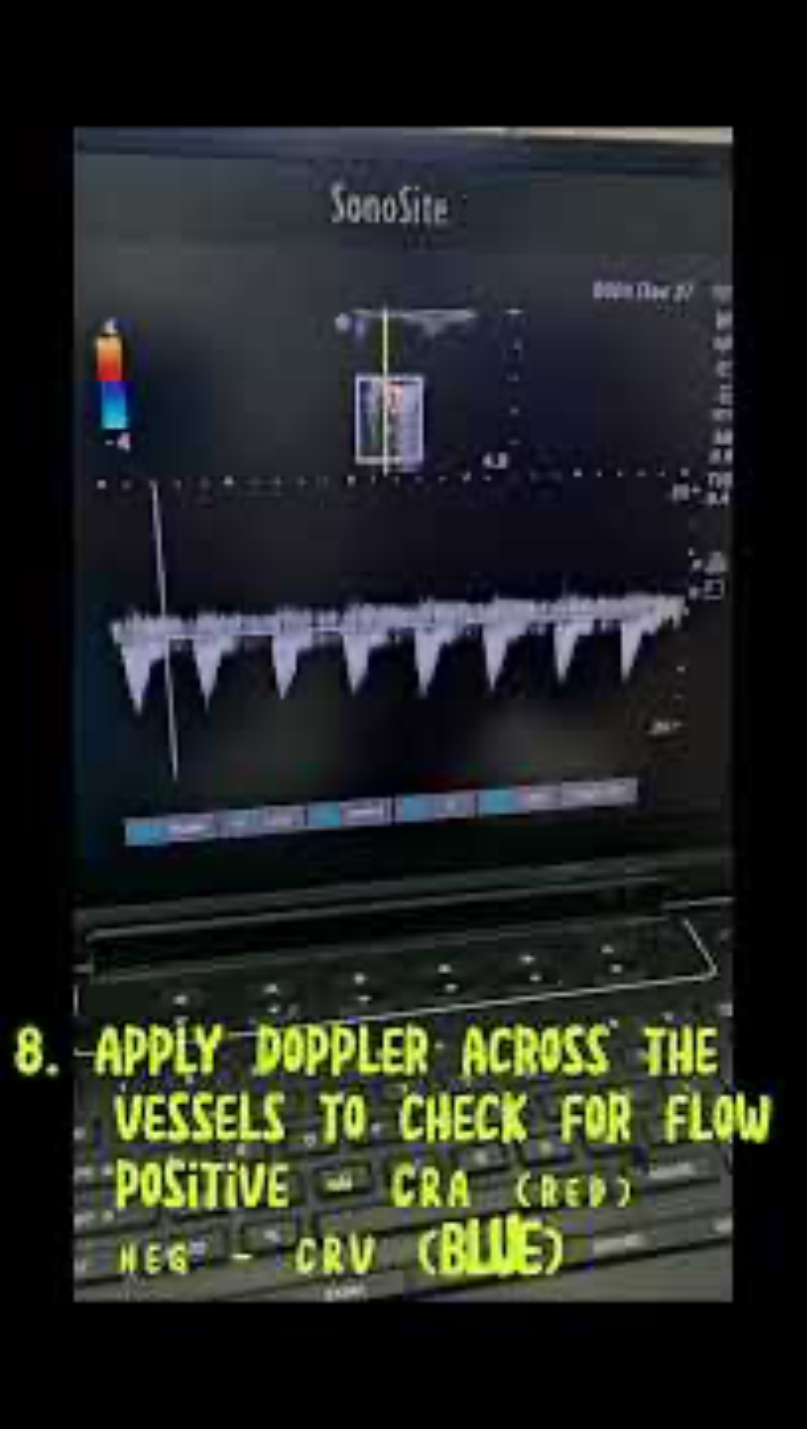
Methods
Notes:
Add video of ONSD

Slide 8
Research question
Evaluate efficacy of optic nerve sheath diameter (ONSD) as a point-of-care testing in PICUs for early diagnosis of raised ICP and as a follow up tool for treatment response

Slide 9
Methods
Prospective observational study
Single center (tertiary PICU), nov 22 – aug 23, Alexandria, Egypte
Inclusion: children > 1 mo – 12 yr with GCS ≤ 8, non-trauma
Exclusion retrobulbar rupture/bleeding, open trauma, peri-orbital wounds, intra-observer variability ≥ 0,3 mm

Slide 10
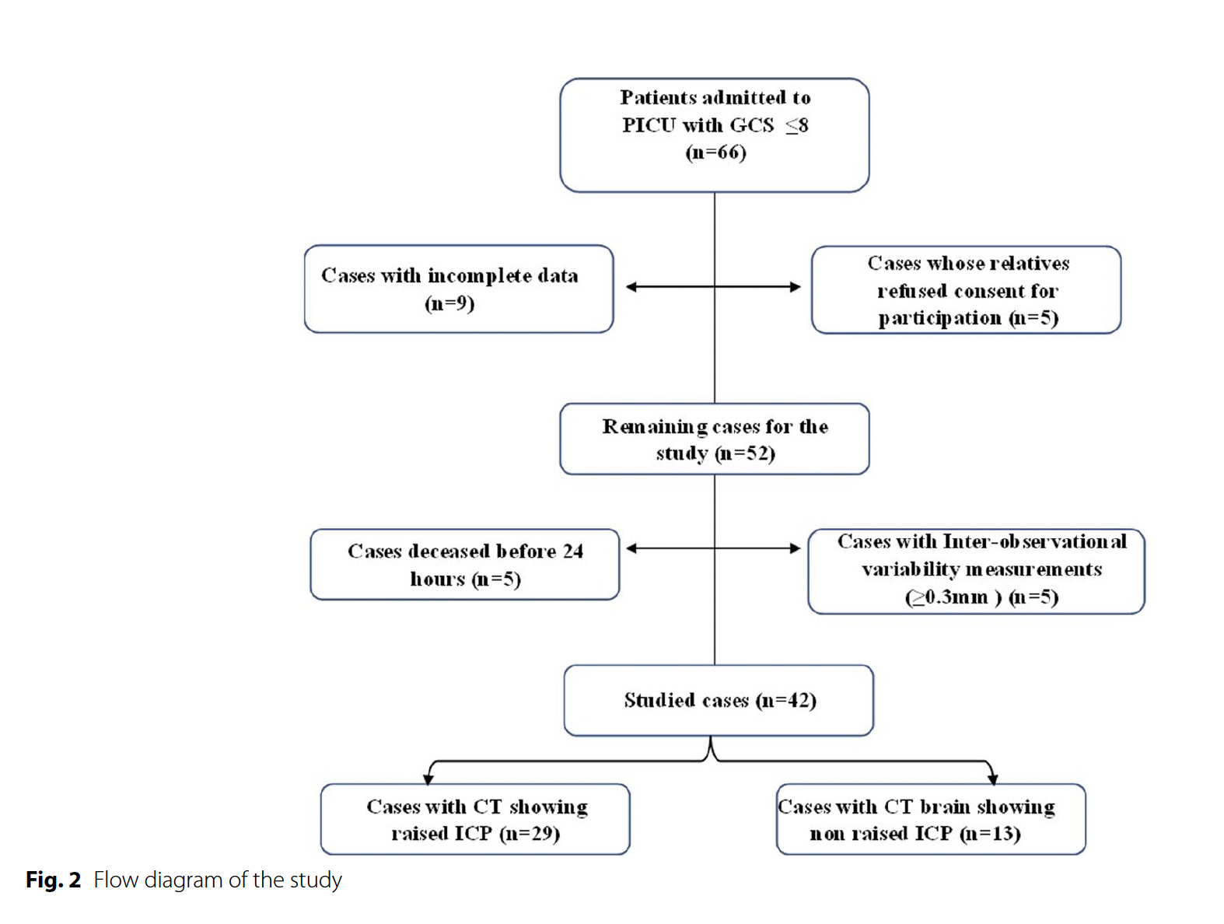
Methods

Slide 11
Methods
Control CT before/within few hours of admission to identify ↑ ICP (radiologist blinded)
↑ ICP: presence of effacement of ventricles, basal cisterns, other CSF spaces, brain herniation, midline shift and loss of grey-white matter differentiation

Slide 12
Methods
ONSD measurements:
2 independent, trained, examiners blinded to clinical details
Value = average both measurements (intra-observer variability ≥ 0,3 mm)
L&R right eyes on admission and after 1, 12, 24 hrs

Slide 13
Methods
Control measurements:
Funduscopic examination for papilledema or retinal changes on admission, and after 1, 12, 24 hrs
PICU physicians were trained by senior ophthalmologist

Slide 14
Methods
Statistics
‘Expert’ statistician → Chat vindt wat anders ;-)
SPSS
Notes:
Because each patient contributes multiple eyes and repeated time points, the current approach (multiple Mann–Whitney and Friedman tests) violates independence assumptions. Analyses treat each eye and each time point as independent. This is incorrect given repeated measures within subjects.
The current non-parametric, slice-by-slice approach is serviceable but sub-optimal for a small, hierarchical, repeated-measures diagnostic study. A mixed-effects framework for longitudinal ONSD and a model-based, validated ROC analysis (with age/AF adjustment and bootstrap internal validation) would yield more efficient, interpretable, and robust results, reduce multiple-testing issues, and directly address the clinical questions posed. A more appropriate, model-based analysis would refine—not overturn—the main message if the original signal is genuine: ONSD likely retains discriminative value for raised ICP. Expect slightly lower (but more credible) AUC, revised cut-offs with proper CIs, and clearer statements about uncertainty, reliability, and longitudinal patterns. Any changes would strengthen the study’s credibility and generalizability, even if some individual p-values lose significance.

Slide 15
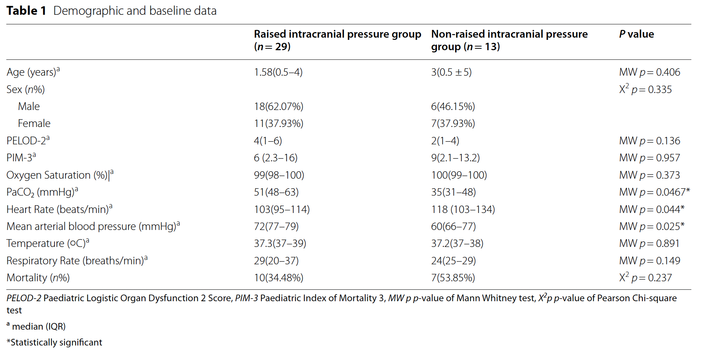
Results
v

Slide 16
Methods
Underlying problems 29 patients with ↑ ICP:
12/29 (41.37%) CNS infections
8/29 (27.68%) status epilepticus
1/29 (3.44%) aplastic anemia
6/29 (20.68%) septic shock
2/29 (6.89%) inborn error of metabolism or hypernatremic dehydration
Notes:
Check statistics using ChatGPT

Slide 17
Methods
Underlying problems 13 children = ICP
3/13 (23.07%) CNS infections
2/13 (15.48%) status epilepticus
8/13(61.53%) septic shock
Notes:
Check statistics using ChatGPT

Slide 18
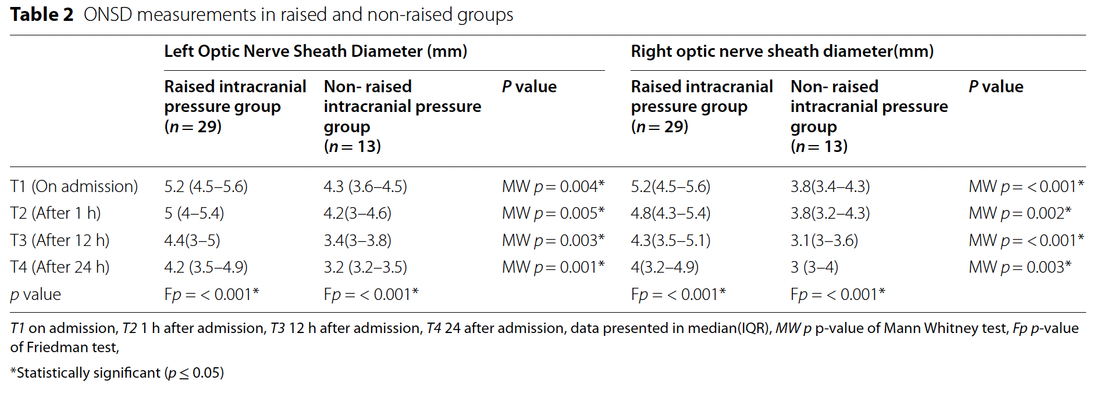
Results
v
v

Slide 19
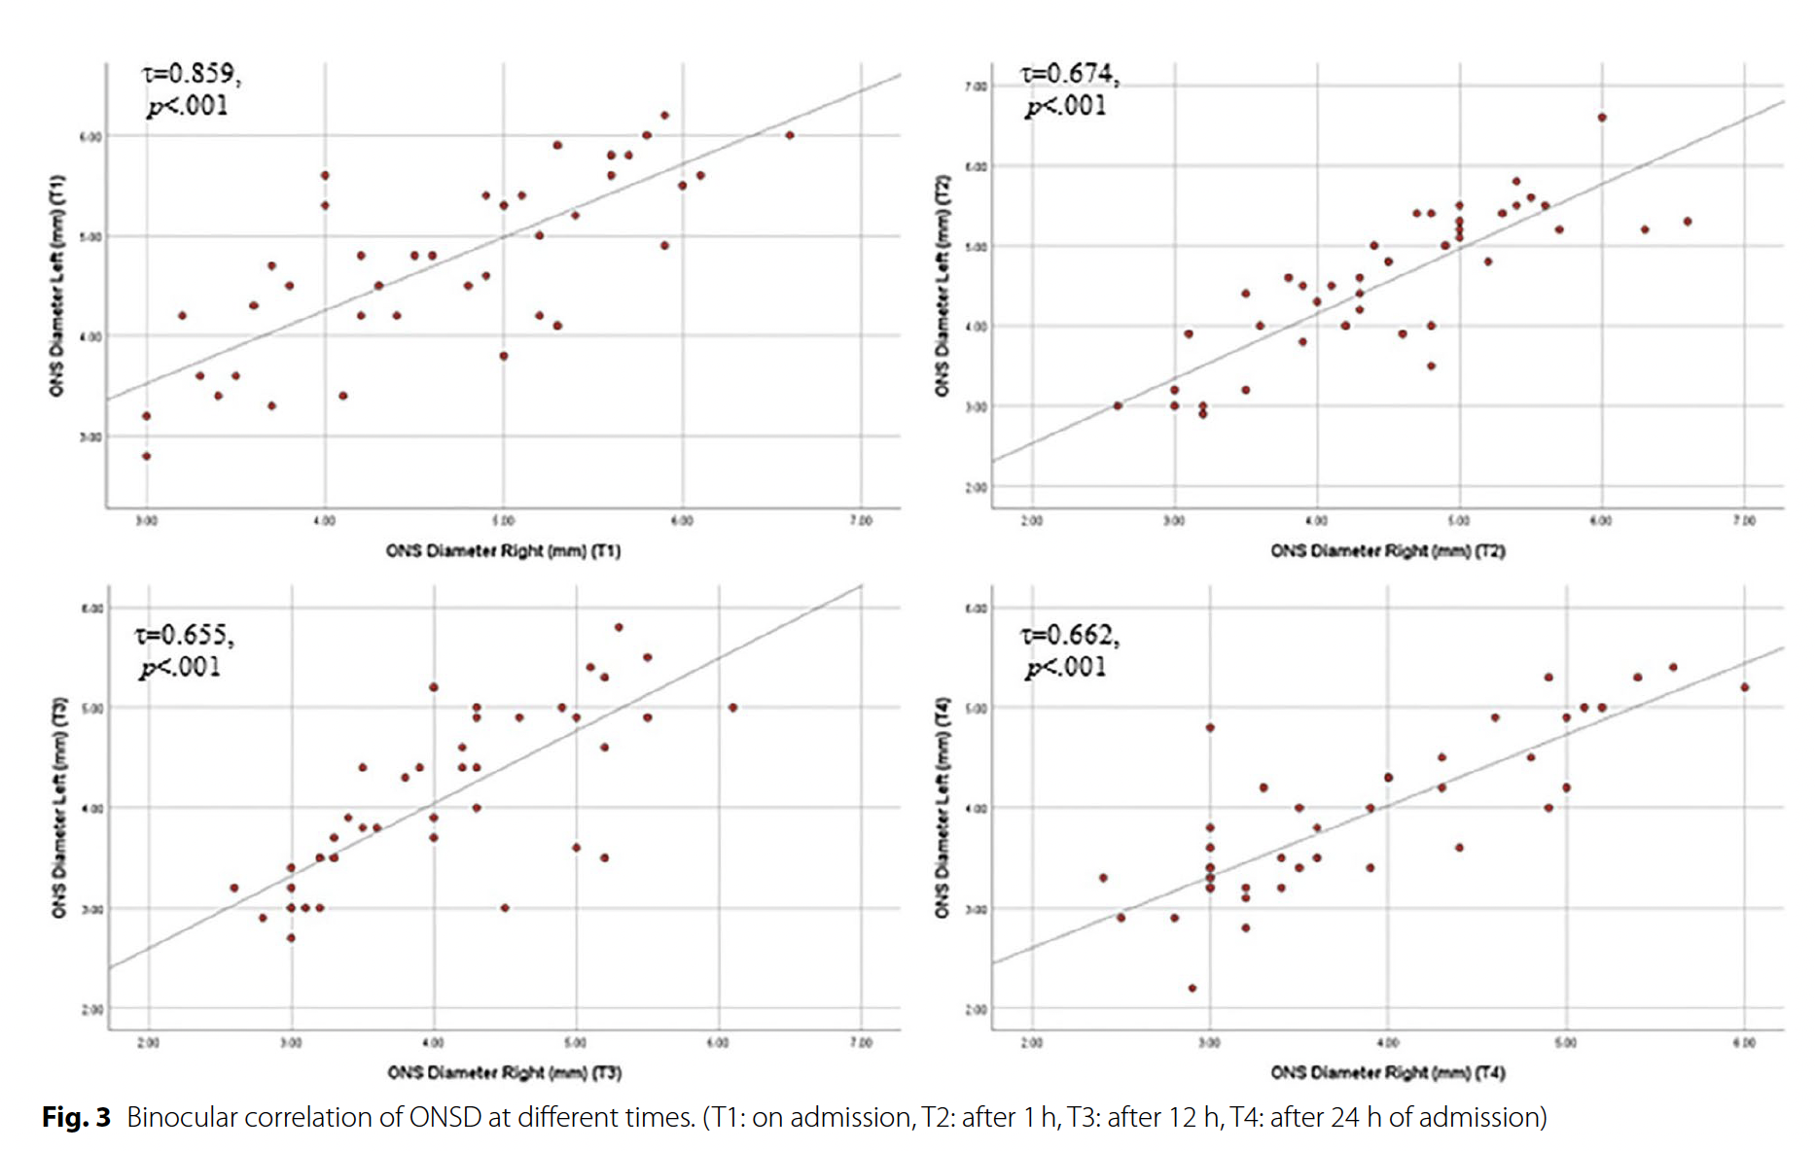
Results

Slide 20
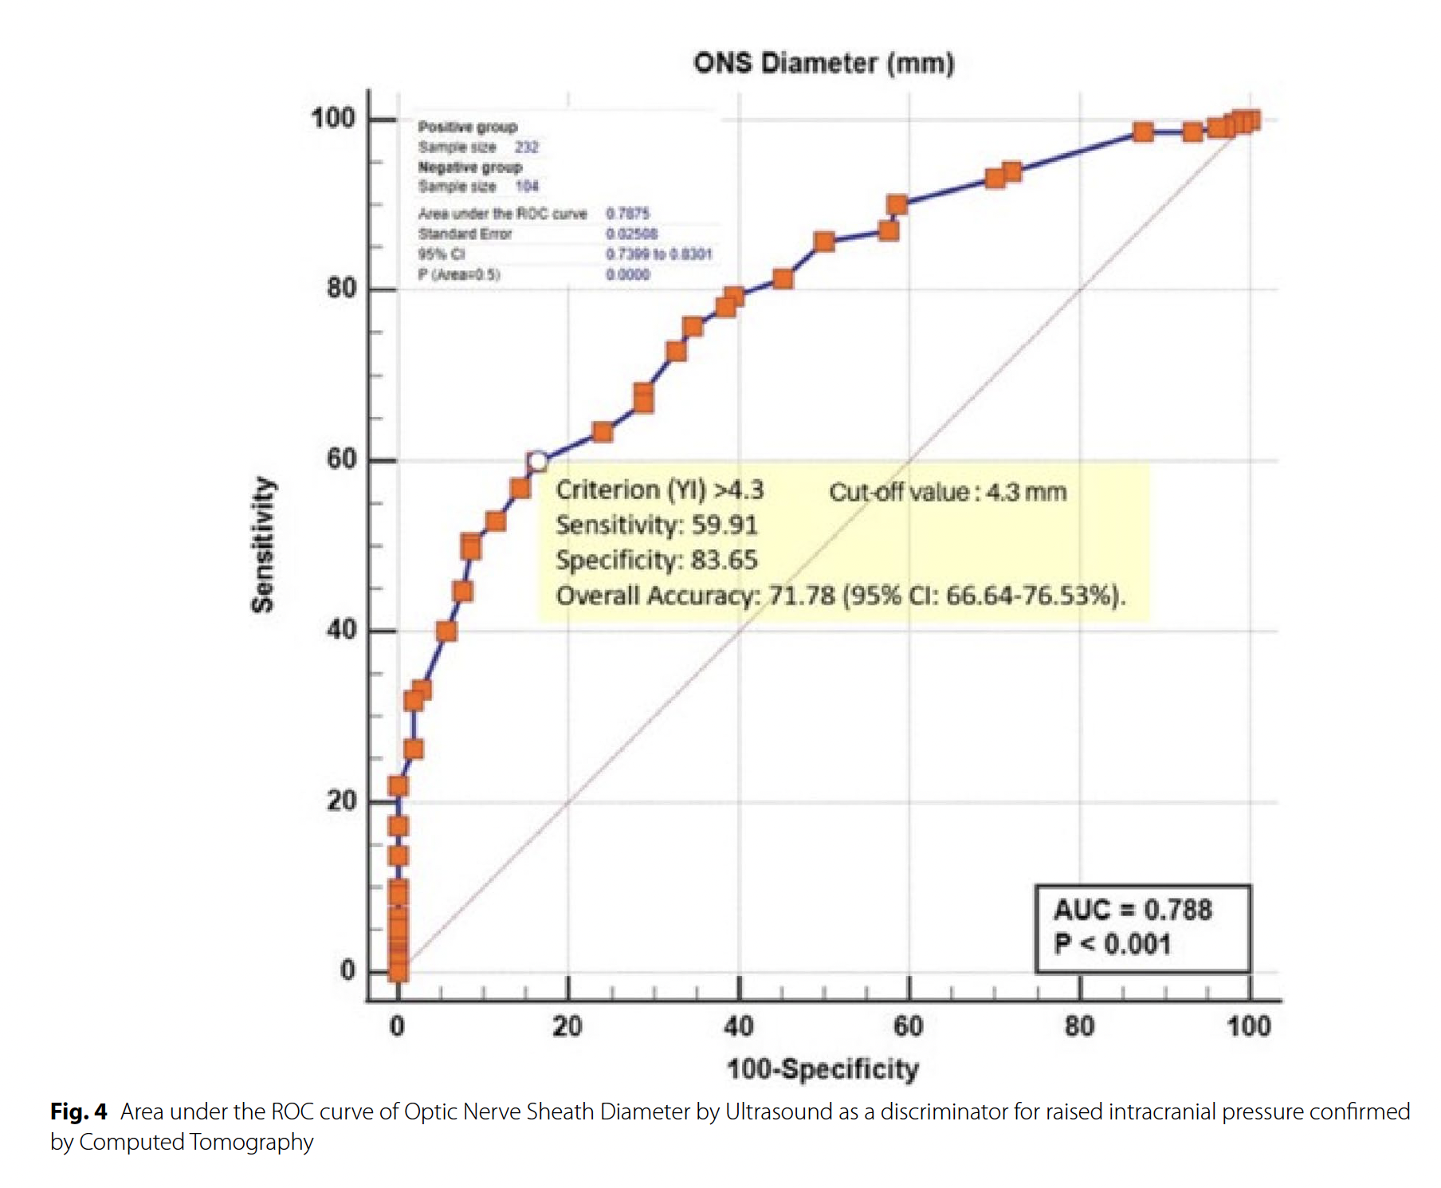
Results

Slide 21
Results
Cutoff value ≥ 4.3 mm = acceptable discriminator (74.13% TP & 65.38% TN)
AUC = 0.788 (95% CI 0.740- 0.830) (p < 0.0001)
Sensitivity of 59.91% (95% CI: 53.30–66.27), specificity of 83.65% (95% CI: 75.12–90.18).
ONSD <4.3 mm, probability of high ICP → 69% to 47%

Slide 22
Discussion
Multiple cutoff points for adults
ONSD significantly ↑ in closed AF group → potential differences related to cranial anatomy?
Follow up: ↓ in ICP
absence of CT findings does not rule out ↑ ICP

Slide 23
Limitations
Single center
Small sample size (power analysis?)
Non-traumatic population
No invasive ICP control

Slide 24
Conclusion
In non-traumatic causes POCUS ONSD = good diagnostic test accuracy for early diagnosis and follow up tool of ↑ ICP
Correctly identifies non-raised ICP & prevents unnecessary interventions

Slide 25
Applicability
What can we learn from this study?
Is it applicable to our context?

Slide 26
Critique
Unclear primary outcome, ambiguous hypotheses, inappropriate power calculation
Misclassification bias likely (raised ICP is inferred from CT findings, not direct measurement)
Data independence issue: analyses treat each eye and each time point as independent (but is repeated measures within subjects)

Slide 27
Critique
Reject:
methodological weaknesses, particularly the invalid reference standard, lack of temporal alignment, small and non-independent dataset, and inadequate modeling

Slide 28
Needed
Diagnostic accuracy of ONSD for raised ICP (primary question): Prospective, blinded, multicentre diagnostic accuracy study (STARD-compliant) with a concurrent, independent reference standard
Monitoring value of ONSD (responsiveness to change): Prospective longitudinal cohort nested in the same setting, synchronized measurements during clinically meaningful events (e.g., hyperosmolar therapy, ventilation changes, CSF drainage).
ONSD-POCUS is a promising adjunct,
not a diagnostic yet

Slide 29
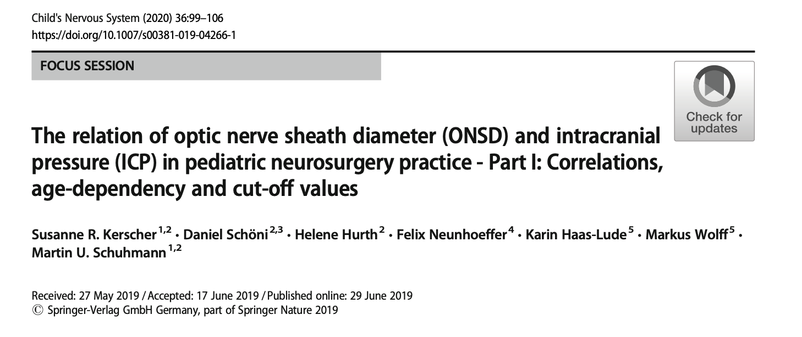
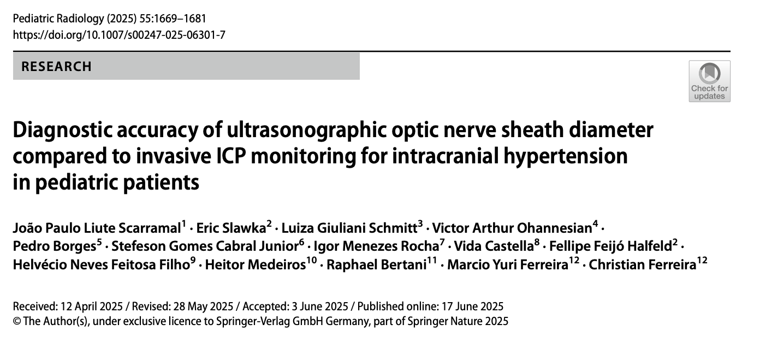
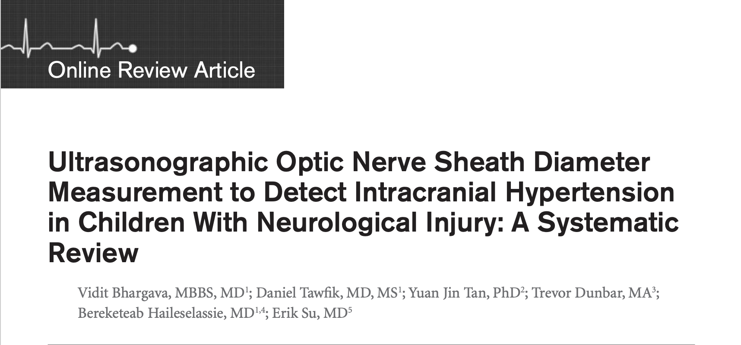
But…

