Slide 1

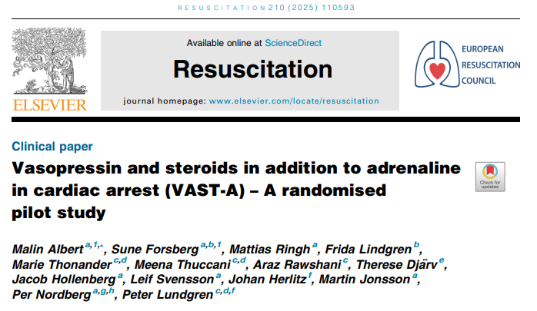
Journal Club 17-11-2025
Jennifer Walker

Slide 2
Background
Potential benefit of combining adrenaline, vasopressin and corticosteroids in IHCA → needs to be confirmed in large clinical trial.
  3 studies suggested potential role: combining vasopressin/cortico with adr in CPR
    All 3: improved return of spontaneous circulation (ROSC)
    1 study: improved 30-day survival, and survival with good neurological outcome
Pilot study: feasibility en safety (effectiveness may be time dependent) –
step-up for main study

Slide 3
Background: mechanism of action
Vasopressin, a non-adrenergic peripheral vasoconstrictor, has a longer duration of action than adrenaline and may enhance coronary and cerebral perfusion pressure during CPR.
Post-cardiac arrest shock activates a systemic inflammatory response, which corticosteroids can mitigate by reducing inflammatory response and reduce reperfusion injuries. Additionally, corticosteroids potentiate drug induced vasoconstriction, further enhancing their efficacy.

Slide 4
Materials / methods
Randomised, double blind, placebo controlled pilot study
3 Swedisch hospitals
Men ≥ 18 years, women ≥ 50 years (non-childbearing potential)
Witnessed IHCA (ADULTS), meeting criteria for adrenaline
Randomised 1:1
  Adrenaline, vasopressin, corticosteroids (intervention)
  Adrenaline & placebo (control)

Slide 5
Materials / methods
Medication: prepared by hospital pharmacies, stored in ICU fridge. Delivered to cardiac arrest by non-clinical rapid response team member
5 doses of vasopressin (20 IU), one dose of methylprednisolone (40 mg)
Administration: 1 dose after every dose of adrenaline, maximum of 5.

Slide 6
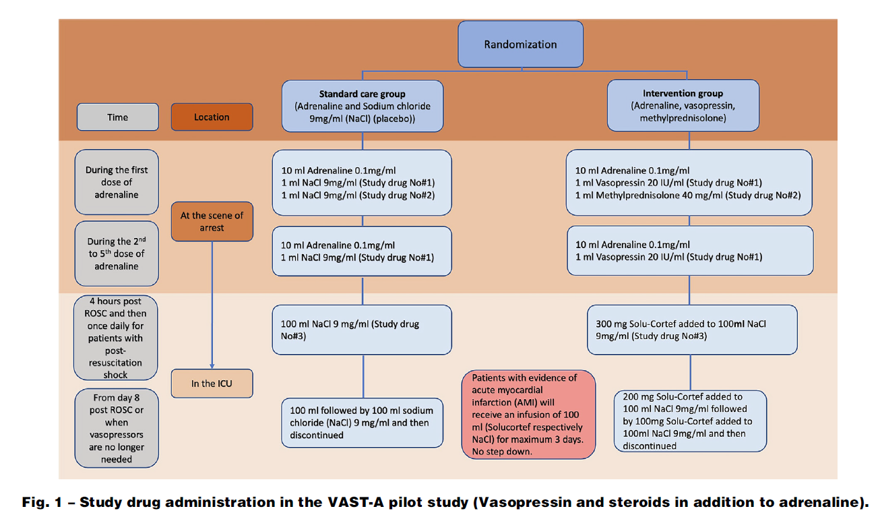

Slide 7
Materials / methods
Primary outcomes
  Feasibility: protocol adherence, event times, enrolment rate
  Safety: was adrenaline administered before study drug
Secondary outcome: ROSC (>20 min)
Notes:
Feasibility was defined as adherence to study protocol for study drug administration.

Slide 8
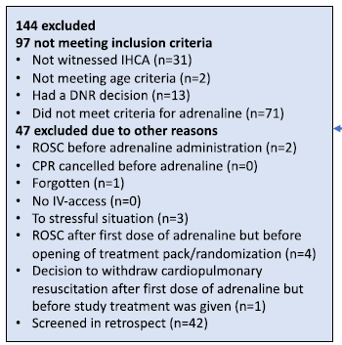
Results
183 screened IHCA: 39 patients randomised (median age 77, 64% male)
Notes:
Onduidelijk waarom ze niet aan criteria voldeden voor adrenaline?

Slide 9
Results
16 intervention, 23 control
Most cardiac arrests: general ward (44%)

Slide 10
Results Feasilibity
7 patients experienced protocol deviations:
  Vasopressin: 3 not enough study doses, 1 more dosis of study drug
  Steroids: 3 of 9 patients in ICU – not received study drug
Median time (mins)
  To adrenaline admin: 7:00 (intervention) vs 5:00 (control)
  To vasopressin / placebo admin: 10:30 vs 9:00

Slide 11
Results Safety
No patient received study drug before adrenaline administration
Predefined serious adverse events:
  2 intervention group: bleeding (transfusion), infection (antibiotics)
  1 standard care group: infection (antibiotics)

Slide 12
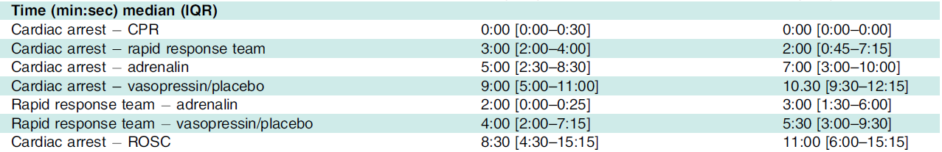
Results ROSC
Intervention group: 38% (6/16) – median time 11 min
Control group: 17% (4/23) – median time 8:30 min (p value 0,30)

Slide 13
Discussion
Feasibility: high proportion of protocol deviation, tendency for delays in adrenaline → adjustments study protocol needed.
  Placing study drug in rapid response team kit? Prepared syringes?
  On ICU: clear communication of enrolment to study y/n
Selection bias? <50% of eligible patients were enrolled.
Low numbers of included patients (statistical analysis interpreted with caution)

Slide 14
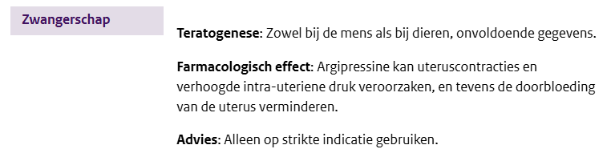
Conclusie
Nu geen conclusies te trekken uit dit onderzoek
Veel grotere groepen nodig met minder uitval om hier iets van te kunnen zeggen
Eerst studie bij volwassenen
Wat te doen bij vrouwelijke tieners / (jong) volwassenen?

