Slide 1
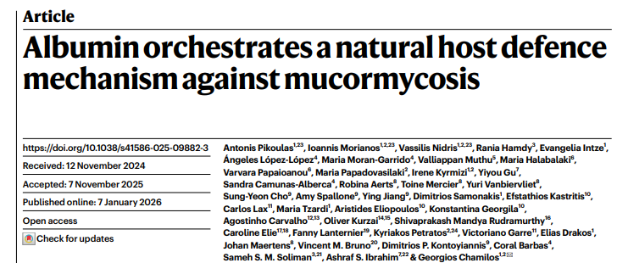

Slide 2
Background mucormycosis
Mortality >50% - 100% (disseminated)
Tissue necrosis- antifungal therapy does not reach- surgery
Riskfactor: DM, acidosis, Fe overload, malnutrition, immunodysregulation in COVID19
Role of albumin? Albumin↓↓ common in patients with immunometabolic abnormalities predisposing for mucor

Slide 3
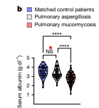
Association albumin and mucor
Tertiary cancer center USA
Adults,
Hematological malignancy,
38-85 yrs
Pulmonary mucor: sign lower albumin
at diagnosis

Slide 4
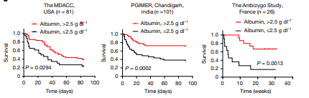
Severe hypoalbuminemia independent predictor poor outcome
Hematological malign. DM, COVID19 Heterogeneous riskfactors

Slide 5
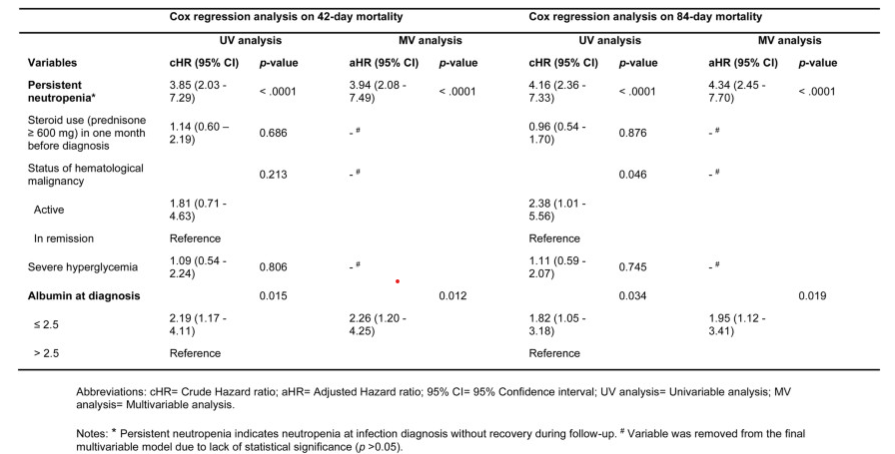
Hypoalbuminemia independent riskfactor: cohort 1

Slide 6
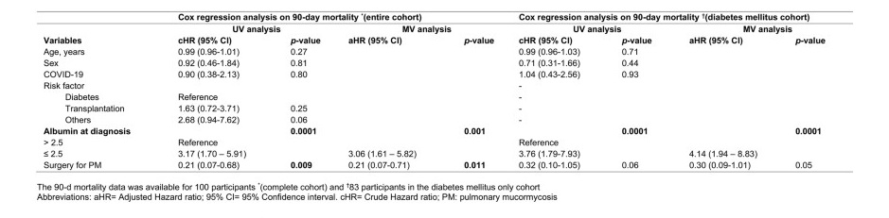
Hypoalbuminemia independent riskfactor:cohort 2

Slide 7
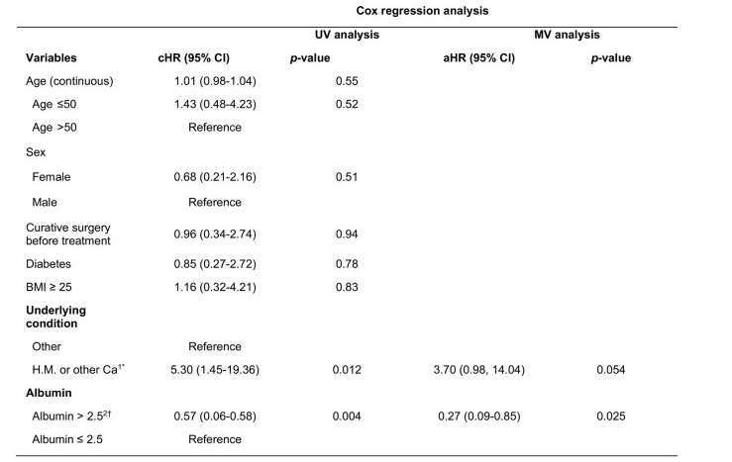
Hypoalbuminemia independent riskfactor cohort 3

Slide 8
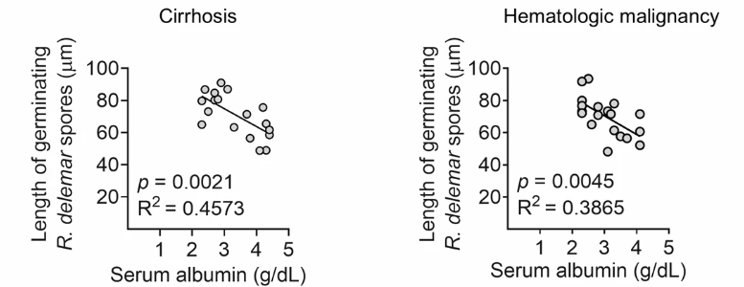
Relation serum albumin conc and length hyphae
N=18 N=20

Slide 9
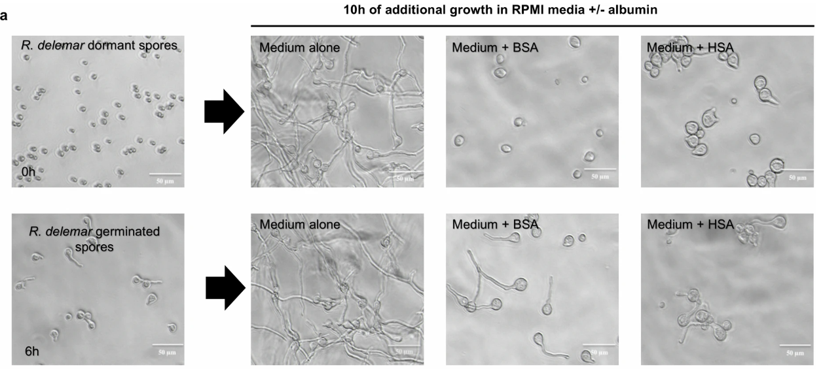
Albumin blocks hyphal growth (after initial isotropic growth(swelling of spores)

Slide 10
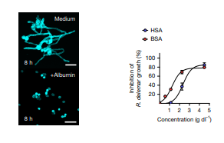
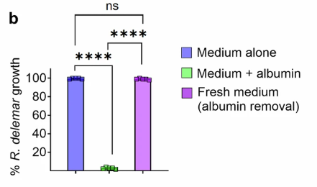
Human albumin from serum healthy people: antifungal activity

Slide 11
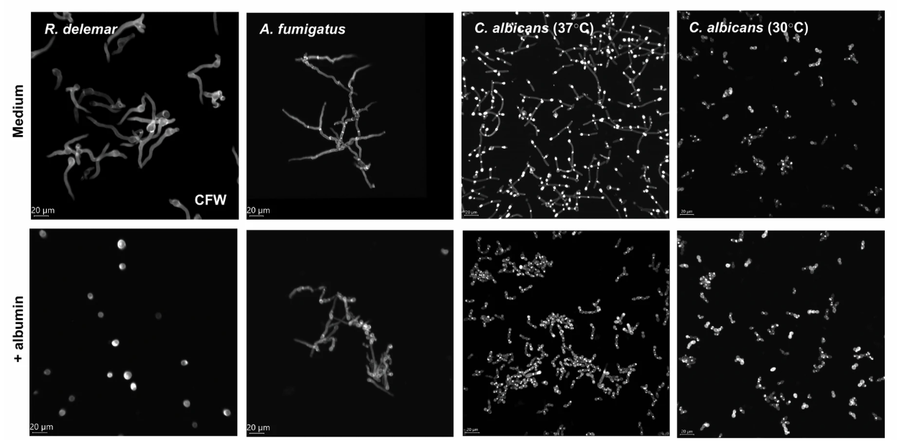

Slide 12
Hypothesis 1: depletion nutrients
Albumin binds different nutrients.
Pathophysiology: albumin → depletion nutrients → mucorales inhibition?
Culture medium+ albumine → ↓ aminoacid concentration
Suppletion of aminoacids and nutrients → no effect on inhib act albumin against R. delemar

Slide 13
Hypothesis 1: depletion nutrients
Albumin binds different nutrients.
Pathophysiology: albumin → depletion nutrients → mucorales inhibition?
Culture medium+ albumine → ↓ aminoacid concentration
Suppletion of aminoacids and nutrients → no effect on inhib act albumin against R. delemar

Slide 14
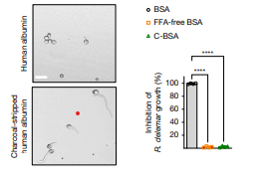
Hypothesis 2: role of FFA
Release of inhibitory molecule bound to albumin?
FFA – transport by albumin and antimicrobial activity
Charcoal removal FFA: no activity against mucor
Charcoal treated albumin +
oleic acid → dissolve FFA →
acitivity against mucor

Slide 15
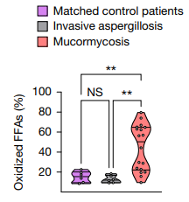
Albumin protects FFA from oxidation

Slide 16
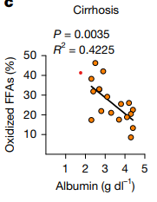
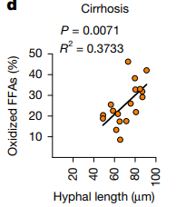
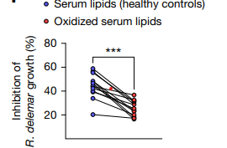
Albumin protects FFA from oxidation
Serum patients mucor: ↑ oxidized FFA
Oxidized FFA ↑ α albumin ↓ and hyphal length
Oxidation serum lipids → ↓ inhibitory properties

Slide 17
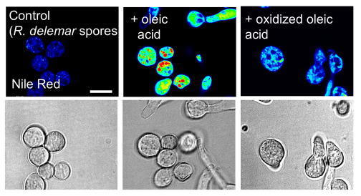
Albumin protects FFA from oxidation
R delemar spores take up OA which ↓ after OA oxidation

Slide 18
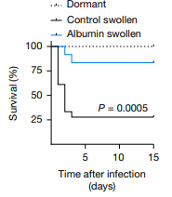
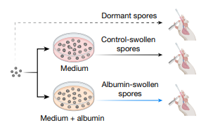
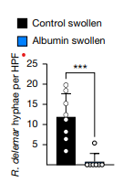
In vivo studies (mouse)
RNA sequencing studies
Albumin –bound FFAs inhibit protein synthesis to modulate pathogenicity during in vivo growth

Slide 19
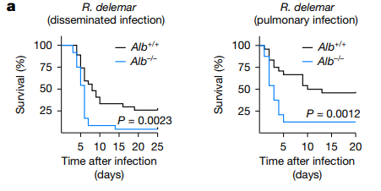
Albumin deficiency promotes mucormycosis: KO mice studies

Slide 20
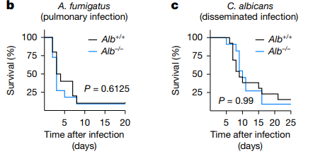
Albumin deficiency promotes mucormycosis: KO mice studies

Slide 21
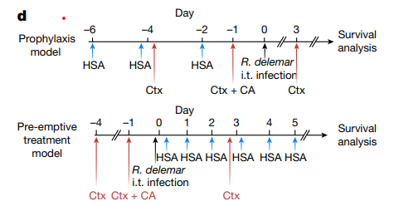
Albumin treatment or prophylaxis

Slide 22
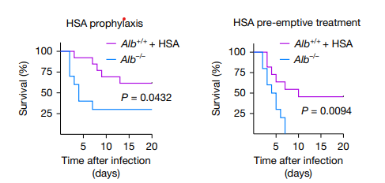
Albumin treatment or prophylaxis

Slide 23
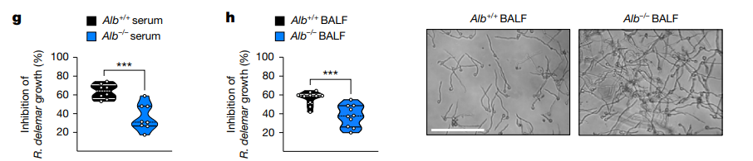
Albumin: Effect in serum and BALF

Slide 24
Conclusie
Metabolic abnormalities that lead to severe hypoalbuminemia→ mucormycosis
Chemical modification that ↓ albumin binding to FFA → ↑FFA oxidation → ↓ antifungal activity

Slide 25


Belang voor PICU
Van belang voor PICU
Implementeren?
Colloquium met experts?

Slide 26
