Slide 1


Journal club PICU
RESEARCH REPORT
Full Access
Comparing Cardiac Output Differences in Patients With Fontan Physiology
Between High and Low Tidal Volume Strategies: A Randomized, Crossover Trial
P. S. Adams, L. M. Stollings, S. Bains, B. Blasiole, K. N. Nguyen, A. S. Phadke, P. M. Callahan, S. M. Trucco, J. Kreutzer, B. H. Goldstein
First published: 24 November 2025
Diana A. Papazova
23 februari 2026

Slide 2
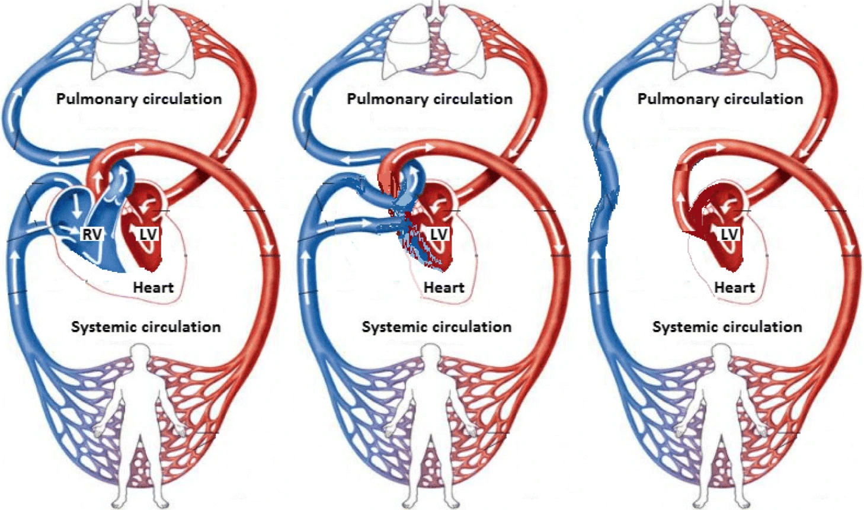
Normal heart circulation vs. Fontan circulation
Chugunova, M., Doyle, M., Keener, J. et al. Use of mathematical modeling to study pressure regimes in normal and Fontan blood flow circulations. Mathematics-in-Industry Case Studies 10, 1 (2019). https://doi.org/10.1186/s40929-019-0019-9

Slide 3
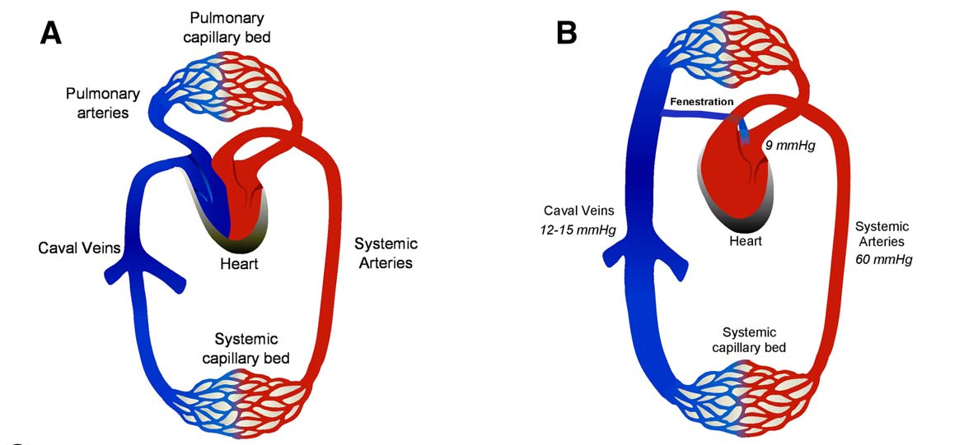
Veldtman, Gruschen R., Alexander R. Opotowsky, Samuel G. Wittekind, Jack Rychik, Daniel J. Penny, Mark A. Fogel, Bradley Scott Marino and Marc Gewillig. “Cardiovascular adaptation to the Fontan circulation.”
Congenital Heart Disease 12 (2017): 699–710.

Slide 4
Fontan physiology: key features
No subpulmonary ventricle
Pulmonary blood flow is passive
Cardiac output depends on:
  Venous return
  Pulmonary vascular resistance (PVR)
  Negative intrathoracic pressure

Slide 5
Why Ventilation Strategy Matters
Positive pressure ventilation:
Increases intrathoracic pressure
Reduces venous return
Decreases pulmonary blood flow
Reduces cardiac output in Fontan patients

Slide 6
And the question is…
P: children with Fontan physiology
I: low tidal volume strategy
C: high tidal volume strategy
O: difference in systemic cardiac output
Secondary outcomes
Difference in pulmonary blood flow
Difference in systemic and pulmonary artery blood pressures
Difference in systemic and pulmonary vascular resistance

Slide 7
Study design
Single centre, prospective, randomized, crossover trial
Population: Patients with established Fontan circulation
Each patient served as their own control
Measurements in cath lab under general anesthesia and NMB:
Direct vascular pressures and blood gas measurements
Oxygen consumption
Low Vt protocol
tidal volumes 6 mL/kg
FiO2 21%
respiratory rate required for EtCO2 of 36–38 mmHg
PEEP 5 cm H2O
I:E ratio 1:2
High Vt protocol
tidal volumes 10 mL/kg
FiO2 21%
respiratory rate required for EtCO2 of 36–38 mmHg
PEEP 5 cmH2O
I:E ratio 1:3 (to maximize lower pressure expiratory time)

Slide 8
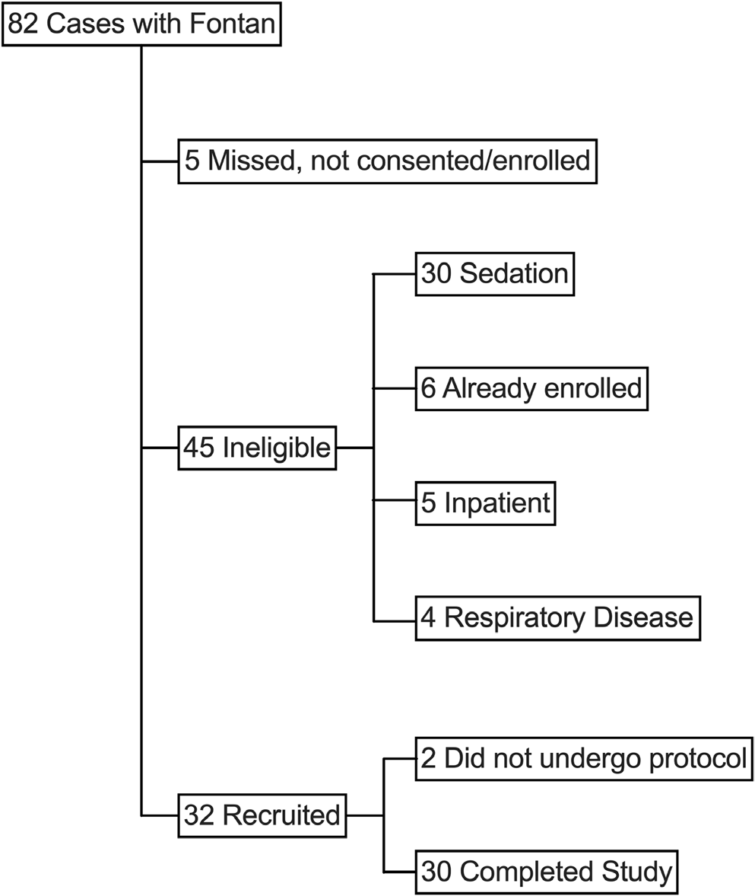

Slide 9
Inclusion criteria
Any 0-17 years old Fontan patient that were presenting as outpatients to undergo a cardiac catheterization (diagnostis or interventional) with GA
Exclusion criteria
Urgent/emergent procedure
Spontaneus vebtialtion
Pregnancy
<6 weeks postop from Fontan completion surgery
Intrinsic pulmonary disease
Fonten completion >7years of age

Slide 10
Demographics of 30 patients included
Age 10.3 (8.2-14.4)
Years after Fontan completion 7.7 (4.8-11.8)
BMI 17.2 (15.5-32.1) kg/m2
Systemic right ventricle 70% (21/30)
Normal ventricular function 70% (21/30)
Fenestrated Fontan conduit 60% (18/30)

Slide 11
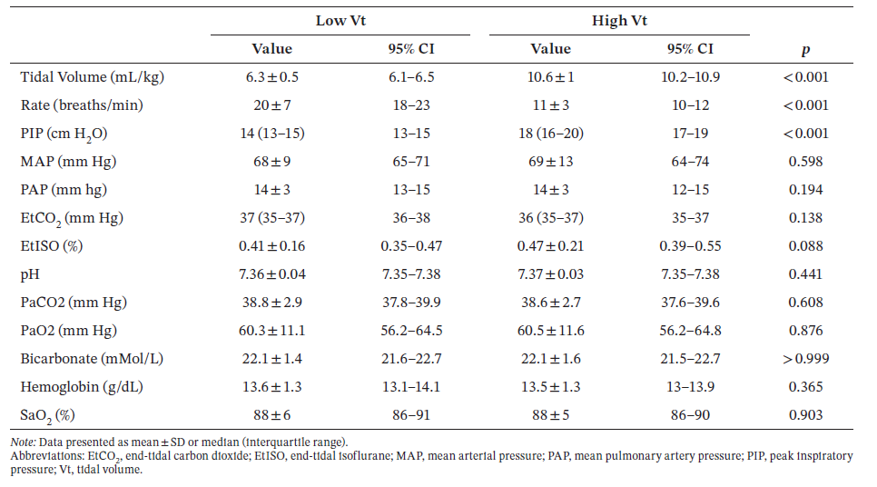
Results

Slide 12
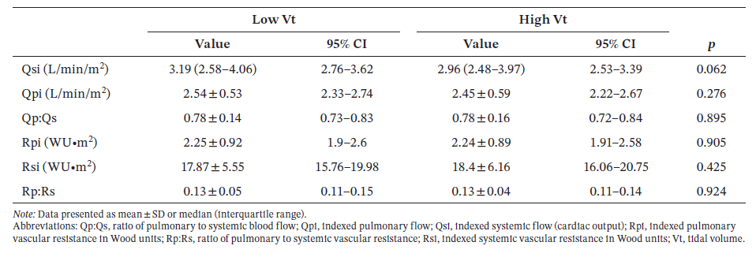
No difference was found in primary or secondary outcomes

Slide 13
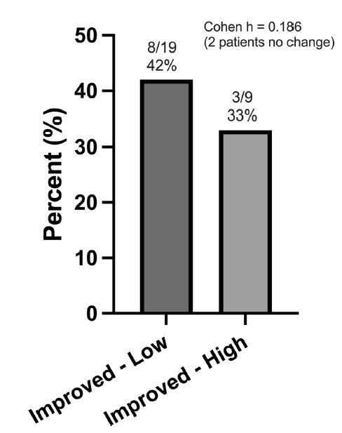
Cohen h < 0.2 -> (very) small effect
Qsi 0,7 L/min/m2:
assumed experimental significant difference in cardiac output
19/30 difference in low Vt
9/30 difference in high Vt

Slide 14
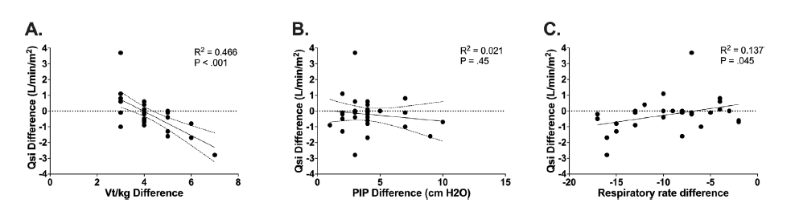

Slide 15
Thoughts
Rarely Fontan patient on a ventilator here but: important to know how to set the ventilator when needed
We have comparison between two ‘normals’ -> it is realistic to expect a difference?
Hypothesis ‘high Vt’ based on old papers (2009, 2011)
Nice example of a relatively ‘easy’ physiological study about a topic with not much evidence

Slide 16
Implicaties voor de PICU WKZ
      1. Is het resultaat van de studie relevant voor PICU WKZ?
  Nee
  2. Indien Ja:
  a. Wat zou je willen implementeren voor de PICU WKZ?
  b. Is het nodig om een colloquium in te plannen met experts om dit vorm te geven?

Slide 17
Cardiac Output= Oxygen Consumption (VO₂ ) / Arterial O₂ – Venous O₂ difference /​

