Slide 1
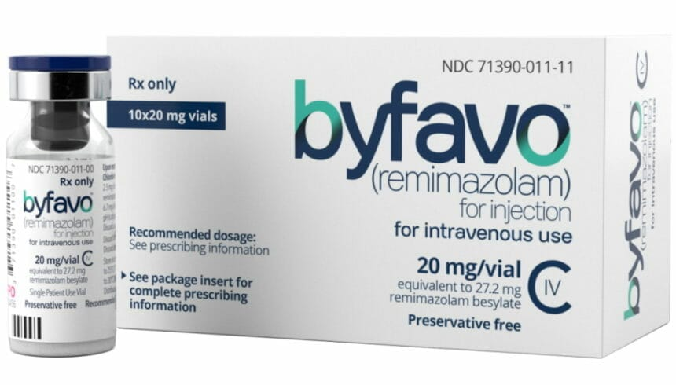
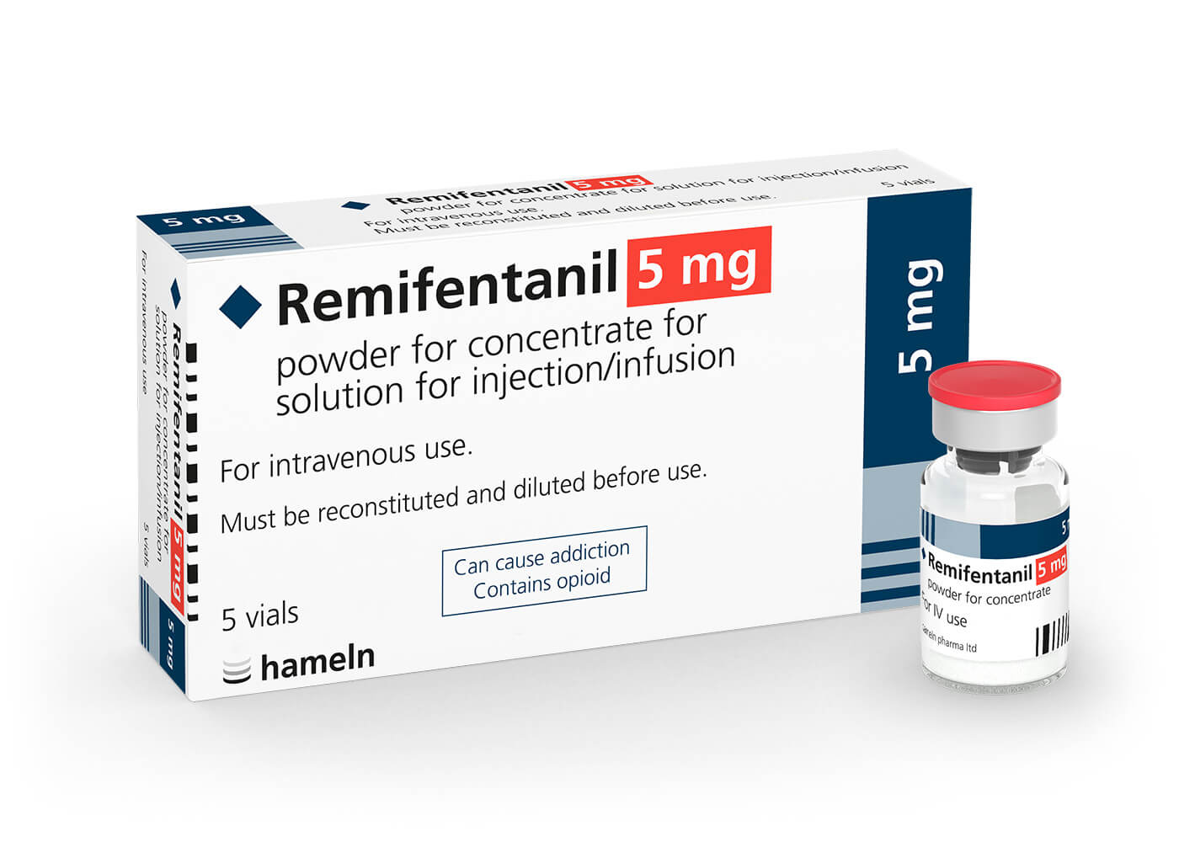
Remimazolam (Byfavo™)
PICU sedatie van de toekomst?
Kimberly van der Laan – begeleider: Valerie Slooff
Juni 2026

Slide 2

Aanleiding
Frequente neurocontroles bij langdurig invasief beademde patiënten
Moeizaam met langwerkende sedatie
Echter contra-indicatie propofol bij kinderen

Slide 3
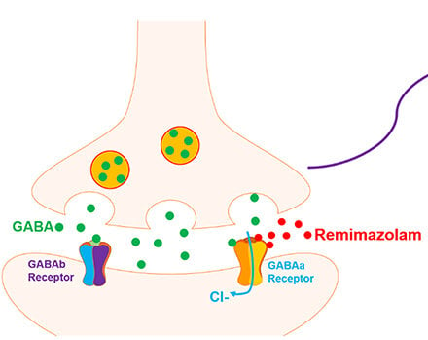
Introductie
I.v. ultrakort- en snelwerkende benzodiazepine agonist
Sedatie, anxiolyse, anticonvulsief
2019 Op de markt
2020 FDA approval (procedurele sedatie <30min)
2021 Goedkeuring EU procedurele sedatie + algehele anesthesie volwassenen
Sedatie ICU?
Interessant voor de PICU?
Zhang et al. Drug Des Devel Ther 2024
Notes:
Remimazolam activates GABAa receptors (opening chloride kanalen) and reduces the excitability of the nervous system. A schematic representation of remimazolam illustrates its mechanism of action through the activation of GABAa receptors, resulting in a decrease in the excitability of the nervous system.
Initiele FDA approval eigenlijk voor korte sedaties, echter in literatuur veel offlabel gebruik beschreven.

Slide 4
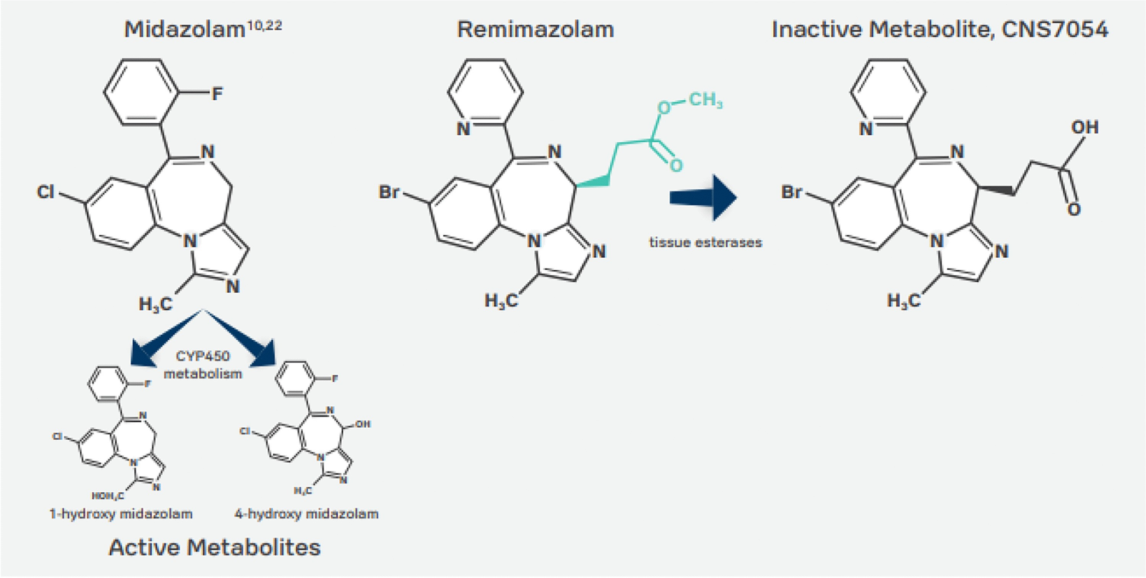
.
Ramamurthi et al. Curr Anesthesiol Rep 2023

Slide 5
Ramamurthi et al. Curr Anesthesiol Rep 2023
Notes:
Afbraak door weefsel esterases (carboxylesterase) tot inactieve metaboliet, verdere metabolisering waarna >80% excretie urine. Grotendeels onafhankelijk van orgaan(dys)functie. Ernstige leverdysfunctie?

Slide 6
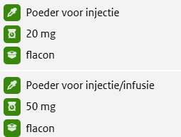
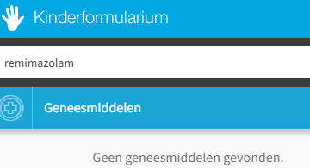
Eigenschappen
Toediening pijnloos
Vd 0.76 – 0.98 L/kg (volwassenen)
Midazolam kinderen 12.1L/kg
T1/2 7-11min, weinig accumulatie
Volledig te antagoneren met flumazenil
Compatibel met o.a. NaCl 0.9%, fentanyl, dexmed, midazolam, rocuronium, glucosehoudende samenstellingen
Slaat neer met ringerlactaat / plasmalyte
± half zo potent als midazolam
Dosering?
Notes:
Klein verdelingsvolume
Eiwitbinding primair aan albumine, relatief hoog
Eiwitbinding ca. 90%
Midazolam 95-98%

Slide 7
PICO
P: kinderen op PICU 0-17jr met indicatie continue i.v. sedatie
I: remimazolam
C: conventionele i.v. sedatie (midazolam, propofol en/of dexmed)
O: invasieve beademingsduur
ligduur PICU
incidentie delier
hemodynamische instabiliteit
incidentie onttrekking
tijd tot extubatie na stop (midazolam)
Leidt remimazolam sedatie in vergelijking met andere i.v. sedativa op de PICU tot kortere beademingsduur?

Slide 8
Zoekstrategie
P: ("Intensive Care Units, Pediatric"[Mesh] OR “PICU*”[tiab] OR “pediatric intensive care”[tiab] OR “paediatric intensive care”[tiab] OR “mechanical* ventilation*”[tiab] OR “Critical Care”[Mesh] OR “Intensive Care Units”[Mesh] OR “intensive care”[tiab] OR “critical care”[tiab])
AND
(“Child”[Mesh] OR “Infant”[Mesh] OR “Adolescent”[Mesh] OR “child*”[tiab] OR “pediatric*”[tiab] OR “paediatric*”[tiab] OR “infant*”[tiab] OR “adolescen*”[tiab] OR “neonat*”[tiab])
AND
I: “remimazolam”[tiab]
AND
(“sedation”[tiab] OR “sedative*”[tiab] OR “Hypnotics and Sedatives”[Mesh])
C: -
O: -
Notes:
("Intensive Care Units, Pediatric"[Mesh] OR "PICU*"[tiab] OR "pediatric intensive care"[tiab] OR "paediatric intensive care"[tiab] OR "mechanical* ventilation*"[tiab] OR "Critical Care"[Mesh] OR "Intensive Care Units"[Mesh] OR "intensive care"[tiab] OR "critical care"[tiab]) AND ("Child"[Mesh] OR "Infant"[Mesh] OR "Adolescent"[Mesh] OR "child*"[tiab] OR "pediatric*"[tiab] OR "paediatric*"[tiab] OR "infant*"[tiab] OR "adolescen*"[tiab] OR "neonat*"[tiab]) AND "remimazolam"[tiab] AND ("sedation"[tiab] OR "sedative*"[tiab] OR "Hypnotics and Sedatives"[Mesh])

Slide 9

12 artikelen
Exclusie: case reports, PSA / anesthesie indicatie, andere uitkomstmaten
→
3 aspecifieke reviews

Slide 10
Aangepaste PICO
P: volwassenen met indicatie continue i.v. sedatie
I: remimazolam
C: conventionele i.v. sedatie (midazolam, propofol en/of dexmed)
O: invasieve beademingsduur
ligduur ICU
hemodynamische instabiliteit
incidentie onttrekking
tijd tot extubatie na stop (midazolam)
Leidt remimazolam sedatie in vergelijking met andere i.v. sedativa op de ICU bij volwassenen tot een kortere beademingsduur?
Notes:
Incidentie delier verwijderd

Slide 11
Aangepaste zoekstrategie
P: ("Intensive Care Units"[Mesh] OR “ICU”[tiab] OR “intensive care”[tiab] OR “mechanical* ventilation*”[tiab] OR “Critical Care”[Mesh] OR “critical care”[tiab])
AND
I: “remimazolam”[tiab]
AND
(“sedation”[tiab] OR “sedative*”[tiab] OR “Hypnotics and Sedatives”[Mesh])
C: -
O: -
Notes:
("Intensive Care Units"[Mesh] OR “ICU”[tiab] OR “intensive care”[tiab] OR “mechanical* ventilation*”[tiab] OR “Critical Care”[Mesh] OR “critical care”[tiab]) AND “remimazolam”[tiab] AND (“sedation”[tiab] OR “sedative*”[tiab] OR “Hypnotics and Sedatives”[Mesh])

Slide 12
89 artikelen
RCT’s, prospectief en retrospectief observationeel, syst reviews, meta analyses
→
9 artikelen

Slide 13
Literatuurbespreking
Study (years) | Design | Sample size (RMZ/control) | Outcomes | Main results (RMZ vs control)
Li et al (2025) | Single-center RCT | 40/40 (RMZ/P) | Ventilation duration LOS | 107.5 vs 104.5h (ns) 7 vs 7d (ns)
Tang et al (2023) | Single-center RCT | 30/30 (RMZ/P) | LOS Hypotension | 23.5 vs 28.0d (ns) 53.3 vs 60.0% (ns)
Yuan et al (2026) | Single-center RCT | 55/55 (RMZ/P) | 7d extubation LOS AE hemodyn | 78.3 vs 76.5% (ns) 8.2 vs 7.3d (ns) 7.3 vs 10.6% (ns)
Xie et al (2026) | Single-center retrospective propensity score-matched | 183/183 (RMZ/P) | Hypotension Ventilation duration LOS | 13.7 vs 22.4% (p=0.041) 5 vs 5d (ns) 19 vs 18d (ns)
Tang et al (2022) | Single-center RCT | 30/30 (RMZ/P) | LOS | ns
Zhao et al (2026) | Single-center RCT | 40/40 (RMZ/P) | Ventilation duration Hypotension LOS | 23.0 vs 20.5h (ns) 15 vs 42.5% (p=0.007) 5.0 vs 4.5d (ns)
Notes:
LOS = ICU LOS
Ns = non-significant

Slide 14
Literatuurbespreking
Study (years) | Design | Sample size (RMZ/control) | Outcomes | Main results (RMZ vs control)
Cheng et al (2026) | Multicenter single- blinded RCT | 151/148 (RMZ/DEX) | Hypotension Ventilation duration LOS | 5.3 vs 7.4% (ns) 66.8 vs 53.7h (ns) 6.0 vs 5.0d (ns)
Liu et al (2025) | Multicenter RCT | 140/132 (RMZ/MIDA) | Time to extubation LOS | 51 vs 80min (p<0.000) 3 vs 3d (ns)
Yao et al (2023) | Single-center prospective observational | 60/46 (RMZ/P&MIDA) | LOS Hypotension Ventilation duration | 6.0 vs 7.0d (ns) 18.3 vs 17.4% (ns) 75 vs 114h (p=0.038)

Slide 15
Conclusie
Ontbrekende evidence voor PICU populatie
Lig- en beademingsduur vergelijkbaar met propofol
Mogelijk minder hemodynamische instabiliteit
Kortere tijd tot extubatie en beademingsduur in vergelijking met midazolam

Slide 16
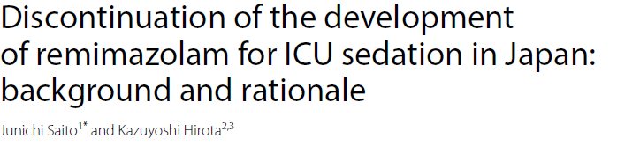
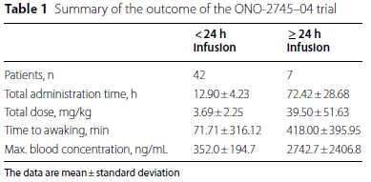

Discussie
Mogelijke indicaties
Op termijn vervanging van propofol én midazolam?
Onttrekking?
Kosten?
Veiligheid?
Notes:
Artikel 2026 over Japanse studie 2013, waarna ontwikkeling voor de IC indicatie stop is gezet. The central safety concern was the unexpected pharmacokinetic failure observed in a subset of patients receiving continuous infusion for 24 h or longer. Specifically, this subgroup exhibited plasma concentrations
of the parent drug far exceeding predicted levels, resulting in significantly delayed awakening and recover. This observation
directly challenged the fundamental non-accumulating advantage of the drug. The mechanism is hypothesized
to be compromised carboxylesterase-1 activity due to severe critical illness, systemic inflammation, or organ
dysfunction—conditions that impair the very non-organ-dependent clearance pathway the drug relies upon.

Slide 17
Bronnen
Ramamurthi, R.J., Hammer, G. Remimazolam in Pediatric Anesthesia and Sedation. Curr Anesthesiol Rep 13, 165–171 (2023).
Zhang, H., Li, H., Zhao, S., & Bao, F. (2024). Remimazolam in General Anesthesia: A Comprehensive Review of Its Applications and Clinical Efficacy. Drug design, development and therapy, 18, 3487–3498.
Saito, J., & Hirota, K. (2026). Discontinuation of the development of remimazolam for ICU sedation in Japan: background and rationale. Journal of intensive care, 14(1), 15.
Yuan, Z. N., Cao, F., Wang, H. J., Qu, S. N., Huang, C. L., Wang, H., Zhang, H., & Xing, X. Z. (2026). Comparative long-term sedation efficacy of remimazolam vs propofol in malignant patients with mechanical ventilation: an exploratory non-inferiority randomized study. Scientific reports, 16(1), 13900.
Tang, Y., Gao, X., Xu, J., Ren, L., Qi, H., Li, R., Shu, H., Zou, X., Yuan, S., Yang, X., & Shang, Y. (2023). Remimazolam besylate versus propofol for deep sedation in critically ill patients: a randomized pilot study. Critical care (London, England), 27(1), 474.
Xie W., Fang X., Shi Z. et al. Effect and hemodynamics of remimazolam besylate on sedation of mechanically ventilated patients: a propensity score-matched study. BMC Anesthesiol (2026). In press.
Cheng, W., Chen, Y., He, F., Zhao, J., Mao, Z., Qin, B., Hu, C., Feng, S., Zhang, F., Dong, X., Li, X., Zhang, B., Yue, T., Zhang, M., Lu, Y., Chen, J., Jin, X., Chang, Y., Chen, P., Wang, L., … Shao, H. (2026). Remimazolam Besylate Versus Dexmedetomidine As a Sedative in ICU Patients Undergoing Mechanical Ventilation: A Multicenter, Single-blinded, Randomized, Noninferiority Trial. Critical care medicine, 54(3), 496–506.
Liu, R., Su, B., Gan, G., Wang, G., Wang, C., Xu, N., Feng, G., Guo, H., Yuan, Q., Li, A., Zheng, W., Li, J., Chen, Y., & Zhang, X. (2025). Effect of remimazolam besylate versus midazolam on time to extubation in critically ill, mechanically ventilated patients: a randomized controlled trial. Frontiers in medicine, 12, 1553495.
Li, Y., Yuan, Y., Zhou, J., & Ma, L. (2025). Effect of remimazolam besylate on elderly patients with mechanical ventilation: a single-center randomized controlled study. BMC anesthesiology, 25(1), 65.

Slide 18
Bronnen
Zhao, C., Fan, X., Li, L., Nan, Z., Lin, X., Han, Y., Wu, Y., Yin, Y., Xin, Y., & Hu, Z. (2026). Remimazolam versus propofol for postoperative ICU sedation in mechanically ventilated cancer patients: a noninferiority randomized clinical trial. Frontiers in pharmacology, 17, 1784928.
Tang, Y., Yang, X., Yu, Y., Shu, H., Yuan, Y., Liu, H., Zou, X., Yuan, S., & Shang, Y. (2022). Remimazolam besylate versus propofol for long-term sedation during invasive mechanical ventilation: a pilot study. Critical care (London, England), 26(1), 279.
Yao, Z., Liao, Z., Li, G., Wang, L., Zhan, L., & Xia, W. (2023). Remimazolam tosylate's long-term sedative properties in ICU patients on mechanical ventilation: effectiveness and safety. European journal of medical research, 28(1), 452.

